Slide 1
SPIRITUAL WARFARE
Angels, Demons, Quantum Physics, and Your Brain
Timothy R. Jennings, M.D. DLFAPA
Medical Director at Honey Lake Clinic
Past-President Tennessee Psychiatric Association
Past-President Southern Psychiatric Association
Author:
Could It Be This Simple? A Biblical Model for Healing the Mind
The God-Shaped Brain: How Your View of God Transforms Your Life
The Remedy New Testament
The God-Shaped Heart
The Aging Brain
The Remedy of the Lord in Song: The Psalms

Slide 2
Why This Program?
Over my career, the question of demon involvement in mental illness has come up repeatedly.
There is confusion on this question across the landscape of Christianity.
Many ideas taught in Christianity are mythical, mystical, and harmful.

Slide 3
Goals
Demythify and demystify
God is the God of reality—to present an evidence-based, reality-based, and rational approach to this topic that empowers, heals, and reduces fear.

Slide 4
Overview
Part I: Nature of humanity; the human brain, quantum mechanics, and our spirit
Part II: Spiritual warfare, angels, and demons
Part III: Myths within Christianity

Slide 5
Part 1
Nature of Humanity
the human brain, quantum mechanics, and our spirit

Slide 6
Humans Have Three Parts
“And the LORD God formed man of the dust of the ground [body], and breathed into his nostrils the breath of life [spirit]; and man became a living soul [mind/individuality]” (Genesis 2:7 KJV).
The “breath of life” is not oxygen and nitrogen but the animating energy, the spark of life, that gives life and comes from God, the only source of life.

Slide 7
To Be Operational, Must Have All Three
Body | Soma | Hardware
Soul | Psyche | Software, Mind, Individuality
Spirit | Pneuma | Energy, Breath of Life

Slide 8
Difference Between Buddha and Jesus
Buddha
Life energy/individuality are merged and are disembodied at death; they transcend time and space and reemerge in new forms through time on their own—reincarnation.
Jesus
Life energy (spirit/pneuma) originates in God and is distinct from individuality (soul/psyche);
at death, the life energy (spirit/pneuma) returns to God (Eccl. 12:7); individuality (soul/psyche) is safe with Christ in heaven and resurrected by God (hardware, software, and energy) at the Second Coming
(1 Thess. 4:13–18).

Slide 9
Humans Were Created to Be Image Bearers of God
“Then God said, ‘Let us make man in our image.’ … So God created man in his own image, in the image of God he created him; male and female he created them” (Genesis 1:26, 27 NIV84).
To be an image bearer of God, one must be animated by the Spirit
of God.

Slide 10
Breath of Life
The breath of life is the animating energy that comes from God.
God is love—and the animating energy or “spirit” breathed into and giving life to Adam and Eve was resonate with love.
”He who pursues … love finds life” (Proverbs 21:21 NIV84).
At creation, Adam and Eve were animated with the spirit of love and bore the image of God.
This spirit of love became corrupted when they sinned and the image of God was marred.

Slide 11
Falling Dominoes of Destruction
Lies believed—break the circle of love and trust
Broken love and trust—fear and selfishness (survival of the fittest)
Fear and selfishness—destructive acts (sins)
Destructive acts (sins)—damage mind, body, character, relationships, a terminal condition

Slide 12
Spirit Infected With Fear and Selfishness
“I heard you in the garden, and I was afraid because I was naked;
so I hid” (Genesis 3:10).
God had not changed; Adam’s spirit was now infected with fear that caused him to act to save self by fleeing from God, which is exactly the opposite of life.

Slide 13
God Intervened
”And I will put enmity between you and the woman, and between your offspring and hers; he will crush your head, and you will strike his heel” (Genesis 3:15 NIV84).
The Holy Spirit strives for every soul, causing our spirits to be convicted, dissatisfied with fear and selfishness, to long for our Eden home, love, peace, joy, and happiness.
The Spirit brings truth to our minds that we can understand, with conviction to our spirits, and leaves us free to make choices—to accept or reject the truth.

Slide 14
Corrupted Spirit
Adam and Eve corrupted their spirit/life with fear and selfishness.
The only spirit of life they had to pass along is the one they possessed—that of fear and selfishness.
We are all born in sin, conceived in iniquity (Psalm 51:5); we are born with the only life, the only animating energy, Adam and Eve had with which to procreate, and that is the spirit of fear and selfishness.

Slide 15
The Spirit of Fear Is Not From God
“For God has not given us a spirit of fear, but of power and of love and of a sound mind” (2 Timothy 1:7 NKJV).
“Create in me a pure heart, God, and make my spirit right again” (Psalm 51:10 NCV).

Slide 16
Must Be Reborn With a New Spirit
“I tell you the truth, no one can see the kingdom of God unless he is born again. … I tell you the truth, no one can enter the kingdom of God unless he is born of water and the Spirit [pneuma]. Flesh gives birth to flesh, but the Spirit [pneuma] gives birth to spirit [pneuma]. You should not be surprised at my saying, ‘You must be born again.’ The wind [pneuma] blows (pneo) wherever it pleases. You hear its sound, but you cannot tell where it comes from or where it is going. So it is with everyone born of the Spirit [pneuma]” (John 3:3, 5–8).

Slide 17
The Pneuma
Translated as spirit, ghost, breath, wind.
Wind is the energy that moves a ship.
The wind blows in a direction, and a ship can align with the wind and be moved by it—or resist and tack against it.
Our choices align our beings, our spirits, our energies, either in harmony with the Holy Spirit where we are more easily empowered, enlightened, and willfully move in harmony with God—or we resist, align with demonic spirits, and come into harmony with their motives, energies, and are more easily moved in directions that are against the Spirit of God.

Slide 18
Being Reborn Means Receiving a New Animating Energy (Spirit)
Being reborn is when we receive a new heart, a right spirit—when we surrender the spirit of fear and selfishness and are indwelled by the Spirit of love and trust.
We become a partaker of the divine nature (2 Peter 1:4) and, like Jesus, live a life in which we experience temptation from the spirit of fear and selfishness but choose to live in harmony with the Spirit of love and trust.
“It is no longer I that live, but Christ lives in me” (Gal. 2:20).

Slide 19
Two Warring Spiritual Energies
“For Christ’s love compels us [Spirit of love], because we are convinced that one died for all, and therefore all died. And he died for all, that those who live should no longer live for themselves [the spirit of fear and selfishness] but for him who died for them and was raised again”
(2 Corinthians 5:14, 15 NIV84).

Slide 20
Clarification
The Holy Spirit vs. A Holy Spirit
The Holy Spirit is the Third Person of the Godhead—with unique individuality and fully divine.
A holy spirit is the spirit that holy created beings have—Gabriel, Enoch, Elijah, etc.
We receive a holy spirit from the Holy Spirit.

Slide 21
We Must Choose Which Spirit We Identify With
Jesus said to His apostles when they wanted to call fire down on those who would not receive Jesus:
“You do not know what manner of spirit [pneuma] you are of. For the Son of Man did not come to destroy men’s lives but to save them” (Luke 9:55, 56 NKJV).

Slide 22
To Be an Image Bearer of God
Requires God’s Spirit to Dwell Within
“Do you not know that you are the temple of God and that
the Spirit of God dwells in you?” (1 Corinthians 3:16 NKJV).
“Those who are led by the Spirit of God are sons of God. For you did not receive a spirit that makes you a slave again to fear, but you received the Spirit of sonship. And by him we cry, ‘Abba, Father.’ The Spirit himself testifies with our spirit that we are God’s children” (Romans 8:14–16 NIV84).

Slide 23
Goal of Satan and His Demons
To destroy the image of God in people and place Satan’s image where God’s should be.
This is accomplished by replacing the animating Spirit of love (God is love) with the animating spirit of fear and selfishness—which happened in Eden; and then...
When people choose to develop a character animated by the spirit of fear and selfishness, they bear the image of Satan. Jesus said that when that happens, then Satan is their father (John 8:44).

Slide 24
First Point
The spirit is the animating energy that gives life and moves to action, and it comes from God.
The spirit can be either a pure spirit of love and trust or corrupted with fear and selfishness.
Because of Jesus and God’s grace, we have a choice as to which spirit we choose to align with and be animated by.
There are only two spiritual forces: heavenly—love, truth, freedom, trust (Holy Spirit and holy angels), and satanic—fear and selfishness (Satan and his forces).

Slide 25
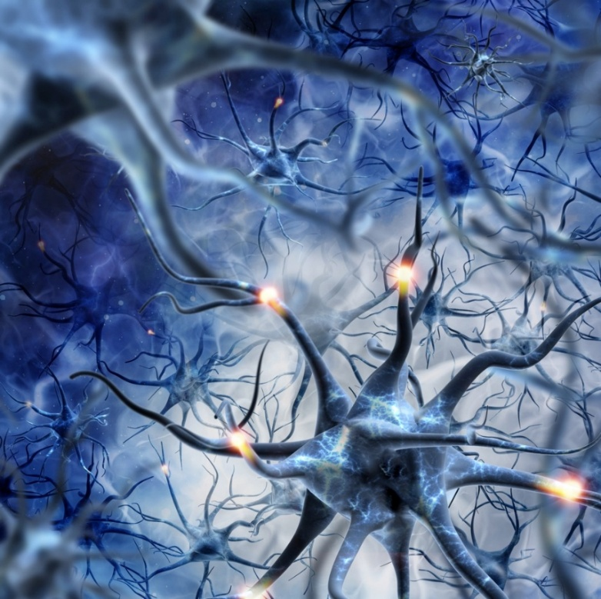
The Human Brain
100 billion nerve cells
Over a trillion supporting cells
Each brain cell has up to 10,000 connections to other cells
40,000,000,000,000,000
Forty Quadrillion
Interconnections
Notes:
1000 seconds was 16 minutes ago
1 million seconds was 11.5 days ago
1 billion seconds was 32 years ago
1 trillion seconds ago was 31,688 years ago
1 Quadrillion seconds is 24 million BC
So, 40 quadrillion seconds ago would be 1 billion BC

Slide 26
40 Quadrillion
1 million seconds
  1,000,000
1 billion seconds
  1,000,000,000
1 trillion seconds
  1,000,000,000,000
1 quadrillion seconds
  1,000,000,000,000,000
40 quadrillion seconds
11.5 days
35 years
31,000 BC
24 million BC
~1 billion BC

Slide 27
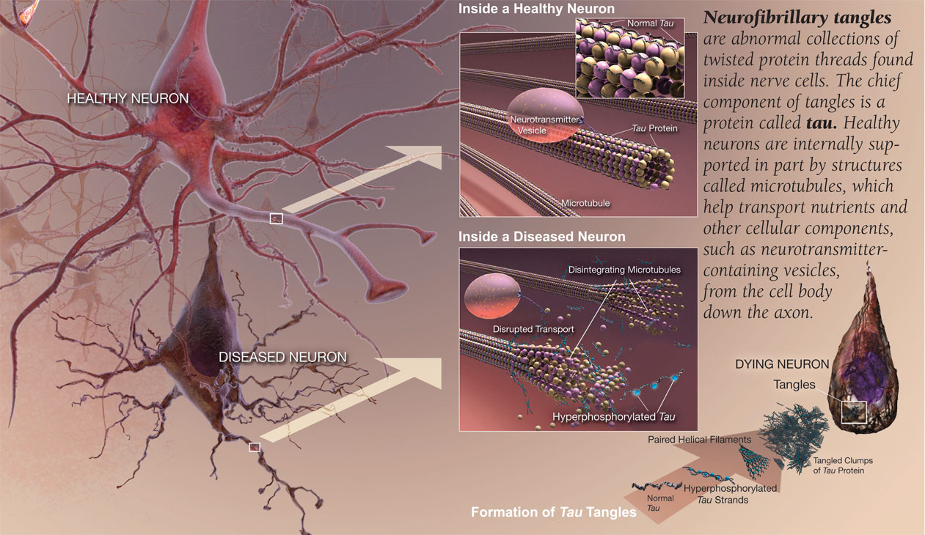
40 Quadrillion Connections
Notes:
1000 seconds was 16 minutes ago
1 million seconds was 11.5 days ago
1 billion seconds was 32 years ago
1 trillion seconds ago was 31,688 years ago
1 Quadrillion seconds is 24 million BC
So, 40 quadrillion seconds ago would be 1 billion BC

Slide 28
Microtubules: Tubulin
10 million microtubules
per neuron
Billions of tubulin molecules per neuron

Slide 29
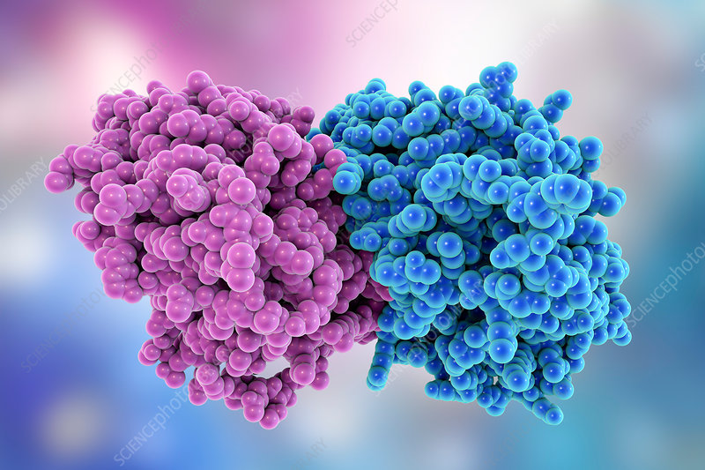
Each Tubulin Composed of 445 AAs
Each AA Composed of ~10 Atoms

Slide 30
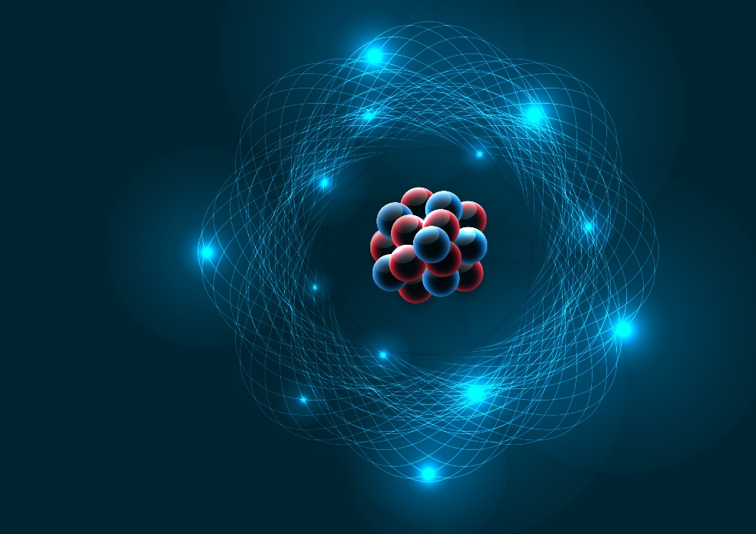
Microtubules: Tubulin
100 billion neurons
10 million microtubules per neuron
Billions of tubulin molecules
per neuron
Each tubulin molecule composed
of 445 amino acids
Each amino acid with ~10 atoms forming electron clouds

Slide 31
Quantum Processing
Tubulin has different conformations
(like “0” and “1”).
As we form memories and choose beliefs, our experiences and choices change the electron cloud of the tubulin encoding information.¹
Biosystems, Vol. 173, November 2018, Pages 191–206 https://www.sciencedirect.com/science/article/abs/pii/S0303264718301710

Slide 32
Quantum Processing
The unique patterns created by our experiences, beliefs, choices, and preferences create unique quantum signatures and harmonics.¹
Quantum energy linkages connect
all life.
Journal of Modern Physics, Vol.13, No.12, December 2022 https: //www.scirp.org/journal/paperinformation?paperid=121997

Slide 33
Law of Worship
By beholding we are changed (2 Corinthians 3:18).
Romans 1
“They followed worthless idols and became worthless themselves” (Jeremiah 2:5).
“You will know the truth and the truth will set you free” (John 8:32).
What we watch, admire, worship, believe and the choices we make change our brains—change the harmonics, the quantum vibration, the resonance of what frequency we are in tune with, either harmonizing with the Holy Spirit of love and trust or Satan’s spirit of fear and selfishness.

Slide 34
Quantum Radiance
Moses’ face was radiant (Exodus 34:29–34).
“All who were sitting in the Sanhedrin looked intently at Stephen, and they saw that his face was like the face of an angel” (Acts 6:15 NIV84).
“There he was transfigured before them. His face shone like the sun, and his clothes became as white as the light. Just then there appeared before them Moses and Elijah, talking with Jesus” (Matthew 17:2, 3 NIV84).
“Christ loved the church and gave himself up for her to make her holy, cleansing her by the washing with water through the word, and to present her to himself as a radiant church, without stain or wrinkle or any other blemish, but holy and blameless” (Ephesians 5:25–27 NIV84).

Slide 35
Quantum Radiance
“The Ancient of Days took his seat. … His throne was flaming with fire, and its wheels were all ablaze. A river of fire was flowing, coming out from before him. Thousands upon thousands attended him; ten thousand times ten thousand stood before him” (Daniel 7:9, 10 NIV84).
“The [New Jerusalem] does not need the sun or the moon to shine on it, for the glory of God gives it light, and the Lamb is its lamp. The nations will walk by its light, and the kings of the earth will bring their splendor into it” (Revelation 21:23, 24 NIV84).

Slide 36
Historical Thinking
Much of our current understanding is based on Newtonian ideas of the universe rather than more modern theories.
We think of receptors, electrical signals, and neurotransmitters, all very Newtonian—but it is only one part of our physical reality.
But such understandings fail to explain:
      Consciousness
      Freedom of choice
      Flocks of birds and schools of fish turning in unison
      Human intuition
      The sudden awareness of a loved one in danger
      Miraculous healings
      Supernatural warnings, guidance, direction

Slide 37
Modern Quantum Physics Began in 1925
Led us away from the certainty of a Newtonian world to probabilities.
Matter: Both particle—being at a specific point in space-time, but also wave—extending throughout the entire region of space-time.
Quantum understanding has led to ideas such as:
  Entanglement—connectedness of all things
  Observer effect
  Vibration and string theory

Slide 38
Observer Effect
Matter is both wave and mass, as well as having spin and vibration.
It remains in a state of uncertainty until impacted by the observer; the act of measuring, observing, or encountering the object determines the outcome—whether it presents as wave or matter.
This provides a scientific basis for freedom of choice and the impact our choices have on us and the world around us.

Slide 39
Our Choices
Our choices alter our neuronal substrate, causing change in the electron cloud formation and aligning us with one of two spirits.
“Circumcision of the heart” is the circumcision of our spirits, of our quantum entanglements, away from the spirit of fear, selfishness, pride, lust, etc., and to the Spirit of love and truth.
This happens through the agency of the Holy Spirit applying truth and love to our minds—but it is only as we choose to say yes to the truth and choose to trust God that our spirits are disentangled from fear and selfishness and aligned with God.

Slide 40
String Theory
Everything in the universe is connected by infinitesimally small strings.
If you magnified a silver dollar to the size of our solar system, a string would be the size of a tree.
The energy (vibration) in the string determines the mass of the matter, E=mc².
Thus, particles separated by physical space are connected by these strings—entangled—and can impact each other.

Slide 41
1897 Commentary by Co-Founder of the SDA Church
It is God's plan that every part of His government shall depend on every other part, the whole as a wheel within a wheel, working with entire harmony. He moves upon human forces, causing His Spirit to touch invisible chords, and the vibration rings to the extremity of the universe. (E.G. White, Manuscript Release, p. 22)

Slide 42
Bible Support for Quantum Strings
“For by him all things were created: things in heaven and on earth, visible and invisible, whether thrones or powers or rulers or authorities; all things were created by him and for him. He is before all things, and in him all things hold together” (Colossians 1:16, 17 NIV84).
“Where can I go from your Spirit? Where can I flee from your presence? If I go up to the heavens, you are there; if I make my bed in the depths, you are there” (Psalm 139:7, 8 NIV84).

Slide 43
Elijah and the Still Small Voice
1 Kings 19:11, 12
God was not in the great wind—Newtonian physics
God was not in the earthquake—Newtonian physics
God was not in the fire—Newtonian physics
God was in the still small voice—quantum connections of the chords that resonate throughout creation

Slide 44
Jesus Said…
“The Spirit gives life; the flesh counts for nothing” (John 6:63 NIV84).
The Spirit is the Spirit of love, which is the animating energy of God, which is the basis of all life, and from which all reality is built.

Slide 45
NOT Pantheism
These invisible chords or strings, while originating from God and sustained by God, are NOT God!
Physical matter originates from God and is sustained by God—but physical matter is NOT God!
God is an intelligent being with individuality, personality, and personhood—these strings are not part of God’s personhood and, thus, God is not “in everything,” as pantheism teaches, even though all things are sustained by Him through these chords/strings (Colossians 1:17).

Slide 46
God Created All Intelligent Beings as Spirit Beings
“Yet a time is coming and has now come when the true worshipers will worship the Father in spirit [pneuma] and truth, for they are the kind of worshipers the Father seeks. God is spirit [pneuma], and his worshipers must worship in spirit [pneuma] and in truth” (John 4:23, 24 NIV84).
Spirit = animating/motivational energy (love)
Truth = understanding/mind
These worshipers include the heavenly beings who worship God.
“Are not all angels ministering spirits [pneuma] sent to serve those who will inherit salvation?” (Hebrews 1:14; Psalm 104:4).

Slide 47
Questions—As Spirit Beings
Is our spiritual energy able to alter physical matter and impact outcomes?
Can such spiritual energy be involved in prayer and healing?
Can such spiritual energy be involved in influencing the wellbeing of others?
Could our spiritual energy be directed toward our friends and family and impact their lives beyond specific truths we share?

Slide 48
Meditation Entanglement
Two individuals were asked to meditate together inside a Faraday cage.
They were then separated into different Faraday cages in separate rooms.
Light shone at irregular intervals into the eyes of one participant caused the same brain regions to activate in the other participant, as measured by EEG—no EEG changes were noted in the control group.
This was not due to EM fields or other known causes (e.g., mirror neurons).
Insight: two people united in “heart” having sudden “awareness.”
Dean Radin, “Testing Nonlocal Observations as a Source of Intuitive Knowledge,” Explore 4, no. 1 (2008): 25

Slide 49
Angelic and Demonic Influence
In the same way these two humans had their brains aligned through meditating together—thus entangling their spirits (quantum energy)—we can choose what we worship, watch, believe, prefer, and value and, thus, align ourselves with either good or evil and become more in tune with, more receptive to, either the Holy Spirit and holy angels or demonic spirits.

Slide 50
Cyrus, Daniel, Gabriel & the Prince of Persia
“Daniel, do not be afraid. Some time ago you decided to get understanding and to humble yourself before your God. Since that time God has listened to you, and I have come because of your prayers. But the prince of Persia has been fighting against me for twenty-one days” (Daniel 10:12, 13 NCV).
Who is this “prince of Persia”?
“The angel prince of the kingdom of Persia opposed me for twenty-one days” (Daniel 10:13 GNT).
Jesus called Satan the prince of the world (John 12:31; 14:30).

Slide 51
Gabriel and the Prince of Persia
Angels are spirit beings.
Cyrus is a spirit being.
Both Gabriel and the fallen angel of Persia were using their spiritual (quantum) energy to influence the spirit (quantum animating energy) of Cyrus.
Prince of Persia was seeking to inflame a spirit of fear and selfishness, but Gabriel sought to inspire with love and trust.
Cyrus ultimately chose which spirit he identified with and acted upon.
Without God’s holy agents (Spirit/angels), no human being could resist the evil influence of fallen angels.

Slide 52
We Are Physical (Newtonian) and
Spiritual (Quantum) Beings
We can impact the world around us through our physical actions and…
We can impact the world through our spirits, our quantum connections to the world and others.

Slide 53
Focused Intention Alters DNA Conformation
Placental DNA was placed in test tubes.
Participants were instructed to generate the emotion of love and goodwill and then focus their intention on causing the DNA to wind tighter or looser.
This can be measured by the absorption of UV light.
What did they find?

Slide 54
Focused Intention Alters DNA Conformation
Focused intention with love and goodwill caused a 25% conformation change in DNA.
When the tubes of DNA were in the room with the participants and they generated emotions of love and goodwill but with no focused intention—no DNA change.
When focused intention but no emotion of love and goodwill—no DNA change.
McCraty, 2003 Modulation of DNA conformation by heart-focused intention p. 6, Boulder Creek, CA: Institute of HeartMath

Slide 55
Focused Intention Alters DNA Conformation
Then to test whether an EM effect or not, had three test tubes together and had the participants focus their intent on changing DNA in two of the test tubes but not the third, and that is exactly what happened.
McCraty, 2003 Modulation of DNA conformation by heart-focused intention p. 6, Boulder Creek, CA: Institute of HeartMath
Notes:
How did they determine when love and goodwill was being generated? By measuring heart rate variability

Slide 56
Focused Intention Alters DNA Conformation
Finally, during five separate experiments in which the DNA samples were a half mile away from the participants, the same DNA conformation changes occurred when the participants focused with love and goodwill.
McCraty, 2003 Modulation of DNA conformation by heart-focused intention p. 6, Boulder Creek, CA: Institute of HeartMath

Slide 57
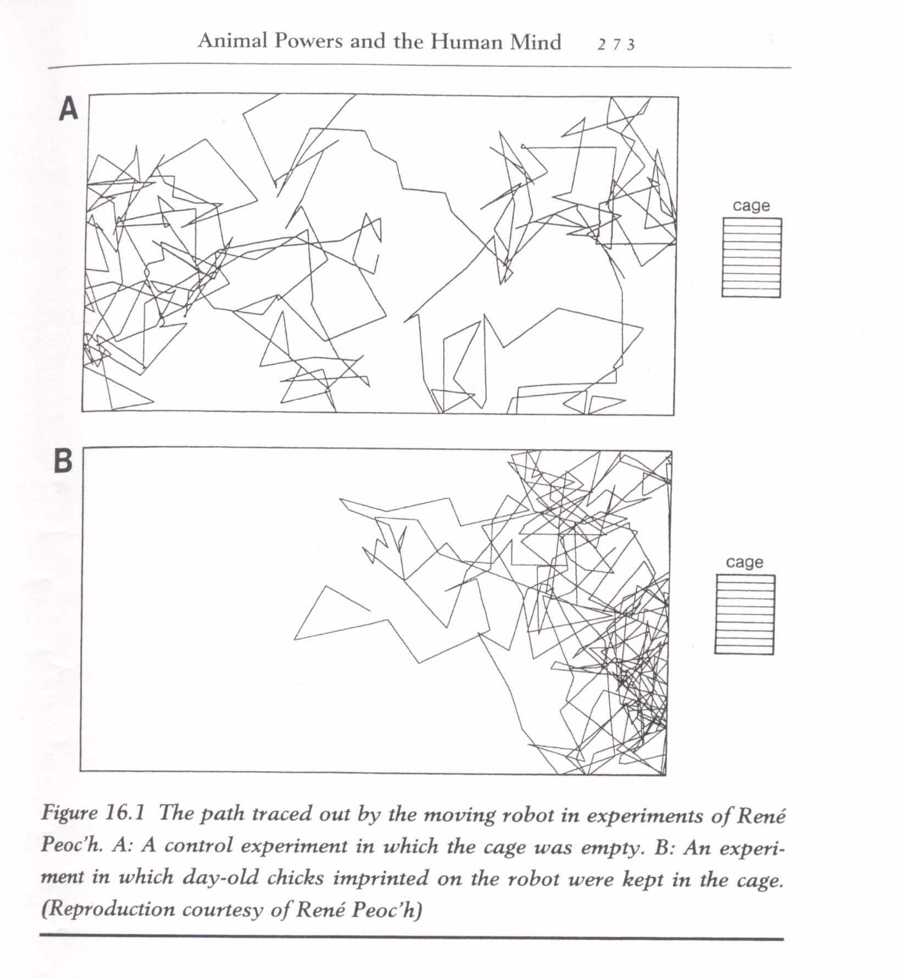
Peoc'h, Rene. "Psychokinesis experiments with human and animal subjects upon a robot moving at random." The Journal of Parapsychology 66.3 (2002): 229
Notes:
Starting in 1980, the author has been conducting PK experiments using a system called the tychoscope, which was originally invented by the French engineer Pierre Janin (1977). The tychoscope is a small, self-propelled "vehicle," or robot, which integrates a random event generator (REG). The tychoscope movements are thus determined by the REG output, which makes it move in successive segments of random length and orients it according to random angles. A plotter attached to the robot traces a record of the movements. Using this first tychoscope, the author was able to show that both animals (chicks in this case) and humans are capable of influencing the normally random movement of the device. While in the absence of a human or animal observer, the trajectories traced by the tychoscope did not differ from those that would have occurred by chance; when a human participant wished to attract the robot in his direction, the difference compared with controls was significant. The results with chick experiments were highly significant. In this case, the imprinting instinct, established by Konrad Lorentz, was used to condition baby chicks to adopt the tychoscope as their mother. The results showed that the device would approach a cage full of conditioned chicks 2 1/2 times more often than an empty cage. By contrast, the movements remained purely random when the chicks were not conditioned to take the robot as their mother. Following these successful experiments, the author decided to extend the research with a 2nd-generation tychoscope, which separated the robot from the REG. In this later work, the REG was integrated into a computer, and the tychoscope's movements were determined by remote-controlled signals from the computer. Using this system, the author tested the possible psychokinetic influence of 80 groups of 15 chicks on a randomly moving robot carrying a lit candle in an otherwise darkened room. In 71% of the cases, the robot spent excessive time in the vicinity of the chicks. In the absence of the chicks, the robot followed random trajectories. The overall results were statistically significant at p The author then tested human psychokinetic action on the robot.

Slide 58
Peoc'h, Rene. "Psychokinesis experiments with human and animal subjects upon a robot moving at random." The Journal of Parapsychology 66.3 (2002): 229
Notes:
Starting in 1980, the author has been conducting PK experiments using a system called the tychoscope, which was originally invented by the French engineer Pierre Janin (1977). The tychoscope is a small, self-propelled "vehicle," or robot, which integrates a random event generator (REG). The tychoscope movements are thus determined by the REG output, which makes it move in successive segments of random length and orients it according to random angles. A plotter attached to the robot traces a record of the movements. Using this first tychoscope, the author was able to show that both animals (chicks in this case) and humans are capable of influencing the normally random movement of the device. While in the absence of a human or animal observer, the trajectories traced by the tychoscope did not differ from those that would have occurred by chance; when a human participant wished to attract the robot in his direction, the difference compared with controls was significant. The results with chick experiments were highly significant. In this case, the imprinting instinct, established by Konrad Lorentz, was used to condition baby chicks to adopt the tychoscope as their mother. The results showed that the device would approach a cage full of conditioned chicks 2 1/2 times more often than an empty cage. By contrast, the movements remained purely random when the chicks were not conditioned to take the robot as their mother. Following these successful experiments, the author decided to extend the research with a 2nd-generation tychoscope, which separated the robot from the REG. In this later work, the REG was integrated into a computer, and the tychoscope's movements were determined by remote-controlled signals from the computer. Using this system, the author tested the possible psychokinetic influence of 80 groups of 15 chicks on a randomly moving robot carrying a lit candle in an otherwise darkened room. In 71% of the cases, the robot spent excessive time in the vicinity of the chicks. In the absence of the chicks, the robot followed random trajectories. The overall results were statistically significant at p The author then tested human psychokinetic action on the robot.

Slide 59
Laying on of Hands
Mice were given standardized wounds.
A faith-healer held the cages of one group 15 minutes twice per day.
That group demonstrated significantly more rapid wound healing than the group of mice not held by the faith-healer.
Grad, B., Cadoret, R. J., & Paul, G. I. (1961). The influence of an unorthodox method of treatment on wound healing in mice. International Journal of Parapsychology, 3, 5–24.

Slide 60
Laying on of Hands
Mice were given an iodine-free diet, which induced goiter growth.
Mice whose cages were held twice daily for 15 minutes by a faith-healer had significantly slower thyroid growth than the control group (over 15 months)
This same outcome occurred when the faith-healer had no direct contact with the mice but, instead, held cotton strips that were placed with the mice.
Grad. B. (1965). Some biological effects of laying on of hands: A review of experiments with animals and plants. Journal of the American Society for Psychical Research, 59, 95–127
Grad, B. (1976). The biological effects of “laying on of hands” on animals and plants: Implications for biology. In Schmeidler, Gertrude (Ed.), Parapsychology: Its relation to physics, biology, psychology and psychiatry (pp. 76–89). Metuchen, NJ: Scarecrow Press.

Slide 61
Laying on of Hands
Mice were injected with mammillary adenocarcinoma.
A typical course is a massive tumor and 100% fatal in 14 to 27 days.
Two groups of mice were injected with the same cancer.
Experimental group had “healer” (faith not required, just a specific mental preparation and focus) place hands around the cage 1 hour per day (no direct contact ever).
Hypothesis—delayed time to death
Journal of Scientific Exploration, Vol. 14, No. 3, pp. 353–364, 2000

Slide 62
Findings
The mice in the experimental group lived their full life span of 2 years.
After two of the control group mice died within 27 days, the “healer” began the same procedure with the remaining control group mice, which were late stage—outcome?
The tumors ruptured, ulcerated, and the cancer remitted—and the mice lived.
Journal of Scientific Exploration, Vol. 14, No. 3, pp. 353–364, 2000

Slide 63
Findings
When new adenocarcinoma was injected at a later time, no tumor growth occurred. They had developed an immune response to the cancer cells.
The entire study was replicated four times with a variety of “healers,” some of whom were skeptics but trained in how to do the healing.
Overall compiled findings of the four experiments
    experimental group 87.9% remission
    offsite control group 0% remission
Journal of Scientific Exploration, Vol. 14, No. 3, pp. 353–364, 2000

Slide 64
Prayer and Healing
Elizabeth Targ, MD, PhD, conducted a study to measure the impact of remote (long distance, never having met the patient) prayer on terminally ill AIDS patients.
Patients were matched regarding CD4 count and severity of illness, and they were randomized into a 10-week remote healing prayer group or control group.
Faith-healers (from multiple traditions) were presented with a patient’s photo, name, and T-helper cell count.
All patients were blinded to who was being prayed for and who was not.
Western Journal of Medicine, 1998, 169(6), 356

Slide 65
Prayer and Healing
Six months later, blinded medical review found those who received remote prayer showed:
  Improved mood (p=0.02)
  Significantly less doctor visits (p=0.01)
  Fewer hospitalizations (p=0.04)
  Fewer days in the hospital (p=0.04)
  Fewer AIDS-defining illnesses (p=0.04)
  Lower illness severity (p=0.03)
Western Journal of Medicine, 1998, 169(6), 356

Slide 66
Spiritual Beings Can Impact Others
These studies document that humans can direct their spiritual energy, quantum energy, to impact the world around them.
Our spiritual energy and its use are determined by the choices we make, which spirit we identify with and are animated by.

Slide 67
Part 2
Spiritual Warfare
angels and demons

Slide 68
Ancient Wisdom
“As a man thinks in his heart, so is he.”
Solomon
Proverbs 23:7

Slide 69
The Battlefield
The thoughts we think, beliefs we hold, and the God we worship change our quantum network.

Slide 70
The Battlefield
“For though we live in the world, we do not wage war as the world does. The weapons we fight with are not the weapons of the world. On the contrary, they have divine power to demolish strongholds. We demolish arguments and every pretension that sets itself up against the knowledge of God, and we take captive every thought to make it obedient to Christ” (2 Corinthians 10:3–5 NIV84).
Internalizing, believing, choosing the truth about God that leads to trust changes our brains, changing our quantum energy, and in that trust …

Slide 71
The Battlefield
“I will give you a new heart and put a new spirit in you;
I will remove from you your heart of stone and give you a heart of flesh” (Ezekiel 36:26 NIV84).
“A man is not a Jew if he is only one outwardly, nor is circumcision merely outward and physical. No, a man is a Jew if he is one inwardly; and circumcision is circumcision of the heart, by the Spirit, not by the written code” (Romans 2:28, 29 NIV84).

Slide 72
How God Wins
“‘Not by might nor by power [Newtonian physics], but by my Spirit [quantum physics],’ says the LORD Almighty” (Zechariah 4:6 NIV84).
The Spirit is the Spirit of love and truth—truth presented in love leaving us free to choose which spirit we internalize, identify with, prefer.

Slide 73
Humans Have Three Parts
And the Lord God formed man of the dust of the ground [body], and breathed into his nostrils the breath of life [spirit]; and man became a living soul [mind/individuality]. (Genesis 2:7 KJV).

Slide 74
To Be Operational, Must Have All Three
Body | Soma | Hardware
Soul | Psyche | Software, Mind, Individuality
Spirit | Pneuma | Energy, Breath of Life

Slide 75
First Death This Reverses
“The dust returns to the ground it came from, and the spirit returns to God who gave it” (Ecclesiastes 12:7 NIV84).
What about the soul?

Slide 76
When Our Computers Runs Out of Power,
Into What State Do They Go?
They “sleep.”
How does the Bible describe those who “die”?
  They “sleep” (Daniel 12:2; Luke 8:52; John 11:11; 1 Cor. 15:20) —
  but as Jesus said, those who believe in Him will never die.

Slide 77
Martin Luther Described
Death as a Sleep
“It is enough for us to know that souls do not leave their bodies to be threatened by the torments and punishments of hell, but enter a prepared bedchamber in which they sleep in peace.”
Weimarer Ausgabe, 43, 360, 21–23 (to Genesis 25:7–10); also Exegetica opera latina, Vol 5, 6 1833 p. 120 and the English translation: Luther’s Works, American Edition, 55 vols. (St. Louis: CPH), 4:313.

Slide 78
Lamb’s Book of Life/Heavenly Servers
“Nothing impure will ever enter it [New Jerusalem], nor will anyone who does what is shameful or deceitful, but only those whose names are written in the Lamb’s book of life” (Revelation 21:27 NIV84).
Names in the Bible are symbolic of character, individuality, personhood—i.e., soul/psyche.

Slide 79
Safe With Christ
“We are confident, yes, well pleased rather to be absent from the body and to be present with the Lord” (2 Corinthians 5:8).

Slide 80
Computers and Clouds
What happens if your computer is backed up on the “cloud” and then someone destroys your machine?
”Don’t be afraid of those who can kill the body [hardware] but cannot kill the soul [psyche/software]” (Matthew 10:28).

Slide 81
What Happens When We Die?
The Body (soma)—hardware—disintegrates to dust.
Genesis 3:19; Psalm 44:25; Ecclesiastes 3:20
The Spirit (pneuma)—life energy—returns to God.
Ecclesiastes 12:7
The Soul (psyche)—software/individuality—is safe with Christ in heaven, stored in the Lamb’s book of life; the heavenly “servers.” 2Corinthians 5:6–8; Revelation 3:5, 21:7
The person “sleeps,” waiting to be “downloaded” into new hardware, a new body.

Slide 82
Paul’s Description
“Brothers, we do not want you to be ignorant about those who fall asleep, or to grieve like the rest of men, who have no hope. We believe that Jesus died and rose again and so we believe that God will bring with Jesus those who have fallen asleep in him. The Lord himself will come down from heaven, with a loud command, with the voice of the archangel and with the trumpet call of God, and the dead in Christ will rise first. After that, we who are still alive and are left will be caught up together with them in the clouds to meet the Lord in the air. And so we will be with the Lord forever” (1 Thessalonians 4:13–18 NIV84).

Slide 83
Life Comes Only From God
The only way to save the human species from death is to purge (cleanse, eliminate, kill) the spirit of fear and selfishness and replace it with the pure, sinless, holy spirit of love and trust.
Jesus did this for us! He became a real human being, descended from Adam through David (Romans 1:3) and Mary, and, thereby, partook of the life breathed into Adam and corrupted by him.
But the Father to Jesus’ humanity was the Holy Spirit
(Matthew 1:18).
Jesus was tempted in all points like us but without sin
(Hebrews 4:15).

Slide 84
Life Comes Only From God
In the humanity of Jesus, God restored the spirit of love and trust and purged (destroyed, eliminated) the spirit of fear and selfishness and, thereby, saved the human species from sin.
“Although he was a son, he learned obedience from what he suffered and, once made perfect, he became the source of eternal salvation for all who obey him” (Hebrews 5:8-9 NIV84).
Wasn’t He always perfect?
We receive eternal life through the indwelling Holy Spirit, who takes the spirit/life of Christ and reproduces it in us.
We choose to identify with that spirit and are recreated in the image of God.

Slide 85
Others Recognize This
“Nicodemus had come to the Lord thinking to enter into a discussion with Him, but Jesus laid bare the foundation principles of truth. He said to Nicodemus, ‘It is not theoretical knowledge you need so much as spiritual regeneration. You need not to have your curiosity satisfied, but to have a new heart. You must receive a new life from above before you can appreciate heavenly things. Until this change takes place, making all things new, it will result in no saving good for you to discuss with Me My authority or My mission.’” (The Desire of Ages, p. 171, emphasis mine).

Slide 86
Salvation = Receiving a New Spirit/Life
“How, then, are we to be saved? ... The light shining from the cross reveals the love of God. His love is drawing us to Himself. If we do not resist this drawing, we shall be led to the foot of the cross in repentance for the sins that have crucified the Saviour. Then the Spirit of God through faith produces a new life in the soul. The thoughts and desires are brought into obedience to the will of Christ. The heart, the mind, are created anew in the image of Him who works in us to subdue all things to Himself. Then the law of God is written in the mind and heart, and we can say with Christ, ‘I delight to do Thy will, O my God.’” (The Desire of Ages, p.. 175, emphasis mine).

Slide 87
Spiritual Warfare
Is the war between spiritual energies seeking for dominance and control of the spirit being?
This is the entire chapter of Romans 7.
“You, however, are controlled not by the sinful nature [spirit of fear and selfishness inherited from Adam] but by the Spirit [pneuma of love and trust], if the Spirit [pneuma] of God lives in you. And if anyone does not have the Spirit [pneuma] of Christ, he does not belong
to Christ” (Romans 8:9 NIV84).

Slide 88
Angels Also Have Three Parts
Soul/Mind/Individuality—Gabriel is an individual with his own identity and individuality (Daniel 8:16, 9:21; Luke 1:19, 26).
Bodies—angels can physically touch people (1 Kings 19:5–7) and have their own food, which God fed to people: “Men ate the bread of angels” (Psalm 78:25).
Spirits—“Are not all angels ministering spirits sent to serve those who will inherit salvation?” (Hebrews 1:14 NIV84).
Angels, like people, can be animated by a spirit of love and trust (holy angels) or fear and selfishness (demons).

Slide 89
To Be Operational, Angels Must Have All 3
Body / soma / hardware
Soul / psyche/ software—individuality
Spirit / pneuma / energy—breath of life
There are no disembodied spirits with individuality and identity.
The breath of life from God requires a created platform (body) upon which it functions and operates, and our choices then impact the quality of that spiritual energy.

Slide 90
Evil Spirit = Unclean Spirit
“Those troubled by evil [akathartos] spirits [pneuma] were cured” (Luke 6:18 NIV84).
Kathartos is the root for cathartic = purge or cleanse.
Akathartos = uncleansed or unclean, like amoral means without morals.
“Those who suffered from unclean spirits were cured” (Luke 6:18 NET).
What makes a spirit unclean or evil?
It is no longer the pure Spirit of love and trust but a spirit infected with some evil, deceit, fear, selfishness, envy, hatred, discord, etc.

Slide 91
Unclean Spirits
Human beings can have unclean or evil spirits, evil animating energy, that is the human being’s spirit alone—when Adam sinned, his spirit became unclean.
Fallen angels have unclean/evil spirits—spirits of fear and selfishness with other vile attributes.
Holy angels have clean spirits of love and trust.
Spiritual warfare is a warfare of spiritual motivation, spiritual energy, and our choices determine which spirit we ultimately align with. The spirit we choose changes us, and we become more godly or more demonic.

Slide 92
Our Choices Change Our Brains—
Thereby Changing Our Spirits
By choosing to trust God and choosing truth, and “whatever is noble, whatever is right, whatever is pure, whatever is lovely, whatever is admirable—if anything is excellent or praiseworthy” (Philippians 4:8), we bring our brains into harmony with God and our spirits are renewed by the indwelling Holy Spirit to love God and others.
Or by distrusting God, and choosing lies, selfishness, and the worldly, we change our brains to align with the spirit of Satan.

Slide 93
Spiritual Beings Can Direct
Their Spiritual Animating Energy
We can direct our spiritual energy to influence the world around us—as evidenced in the studies cited earlier.
We can use our spirits to influence the spirits of people, with either love and trust or fear, selfishness, and hate. Haven’t you felt in your spirit the spirit of kindness or malignity in others?
We exert this spiritual impact without leaving our bodies!
Just like angels—they exert spiritual influence without leaving their bodies (Gabriel and the prince of Persia).

Slide 94
Demons Are Fallen Angels
“[Jesus] replied, ‘I saw Satan fall like lightning from heaven’” (Luke 10:18 NIV84; see also Isaiah 14, Ezekiel 28, and Revelation 12).
“There was war in heaven. Michael and his angels fought against the dragon, and the dragon and his angels fought back. But he was not strong enough, and they lost their place in heaven. The great dragon was hurled down—that ancient serpent called the devil, or Satan, who leads the whole world astray. He was hurled to the earth, and his angels with him” (Revelation 12:7–9 NIV84).
“And the angels who did not keep their positions of authority but abandoned their own home—these he has kept in darkness” (Jude 6 NIV84).

Slide 95
Being Indwelt by Another Spirit
“My prayer is not for them alone. I pray also for those who will believe in me through their message, that all of them may be one, Father, just as you are in me and I am in you. May they also be in us so that the world may believe that you have sent me. I have given them the glory that you gave me, that they may be one as we are one: I in them and you in me. May they be brought to complete unity to let the world know that you sent me and have loved them even as you have loved me” (John 17:20–23 NIV84).

Slide 96
Being Indwelt by Another Spirit
Being indwelt or filled by the Holy Spirit does not mean it is like a hand inside a puppet; it does not mean the physical occupation of our bodies. It means the aligning of our animating energy, spirit, that motivates us into unity or oneness with God.

Slide 97
Bodies and Spirits
“Therefore, I urge you, brothers, in view of God’s mercy, to offer your bodies as living sacrifices, holy and pleasing to God—this is your spiritual act of worship” (Romans 12:1 NIV84).
The spirit operates only upon the hardware of a physical body.
As we damage our brains, we interfere with our connection to God and strengthen the unclean spirit inherited from Adam.
Addictions, pornography, and unhealthy lifestyles alter the physiology of the brain, changing our quantum resonance, increasing the intensity of the spirit of fear and selfishness.

Slide 98
Fruits of the Holy Spirit
“But the fruit of the Spirit [pneuma] is love, joy, peace, patience, kindness, goodness, faithfulness, gentleness and self-control. Against such things there is no law. Those who belong to Christ Jesus have crucified the sinful nature with its passions and desires [spirit, animating drives, of fear and selfishness, inherited from Adam]. Since we live by the Spirit [pneuma], let us keep in step with the Spirit [pneuma]. Let us not become conceited, provoking and envying each other” (Galatians 5:22–26 NIV84).

Slide 99
Filled by the Holy Spirit
Results in ”self-control.” We do not become puppets.
Having the Holy Spirit within is not a physiological occupation of the cells of the body but is the individual choosing to surrender to God and identify with the animating life energy pneuma of God such that they are living the life of Christ.
”It is no longer I that live by Christ lives in me” (Galatians 2:20 NIV84)

Slide 100
Choosing to Directly Reject Truth
Aligns the Spirit and Mind with Demons
“From that time on Jesus began to explain to his disciples that he must go to Jerusalem and suffer many things at the hands of the elders, chief priests and teachers of the law, and that he must be killed and on the third day be raised to life. Peter took him aside and began to rebuke him. ‘Never, Lord!’ he said. “This shall never happen to you!” Jesus turned and said to Peter, ‘Get behind me, Satan! You are a stumbling block to me; you do not have in mind the things of God, but the things of men’” (Matthew 16:21–23 NIV84).

Slide 101
Choosing to Directly Reject Truth
Aligns the Spirit and Mind with Demons
Peter chose to embrace the spirit of fear rather than the spirit of love and trust.
The spirit of fear tempted Peter to resist the truth.
This permitted Peter to be influenced by Satan and speak words instigated by Satan through inflaming fear that led to denial of the truth.
Peter, after the denial, went out and wept bitterly, repented, died to fear and selfishness , and was reborn with a new spirit of love and trust.

Slide 102
Spiritual Victory
This is why Jesus responded with: “If anyone would come after me, he must deny himself [spirit of fear and selfishness] and take up his cross and follow me. For whoever wants to save his life [spirit of fear and selfishness] will lose it, but whoever loses his life for me [spirit of love and trust] will find it” (Matthew 16:24, 25 NIV84).
“And the Lord said, ‘Simon, Simon, behold, Satan hath desired to have you, that he may sift you as wheat: But I have prayed for thee, that thy faith fail not: and when thou art converted, strengthen thy brethren’” (Luke 22:31, 32 KJV).

Slide 103
Spiritual Warfare
“So I say, live by the Spirit [pneuma], and you will not gratify the desires of the sinful nature [unclean spirit of fear and selfishness inherited from Adam]” (Galatians 5:16 NIV84).
“For the sinful nature [fear and selfishness] desires what is contrary to the Spirit [pneuma love and trust], and the Spirit [pneuma] what is contrary to the sinful nature. They are in conflict with each other, so that you do not do what you want. But if you are led by the Spirit [pneuma], you are not under law” (Galatians 5:17, 18 NIV84).

Slide 104
King Saul, the Witch, and the Demon
“And the woman said to Saul, “I saw a spirit ascending out of the earth.” So he said to her, “What is his form?” And she said, “An old man is coming up, and he is covered with a mantle.” And Saul perceived that it was Samuel, and he stooped with his face to the ground and bowed down.
“Now Samuel said to Saul, ‘Why have you disturbed me by bringing me up?’ And Saul answered, ‘I am deeply distressed; for the Philistines make war against me, and God has departed from me and does not answer me anymore, neither by prophets nor by dreams. Therefore I have called you, that you may reveal to me what I should do.’” (1 Samuel 28:13-15 NKJV)

Slide 105
How Do We Know This is a Demon
And Not the Spirit of Samuel?
Intelligent beings require three parts to function, just like computers—no disembodied spirits with individuality!

Slide 106
King Saul, the Witch, and the Demon
And the woman said to Saul, “I saw a spirit ascending out of the earth.” So he said to her, “What is his form?” And she said, “An old man is coming up, and he is covered with a mantle.” And Saul perceived that it was Samuel, and he stooped with his face to the ground and bowed down.
Now Samuel said to Saul, “Why have you disturbed me by bringing me up?” And Saul answered, “I am deeply distressed; for the Philistines make war against me, and God has departed from me and does not answer me anymore, neither by prophets nor by dreams. Therefore I have called you, that you may reveal to me what I should do.” 1 Samuel 28:13-15 NKJV

Slide 107
How Do We Know This is a Demon
And Not the Spirit of Samuel?
“Intelligent beings require three parts to function, just like computers—no disembodied spirits with individuality!
The spirit arises from the “earth” which the Bible represents is where Satan and his fallen angels (demons) reside Revelation 12:4
The spirit returns to God, it does not go into the earth Ecc. 12:7
The witch is animated by an evil spirit—evil spirits have no power over the righteous
Saul is abandoned by God and God is not answering him

Slide 108
Demon Possession
Is not intracellular occupation.
Is possessing, dominating, influencing a person’s heart and mind by getting them to choose the methods, values, motives, practices, desires, and lies of the demonic.
Which causes their spirit to align with fear, selfishness, exploitation, rage, cruelty, deception, and hatred, etc.
The human becomes more sensitive to the influence, movements, spirit (animating energy) of fallen evil angels.

Slide 109
Filled With Satanic Spirit
“Then Peter said, ‘Ananias, how is it that Satan has so filled your heart that you have lied to the Holy Spirit and have kept for yourself some of the money you received for the land?’” (Acts 5:3 NIV84).

Slide 110
Fruits of Demonic Spirit
“The acts of the sinful nature are obvious: sexual immorality, impurity and debauchery; idolatry and witchcraft; hatred, discord, jealousy, fits of rage, selfish ambition, dissensions, factions and envy; drunkenness, orgies, and the like” (Galatians 5:19–21 NIV84).

Slide 111
Fruits of Demonic Spirit
“But mark this: There will be terrible times in the last days. People will be lovers of themselves, lovers of money, boastful, proud, abusive, disobedient to their parents, ungrateful, unholy, without love, unforgiving, slanderous, without self-control, brutal, not lovers of the good, treacherous, rash, conceited, lovers of pleasure rather than lovers of God—having a form of godliness but denying its power”
(2 Timothy 3:1–5 NIV84).

Slide 112
Fruits of Demonic Spirit
Therefore God gave them over in the sinful desires of their hearts to sexual impurity for the degrading of their bodies with one another. They exchanged the truth of God for a lie. … Because of this, God gave them over to shameful lusts. … They have become filled with every kind of wickedness, evil, greed and depravity. They are full of envy, murder, strife, deceit and malice. They are gossips, slanderers, God-haters, insolent, arrogant and boastful; they invent ways of doing evil; they disobey their parents; they are senseless, faithless, heartless, ruthless. Although they know God’s righteous decree that those who do such things deserve death, they not only continue to do these very things but also approve of those who practice them
(Romans 1:24–32 NIV84).

Slide 113
Fruits of Demonic Spirit
“So they shouted louder and slashed themselves with swords and spears, as was their custom, until their blood flowed”
(1 Kings 18:28 NIV84).
“They went across the lake to the region of the Gerasenes. When Jesus got out of the boat, a man with an evil spirit came from the tombs to meet him … he would cry out and cut himself with stones”
(Mark 5:1–5 NIV84).

Slide 114
Symptoms of Demonic/Unclean Spirit
Sexual immorality and impurity
Idolatry and witchcraft
Hatred, discord, jealousy
Fits of rage/irrational
Selfish ambition
Dissensions, factions, and envy
Drunkenness and orgies
Selfish, greedy, boastful
Proud, abusive
Disobedient to their parents
Without compassion
Ungrateful, without love
Unforgiving and malicious
Slanderous, without self-control/impulsive, and moody
Brutal, not lovers of the good
Treacherous/cause division
Rash and conceited
Lovers of pleasure
Dishonest and deceitful
Untrustworthy
Self-harm and harm others

Slide 115
First Point
The spirit is the animating energy that gives life and moves
to action; it comes from God.
The spirit can be either a pure spirit of love and trust—
or corrupted with fear and selfishness.
Because of Jesus and God’s grace, we have a choice as to which spirit we align with and be animated by.
There are only two spiritual forces: Heavenly—love, truth, freedom, trust (Holy Spirit and holy angels), and satanic—fear and selfishness (Satan and his forces).

Slide 116
Second Point
Our choices change our brain structure.
Our brain structure impacts our quantum signature.
Our quantum signature aligns with either the Holy Spirit or the spirit of demons.
As we align by choice and preference with the demonic, we become more in tune with the demonic and more receptive to their quantum influence. If we choose truth, love, and trust in Jesus, we become more receptive to the Holy Spirit.

Slide 117
The Demoniac
A person who chooses, aligns, prefers, and develops a mind, character, brain in harmony with evil becomes more susceptible to demonic influence and control.
When confronted with the light/Holy Spirit—they will recoil, protest, act out, and, if really in tune with the demonic, speak what they are hearing, similarly to a prophet of God speaking the Word of the Lord under the influence of the Holy Spirit.

Slide 118
Casting Out
Casting out a demon is the power of God restraining, restricting, and preventing a fallen angel from accessing and operating upon the quantum network (spirit) of a human.
Casting out a demon does not cause the person to become righteous; that person must still choose for themselves to trust Jesus, invite in the Holy Spirit, and choose the methods and principles of God, which changes their neurobiology and spirit.

Slide 119
Jesus Warned
“When an evil spirit comes out of a man, it goes through arid places seeking rest and does not find it. Then it says, ‘I will return to the house I left.’ When it arrives, it finds the house unoccupied, swept clean and put in order. Then it goes and takes with it seven other spirits more wicked than itself, and they go in and live there. And the final condition of that man is worse than the first”
(Matthew 12:43–45 NIV84).

Slide 120
Defeat Demons With Truth, Love, and Trust in God
Jesus demonstrated when tempted, “It is written …”
You will know the truth and the truth will set you free (John 8:32).
“There is no fear in love. But perfect love drives out fear” (1 John 4:18 NIV84).
“And the LORD restored Job’s losses when he prayed for his friends” (Job 42:10 NKVJ).
The just live by faith, by trusting God when tempted with fear (Romans 1:17; Ephesians 6:16; Hebrews 11).

Slide 121
Example of Spiritual Warfare
At the Last Supper, the disciples were arguing about who would be the greatest—the spirit of fear/selfishness was warring with spirit of love and trust.
Consider the impact upon each heart/spiritual motivational animating energy when Christ washed their feet.

Slide 122
Example of Spiritual Warfare
Bible Commentary
“So Christ expressed His love for His disciples. Their selfish spirit filled Him with sorrow, but He entered into no controversy with them regarding their difficulty. Instead He gave them an example they would never forget. His love for them was not easily disturbed or quenched. … This action opened the eyes of the disciples. Bitter shame and humiliation filled their hearts. They understood the unspoken rebuke, and saw themselves in altogether a new light” (The Desire of Ages, p. 644, emphasis mine).

Slide 123
Example of Spiritual Warfare
Bible Commentary
“The constraining power of that love was felt by Judas [Holy Spirit/pneuma love and trust]. When the Saviour's hands were bathing those soiled feet, and wiping them with the towel, the heart [spirit] of Judas thrilled through and through with the impulse [conviction/desire for good] then and there to confess his sin. But he would not [free choice] humble himself. He hardened his heart [he chose which spirit to live] against repentance; and the old impulses [fear and selfishness], for the moment put aside, again controlled him. Judas was now offended at Christ's act in washing the feet of His disciples. …

Slide 124
Example of Spiritual Warfare
Bible Commentary
“If Jesus could so humble Himself, he thought, He could not be Israel's king. All hope of worldly honor [from the unclean spirit of fear and selfishness] in a temporal kingdom was destroyed. Judas was satisfied [settled intellectually and spiritually that he can no longer be moved] that there was nothing to be gained by following Christ. After seeing Him degrade Himself, as he thought, he was confirmed in his purpose to disown Him, and confess himself deceived. He was possessed by a demon, and he resolved to complete the work he had agreed to do in betraying his Lord” (The Desire of Ages, p. 645, emphasis mine).

Slide 125
Filled With Satanic Spirit
“Then Satan entered Judas, called Iscariot, one of the Twelve” (Luke 22:3 NIV84).

Slide 126
Spiritual Warfare
Is the battle between two animating motivational energies—the spirit of love and trust versus the spirit of fear and selfishness.

Slide 127
Part 3
Myths in Christianity

Slide 128
The Nephilim in Scripture
“The Nephilim were on the earth in those days—and also afterward—when the sons of God went to the daughters of men and had children by them. They were the heroes of old, men of renown.” (Genesis 6:4 NIV84)

Slide 129
The Nephilim Myth
“The Nephilim were on the earth in those days—and also afterward—when the sons of God went to the daughters of men and had children by them. They were the heroes of old, men of renown.” (Genesis 6:4 NIV84)
“Now there was a day when the sons of God came to present themselves before the Lord, and Satan also came among them.” (Job 1:2 NKJV)
The argument—the sons of God must be angels

Slide 130
The Nephilim Myth
Heavenly angels rebelled against God, left their assigned place, and married humans, resulting in children who were an intermingling of the two beings—known as the Nephilim.
The Nephilim were not part of God’s creation, and their spirits had no place to rest after their bodies died. As a result, their spirits wander the planet and long for the bodies they once had. This is the basis for spiritual possession.
Demons are the spirits of the Nephilim and exist in the unseen world, where they are invisible, but they can still impact the lives and bodies of human beings.

Slide 131
Problems With The Nephilim Myth
Not found in Scripture
The idea that angels had children with humans is not from the Bible but from the pseudo-apocryphal book of Enoch, which was not written by Enoch, as it quotes Deuteronomy and other Old Testament books.
The book of Enoch describes different fallen angels having sex with humans and gives long genealogies of these beings—the apostle Paul warns against it.

Slide 132
Paul’s Warning
“As I urged you when I went into Macedonia, stay there in Ephesus so that you may command certain men not to teach false doctrines any longer nor to devote themselves to myths and endless genealogies. These promote controversies rather than God’s work—which is by faith. The goal of this command is love, which comes from a pure heart and a good conscience and a sincere faith” (1 Timothy 1:3–5 NIV84).

Slide 133
Problems With The Nephilim Myth
In the Context of the Bible Story Arc
After Adam sinned—Messiah is promised in Genesis 3:15.
This is the focus of the entire OT narrative.
Satan’s attacks are both physical but more importantly spiritual—paganism and false prophets with false scriptures.
Mark 7:11 Jesus condemns Corban as contrary to Scripture
Mishna (Ned III. 6; IX) states that anything set apart as a qorbān
Interpreting the Bible through extra-biblical sources brings the myths into one’s understanding of the Bible.

Slide 134
Problems With The Nephilim Myth
Not found in Scripture
Assumes the Sons of God are angels

Slide 135
The Sons of God

Slide 136
The Sons of God = The Godlike
“The son of Enosh, the son of Seth, the son of Adam, the son of God.” (Luke 3:38 NIV84)
Adam is not an angel! Sons of God is not referring to angels—but to those beings who are loyal to God and thus are like God in character!
“Those who are led by the Spirit of God are sons of God.” Romans 8:14
Jesus said that those who were not loyal to Him were sons of their father the devil. (John 8:44)
But even IF angels could reproduce with humans, these were angels in rebellion and thus could not be sons of God!

Slide 137
Problems With The Nephilim Myth
Not found in Scripture
Assumes the Sons of God are angels
Assumes angels and humans can produce children
Violation of reality as God built it; God created unique “kinds” of life, and only those “kinds” can reproduce with each other. Cats cannot reproduce with monkeys. And angels cannot reproduce with humans.

Slide 138
Problems With The Nephilim Myth
Not found in Scripture
Assumes the Sons of God are angels
Assumes angels and humans can produce children
Assumes these children were the Nephilim
Assumes that at death, the spirits of these beings became demons
Assumes that spirits are disembodied intelligent beings with awareness, individuality, identity, and agency

Slide 139
The Book of Enoch
A Demonically Inspired Fantasy Book (Novel)
Idols in the OT are connected to the demons behind them.
“They sacrificed to demons, which are not God—gods they had not known, gods that recently appeared, gods your fathers did not fear” (Deuteronomy 32:17 NIV84).
“They sacrificed their sons and their daughters to demons. They shed innocent blood, the blood of their sons and daughters, whom they sacrificed to the idols of Canaan, and the land was desecrated by their blood” (Psalm 106:37, 38 NIV84).
“The people of Israel must no longer be unfaithful to the LORD by killing their animals in the fields as sacrifices to the goat-demons” (Leviticus 17:7 GNT).

Slide 140
The Book of Enoch
A Demonically Inspired Fantasy Book
Idols in the OT are connected to the demons behind them.
God contrasts Himself from them repeatedly by the fact that He is the Creator and they are not.

Slide 141
God Is Distinct as the ONLY Creator
“Blessed be your glorious name, and may it be exalted above all blessing and praise. You alone are the LORD. You made the heavens, even the highest heavens, and all their starry host, the earth and all that is on it, the seas and all that is in them. You give life to everything, and the multitudes of heaven worship you”
(Nehemiah 9:5, 6 NIV84).
“The gods of all other nations are only idols, but the LORD created the heavens” (Psalm 96:4, 5 GNT).

Slide 142
The Book of Enoch
A Demonically Inspired Fantasy Book
Idols in the OT are connected to the demons behind them.
God contrasts Himself from them repeatedly by the fact that He is the Creator and they are not.
We, as image bearers of God, have the godlike capacity for pro-creation—angels do not!
It is demonic fantasy (wish) to have pro-creative ability.
Fallen angels have inspired other false scriptures.

Slide 143
Myth: Casting Out Requires a Team
It is commonly taught that exorcism or casting out of a demon requires ordained clergy or a special team and that individual believers cannot do this.
This is a Dark Ages untruth intended to disempower the priesthood of believers and empower the institutional church and the clergy class, making believers helpless as believers and requiring them to turn to the church authorities for sacraments, rituals, and power.
“Philip went to the city of Samaria and preached about the Christ. … Many of these people had evil spirits in them, but Philip made the evil spirits leave” (Acts 8:5, 7 NCV).

Slide 144
Myth: Casting Out Requires a Ritual
It is commonly taught that exorcism or casting out demons requires some special prayer, often the Lord’s Prayer, or confession and absolution, reading a Bible passage, or other certain formula recitation.
The presence of clergy.
Some object, like a crucifix, or sprinkling of “holy” water.
Some claim it is necessary to remove physical objects from the person or home.

Slide 145
My Concerns With Such Procedures
It is not biblical—such rituals come from the imperial Dark Ages church, implemented to empower a clergy class and disempower the priesthood of believers.
The result is increasing superstition through made-up ritual, using the Lord’s Prayer as an incantation, and promoting falsehoods about demons, all of which increase the spirit of fear rather than love, truth, and sound mind.

Slide 146
Driving Out Demons
“Once when we were going to the place of prayer, we were met by a slave girl who had a spirit by which she predicted the future. … This girl followed Paul … shouting, ‘These men are servants of the Most High God, who are telling you the way to be saved. …’ Finally Paul became so troubled that he turned around and said to the spirit, ‘In the name of Jesus Christ I command you to come out of her!’ At that moment the spirit left her” (Acts 16:16–18 NIV84).
No gathering of clergy; no reciting of the Lord’s Prayer; no sign of the cross; no confession and absolution; no sprinkling of holy water; no ritual prayer. Just a command!

Slide 147
Driving Out Demons
“‘Master,’ said John, ‘we saw a man driving out demons in your name and we tried to stop him, because he is not one of us.’ ‘Do not stop him,’ Jesus said, ‘for whoever is not against you is for you’”
(Luke 9:49, 50 NIV84).
This person evidently wasn’t even part of the “church” and certainly wasn’t engaging in ritualistic behaviors—just driving out demons in the name of Jesus.

Slide 148
Specific Ritual Does Not Matter— the Presence of the Holy Spirit Does
“God did extraordinary miracles through Paul, so that even handkerchiefs and aprons that had touched him were taken to the sick, and their illnesses were cured and the evil spirits left them. Some Jews who went around driving out evil spirits tried to invoke the name of the Lord Jesus over those who were demon-possessed. They would say, ‘In the name of Jesus, whom Paul preaches, I command you to come out.’ Seven sons of Sceva, a Jewish chief priest, were doing this. One day the evil spirit answered them, ‘Jesus I know, and I know about Paul, but who are you?’ Then the man who had the evil spirit jumped on them and overpowered them all. He gave them such a beating that they ran out of the house naked and bleeding” (Acts 19:11–16 NIV84).

Slide 149
Specific Ritual Does Not Matter— the Presence of the Holy Spirit Does
The seven sons of Sceva were doing a ritual incantation without the presence of the Holy Spirit. Ritual incantations can lead people to believe that the ritual, the right words, the holy water, the priestly vestments, the quoting of Scripture, or the claiming the blood or name of Jesus has power over the fallen angels. But none of that does—the power is the actual Spirit of God, which must be in the heart and mind of the agent seeking to cast out the demon.

Slide 150
My Recommendations
Biblical approach: We avoid rituals, incantations, rote prayers, etc., and simply ask Jesus to drive the evil spirit away.
The representative of Christ must know Christ and have been reborn with the Holy Spirit animating their inner being.
The representative of Christ never engages in conversation with demons.

Slide 151
Summary
Humans and angels are spirit (quantum) beings.
Spirits can be either clean/holy (love and trust) or unclean/evil (fear, selfishness, etc.).
Humans and angels can influence others with their quantum energy (spirits).
Salvation is being reborn such that the self is no longer animated by the spirit of fear/selfishness but by love and trust in Jesus.

Slide 152
Summary
Our choices change our brains, aligning ourselves with either the Holy Spirit of love, truth, freedom in trust—or with the spirit of Satan, fear, selfishness, etc.
Demon possession is the heart/mind of an individual so in tune with the spirit of fear and selfishness that they lose control of themselves and a fallen angel can use their quantum energy to direct the actions of the one possessed.
Casting out a demon is calling on the power of God to restrain the fallen angel from impacting the quantum energy spirit of the one possessed.

Slide 153
QUESTIONS?

