Slide 1
How the War Is Waged:
What God Wants
Session 16

Slide 2
Waging War
“Though we live in the world, we do not wage war as the world does. The weapons we fight with are not the weapons of the world. On the contrary, they have divine power to demolish strongholds. We demolish arguments and every pretension that sets itself up against the knowledge of God, and we take captive every thought to make it obedient to Christ.” 2 Corinthians 10:3–5

Slide 3
Satan’s Weapon: Lies
Lies believed leads to broken love and trust.
Broken love and trust leads to fear and selfishness (survival of
the fittest).
Fear and selfishness leads to destructive behavior.
Destructive behavior leads to damage mind, character, body.

Slide 4
Healing Solution
Truth believed destroys lies and wins to trust.
Restored trust opens the heart, allowing God to pour love into our hearts—which casts out fear. Romans 5:5
Love and trust results in acts of service, giving, beneficence, and altruism
Acts of service results in growth in godliness and witnessing the kingdom of love.

Slide 5
Lies
Lies about God’s law, which leads to distrust.
  Lies about God—source of pain and death
  Antithetical beliefs—love me or I will torture you in hell—
  which damages the mind
Truth about God’s law, which sets free.
  Design-law lens
  Sin is source of pain suffering death.
  The power of sin is the law.
  God is always good and the source of life.

Slide 6
Lies: Symbolism/Ritual
Without Meaning or Wrong Meaning
“‘The multitude of your sacrifices—what are they to me?’ says the Lord. ‘I have more than enough of burnt offerings, of rams and the fat of fattened animals; I have no pleasure in the blood of bulls and lambs and goats. When you come to appear before me, who has asked this of you, this trampling of my courts? Stop bringing meaningless offerings! Your incense is detestable to me. New Moons, Sabbaths and convocations—I cannot bear your evil assemblies. Your New Moon festivals and your appointed feasts my soul hates. They have become a burden to me; I am weary of bearing them.’” Isaiah 1:11–13 … “Come, let us reason together.” v. 18

Slide 7
Lies: Symbolism/Ritual
Without Meaning or Wrong Meaning
Power in blood, cleansed by blood
  What law lens—how does reality work?
Covered by robe
  What law lens?
Symbolism without meaning darkens the mind, turns off the reason, impairs the judgment, and prevents genuine healing.

Slide 8
Blind Faith
Believing without evidence
How much truth supports Satan? How much supports God?
So, what strategy would Satan use?
  Believing based on “faith” without inquiry, without evidence. Which is known as …
Spiritualism—the pursuit of knowledge without the investigation
of evidence or use of reason
What evidence has God provided?
  Scripture, nature/science, experience

Slide 9
Trusting Emotions
“When tempted, no one should say, ‘God is tempting me.’ For God cannot be tempted by evil, nor does he tempt anyone; but each one is tempted when, by his own evil desire, he is dragged away and enticed.” James 1:13, 14
Feelings can lie!

Slide 10
Surrendering Judgment to Others
Every person must be fully persuaded in their own mind. Romans 14:5
The mature develop by practice the ability to discern right from wrong. Hebrews 5:14

Slide 11
What God Wants
Our loving friendship—trust, loyalty, love, devotion
Which cannot be achieved by the methods of the world (Satan)—with imperialism and threats of punishment
Only by the way the Spirit works: “Not by might nor by power.” Zechariah 4:6

Slide 12
God’s Warriors
Present truth in love, leave others free
Think for themselves
Harmonize Scripture, nature/science, experience
Understand and put into practice God’s design laws
Move past symbolism to reality
Have genuine wisdom—are understanding friends of God John 15:15

Slide 13
Round Table Discussion
What types of attacks by Satan have you experienced?
What lies have been most difficult for you to eliminate?
What truths have been most impactful in your life?
How does the Holy Spirit work—what methods are used?
Why can God not win with might and power? Zechariah 4:6
How is justice described in the human-law model?

Slide 14
Round Table Discussion
What is the justice of God?
What law determines what is right/just?
Give examples of the justice of design law, which exposes the fallacy of human justice. (Child disobeys and drinks toxin, or steps into traffic, or off a cliff, or uses drugs, or commits adultery—what is the just action to take with your child, if you do what is right?)
What if the child refuses all your actions to heal and save?
What is the just action for you to take? What happens and why?

Slide 16
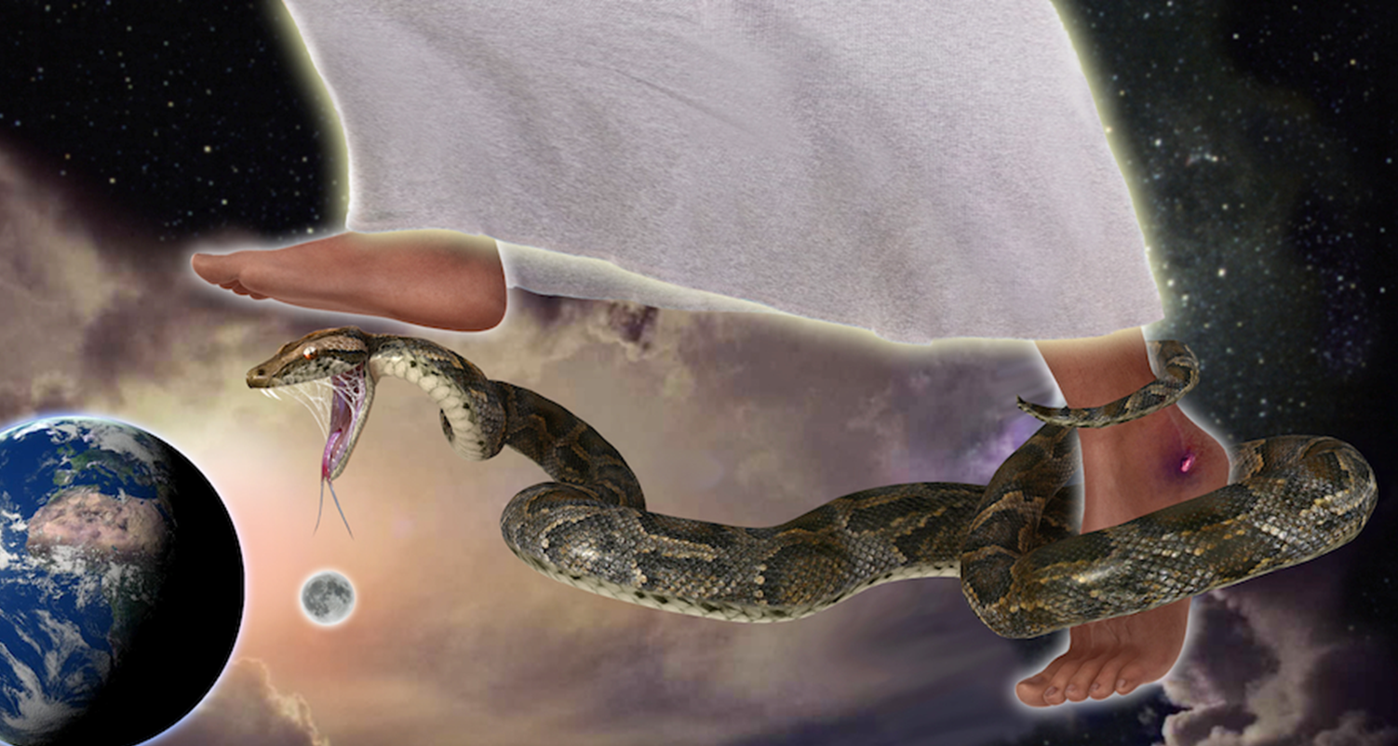
What Kind of Being Is God?

