Slide 1
The Final Message:
Preparing People To Meet Jesus
Session 15

Slide 2
Jesus Said:
“This gospel of the kingdom will be preached in the whole world as a testimony to all nations, and then the end will come.” Matthew 24:14
What kingdom?
The kingdom of the Creator God of Love whose laws are design laws
Has that message gone to the world?

Slide 3
Beastly Intoxication
“Fallen! Fallen is Babylon the Great! She has become a home for demons and a haunt for every evil spirit, a haunt for every unclean and detestable bird. For all the nations have drunk the maddening wine of her adulteries.” Revelation 18:2,3
The “maddening wine” is the lies about God that the entire world accepts —specifically that God’s laws are imposed and God functions as enforcer and source of inflicted pain, suffering and death.

Slide 4
Law of Worship
By beholding we are changed. 2Corinthians 3:18
“Let us fix our eyes on Jesus, the author and perfecter of our faith.” Hebrews 12:2
“We know that when he appears, we shall be like him, for we shall see him as he is.” 1John 3:2
Which requires we reject the imperial view of God with the human law construct and worship the Creator.

Slide 5
Revelation 14:6-8
“I saw another angel flying in midair, and he had the eternal gospel to proclaim to those who live on the earth—to every nation, tribe, language and people. He said in a loud voice, ‘Fear God and give him glory, because the hour of his judgment has come. Worship him who made the heavens, the earth, the sea and the springs of water.’
“A second angel followed and said, ‘Fallen! Fallen is Babylon the Great, which made all the nations drink the maddening wine of her adulteries.’”

Slide 6
Sabbath An Aid In Human Healing
What law lens do you understand Sabbath through?
“The Sabbath was made for man, not man for the Sabbath.” Mark 2:27
“Remember the Sabbath to keep it holy…for in six days God created…” Exodus 20:8-11
How is Sabbath understood through design law?
“You must observe my Sabbaths. This will be a sign between me and you for the generations to come, so you may know that I am the Lord, who makes you holy.” Exodus 31:13 NIV84, Ezekiel 20:12,20

Slide 7
Remember The Sabbath To Keep It Holy…
If you have an orgy of pagan worship on the Sabbath, have you made it less holy?
If you live righteously on the Sabbath, have you made it more holy?
Are we keeping the Sabbath holy or keeping ourselves holy?
Can we keep ourselves holy only one day per week?

Slide 8
What Is The Purpose Of The Sabbath?
Sign—mark, flag, pennant, banner—and resource for healing.
How did the Sabbath become a day of rest and worship? By its creation.
What was happening that week and why is the Sabbath so significant?
Satan alleged that God is arbitrary and God’s law is imposed law requiring punishment.

Slide 9
What Is The Purpose Of The Sabbath?
God responded by creating this planet and humankind — revealing what?
Then God said, “Universe you have heard the allegations, seen the evidence, now take your time, think for yourself, and come to your own conclusion. I rest my case.”
Day 1-6 of Creation week reveals God is powerful; day seven reveals His Character — truth, presented in love, leaving free.

Slide 10
Sabbath A Sign
Consider the flag of the United States…
The Sabbath became a day of worship by design, by creation and represents God’s government of love.
Sunday became a day of worship by legislation and represents imperial law the systems of this world.

Slide 11
Sabbath A Sign
Those who present the seventh-day Sabbath as an imposed rule that requires God to punish, are not Sabbath-keepers—consider the Jews who crucified Christ
People who worship on Sunday, but present truth, in love while leaving others free are Sabbath keepers.
It is about two systems of governing—two types of law: Design versus Imposed/Imperial.
The days are connected directly to their origins as signs of the two governments.

Slide 12
The Final Message
Is the truth about God as Creator whose character is love and laws are design laws.
Freeing people from the enslavement of the beastly imperial view of God.
Thus, restoring in people God’s design law of love (written in the heart/character).
Such, that “they do not love their lives so much as to shrink from death.” Revelation 12:11

Slide 13
The Final Message
“We know that when he appears, we shall be like him, for we shall see him as he is.” 1John 3:2
The Sabbath is evidence of God’s character and a blessing to humankind as it is a resource for us to exercise our trust in God by remembering God’s design laws and practicing them in our lives.

Slide 14
Round Table Discussion
What do you say to people who argue that salvation, in the end, is determined by keeping the Sabbath?
Can a person observe the Bible Sabbath and be God’s enemy? (Jews who crucified Christ)
If the specific day one goes to church upon is not the true issue what is? (The law/methods one practices and the God one worships—design versus imperial)
What is the method of God when it comes to worship and what is the method of the beast? (Truth, love, freedom Romans 14:5, versus deceit, pride, coercion—imperialism)

Slide 15
Round Table Discussion
What makes a system, method, or worship practice beastly?
What is the Sabbath a sign of?
How is the Sabbath connected to holiness? Who makes us holy?
If we recognize ancient Israel as actors in a drama, what lesson
is there from the connection between Sabbath rest and holiness?

Slide 17
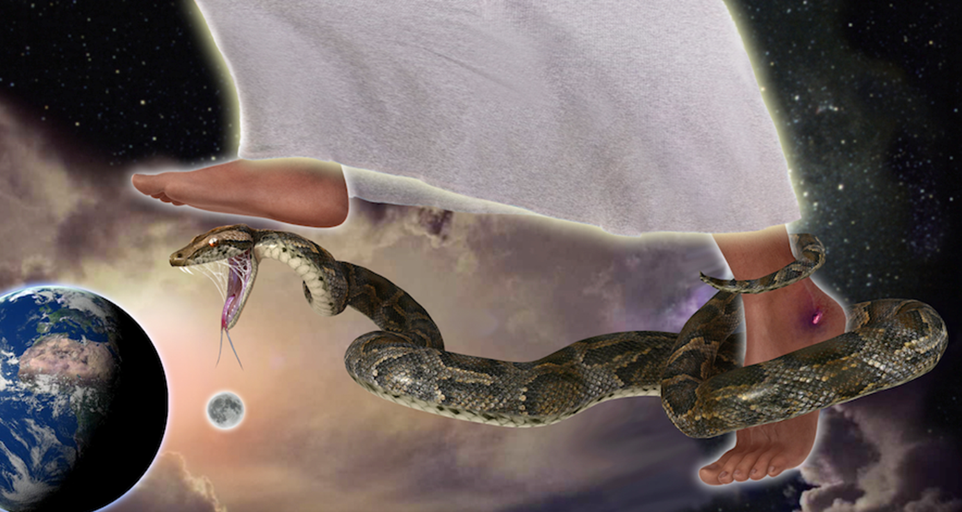
What Kind of Being is God?

