Slide 1
What Jesus Accomplished at the Cross
Session 7

Slide 2
What was the problem sin caused that the plan of salvation is designed to fix?

Slide 3
When Adam Sinned
Did God get changed?
Did God’s law get changed?
Did the condition of humankind get changed?
Then where must the work of Christ occur to save humankind?
Do we see why He had to become human?

Slide 4
What Did Jesus Accomplish?
Imposed Law
  He paid the penalty to protect us from legal condemnation and
  God’s wrath.
Design Law
  Something much more profound. He provided the remedy to our sin condition and made possible this creation’s restoration back to God’s design.

Slide 5
What Did Jesus Accomplish?
He revealed truth, which exposed Satan as liar, secured the unfallen universe, and win humanity back to trust:
    “God was pleased to have all his fullness dwell in him, and through him to reconcile to himself all things, whether things on earth or things in heaven, by making peace through his blood, shed on the cross.” Colossians 1:19, 20

Slide 6
What Did Jesus Accomplish?
He destroyed Satan and his power:
    “Since the children have flesh and blood, he too shared in their humanity so that by his death he might destroy him who holds the power of death—that is, the devil.” Hebrews 2:14

Slide 7
Satan’s Power
Lies—Satan is the father of lies. John 8:44
Life eternal is knowing God. John 17:3
  Eternal death is not knowing God.
  Satan’s power is the lies he tells about God, that if we believe
  will keep us from knowing Him.
  Christ revealed the truth which destroys the lies and wins us
  back to trust.

Slide 8
What Did Jesus Accomplish?
He revealed truth, which exposed Satan as liar, secured the unfallen universe, and won humanity back to trust:
Destroyed Satan and his power.
Destroyed the infection of selfishness and cured humankind.
    “Christ Jesus, who has destroyed death and has brought life and immortality to light through the gospel.” 2 Timothy 1:10

Slide 9
How Did Jesus Destroy Death?
What is the basis of life?
  God—the life emanating from Him flows out to all who are
  in unity with Him and who continue to live in harmony with
  His design.
What happens if one breaks this design?
  One severs the connection with the source of life—
  dying they die.
  Death is the natural outcome of selfishness.

Slide 10
Sin Is Deviation from God’s Design and, Thus, Sin Destroys the Sinner
“For sin pays its wage—death.” Romans 6:23 GNT
“Sin when it is full-grown brings forth death.” James 1:15 RSV
“The one who sows to please his sinful nature, from that nature
will reap destruction.” Galatians 6:8
“In rejecting God’s structure and establishing our own, in violating
God’s intention for the creation and substituting our own intentions, we cause our own disintegration.” Kaiser, W., et al., Hard Saying of the Bible, Intervarsity Press, 1996, p. 542

Slide 11
Historic SDA View
“We are not to regard God as waiting to punish the sinner for his sin. The sinner brings the punishment upon himself. His own actions start a train of circumstances that bring the sure result. Every act of transgression reacts upon the sinner, works in him a change of character, and makes it more easy for him to transgress again. By choosing to sin, men separate themselves from God, cut themselves off from the channel of blessing, and the sure result is ruin and death.” 1 Selected Messages, p. 235

Slide 12
How Did Jesus Destroy Death?
In order to destroy death, Christ had to restore humanity back into harmony with the law of love—the law of life.
Christ loved perfectly and refused to act in order to save Himself.

Slide 13
What Did Jesus Accomplish?
He revealed truth, which exposed Satan as liar, secured the
unfallen universe, and won humanity back to trust:
He destroyed Satan and his power.
He destroyed the infection of selfishness and cured humankind.
Destroyed the devil’s work.
    “The reason the Son of God appeared was to destroy the devil’s
    work.” 1 John 3:8

Slide 14
Historic SDA View
“The life of Christ is to be revealed in humanity. Man was the crowning act of the creation of God, made in the image of God, and designed to be a counterpart of God; but Satan has labored to obliterate the image of God in man, and to imprint upon him his own image.” E.G. White, Lift Him Up, p. 48
Christ restored God’s image in humanity!

Slide 15
Jesus Christ Was Unique
Adam was formed from dust .
Eve was formed from Adam’s side.
You and I were born from a sinful mother and father.
Jesus was formed in none of these ways:
    “When the time had fully come, God sent his Son, born of a woman, born under law, to redeem those under law, that we might receive the full rights of sons.” Galatians 4:4, 5
    The Holy Spirit was His Father. Matthew 1:18

Slide 16
Jesus Came to Cure Humanity
In Jesus, the two antagonistic principles fought it out:
    Love others or survival of the fittest (selfishness)
Jesus restored the love of God into the human species and
reconnected humanity to God’s circle of love/life!

Slide 17
Jesus, in Humanity, Exercised Love to Overcome the Desire to Save Self
“Jesus, full of the Holy Spirit, returned from the Jordan and was led by the Spirit in the desert, where for forty days he was tempted by the devil.” Luke 4:1, 2
Temptations Overcome
  Turn stone to bread—save yourself
  Jump down—prove yourself
  Bow down—save yourself

Slide 18
Jesus’Temptations
Jesus was “tempted in every way, just as we are—yet was without
sin.” Hebrews 2:14
And each one of us “is tempted when, by his own evil desire, he is
dragged away and enticed.” James 1:14
Did Jesus experience the internal temptation to save Himself?

Slide 19
Jesus at Gethsemane
Did Jesus experience powerful feelings?
What did His feelings tempt Him to do?
  Save Himself
But with each temptation, Jesus gave Himself in love instead.
  “No one can take my life; I will give it freely.” John 10:18

Slide 20
At the Cross, More Temptations to Save Self
“‘He saved others,’ they said, ‘but he can’t save himself! He’s the King of Israel! Let him come down now from the cross, and we will believe in him.’” Matthew 27:42
“The people stood watching, and the rulers even sneered at him. They said, ‘He saved others; let him save himself if he is the Christ of God, the Chosen One.’” Luke 23:35

Slide 21
In Jesus, Love Destroyed Selfishness, in His Human Nature
“Whoever wants to save his life will lose it, but whoever loses his
life for me will find it.” Matthew 16:25
When Jesus refused to use His power to save Himself, but instead gave Himself freely, He destroyed death—selfishness being the basis of death—and brought life and immortality to light.
2 Timothy 1:9, 10

Slide 22
Historic SDA View
“The foe who in the wilderness had confronted Christ assailed Him
now with fierce and subtle temptations. Had Jesus yielded for a
moment, had He changed His course in the least particular to save
Himself, Satan’s agencies would have triumphed, and the world would have been lost.” E.G. White, The Desire of Ages, p. 486

Slide 23
Why Did Jesus Have to Die?
Because Adam infected humankind with selfishness and life requires that the law of love be restored into humanity.
If Christ, at any point along death’s approach, had used His power to stop death from consuming Him, who would He have saved?
The only way to destroy selfishness was by experiencing temptation to act selfishly—but, with a human brain, choose to love perfectly; thus, He established a new, perfect human character.
Christ restored the law of life into humanity by giving Himself freely in love.

Slide 24
Jesus Rose Again as the Inevitable
Outcome of His Victory
Christ destroyed selfishness, the basis of death.
Christ restored the law of love into humanity, the basis of life.
His resurrection was the only outcome of the law of love being restored!
  “The law of the Lord is perfect reviving the soul.” Psalm 19:7

Slide 25
Christ Procured the Remedy
“Although he was a son, he learned obedience from what he suffered and, once made perfect, he became the source of eternal salvation for all who obey him.” Hebrews 5:9, 10
  Wasn’t Jesus always perfect?
He was always sinless!
  But character cannot be created; it must be developed by the choices of the individual agent.
  Once Jesus developed a perfect human character, He became the source of salvation or healing.

Slide 26
John 6:53, 54
Jesus said to them, “I tell you the truth, unless you eat the flesh of the Son of Man and drink his blood, you have no life in you. Whoever eats my flesh and drinks my blood has eternal life, and I will raise him up at the last day.”
Flesh: Bread and Word: Truth—destroys lies and wins to trust.
When we trust with an open heart, the Holy Spirit takes Christ’s life and reproduces it is us:
  “… no longer I that lives but Christ lives in me.” Galatians 2:20
  We become “partakers of the divine nature.” 2 Peter 1:4

Slide 27
Historic SDA View
“The law requires righteousness—a righteous life, a perfect character; and this man has not to give. He cannot meet the claims of God’s holy law. But Christ, coming to the earth as man, lived a holy life, and developed a perfect character. These He offers as a free gift to all who will receive them.” E.G. White, The Desire of Ages, p. 762

Slide 28
Why Does the Law Require a Righteous Character?
For the same reason the law of respiration requires that we breathe!

Slide 29
Keys Learning Points
Sin changes the sinner to be out of harmony with God and His
design for life.
God’s design (law) for life could not change, so in order to save humankind, we had to be changed (restored) to be in harmony
with His design (law).
Jesus came to accomplish this work while simultaneously revealing truth and destroying the lies that broke the circle of love and trust.
The primary lie being that God’s law functions like human law.

Slide 30
Round Table Discussion
What was the problem sin caused that the plan of salvation was
designed to fix?
What did Christ accomplish?
What happens to our understanding of Christ’s mission if we substitute imposed law for design law?
If we accept the lie that God’s law functions like human law, then what is the problem that sin caused that Christ needed to fix?
Does such an idea change how we see and understand God?
How do we participate in what Christ accomplished for us at the cross?
How can the legal view of salvation actually obstruct what God is
trying to accomplish through Christ in the hearts/minds of
people?

Slide 32
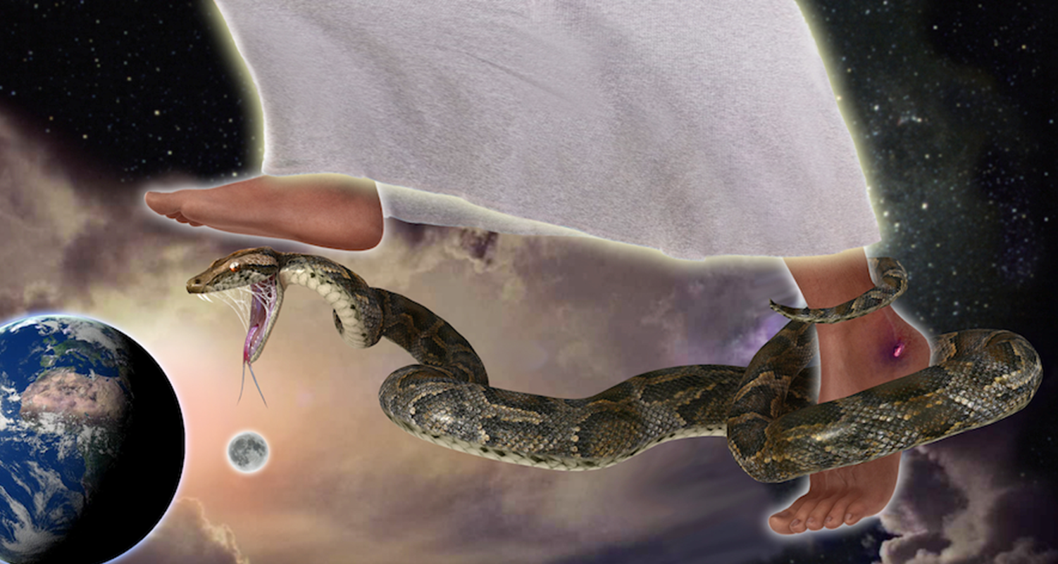
What Kind of Being Is God?

