Slide 1
Effective Public Speaking
Session 17
Timothy R. Jennings, M.D. DFAPA
Past-President, Southern Psychiatric Association
Past-President, Tennessee Psychiatric Association
Author of:
Could It Be This Simple?
The God-Shaped Brain
The Journal of the Watcher
The Remedy — New Testament Paraphrase
The God-Shaped Heart
The Aging Brain: Proven Steps to Prevent Dementia and Sharpen Your Mind
The Remedy of the Lord in Song: The Psalms

Slide 2
Know Your Material
Know what you know, and know what you don’t know.
It is okay not to know everything!
Your anxiety level impacts audience—be confident, be relaxed.
Be excited and passionate.
Practice multiple times alone and, if necessary, before family/friends.

Slide 3
Know Your Audience
Shape the presentation to speak in their language.
Are you speaking to Christians or non-Christians—
same denomination or different?

Slide 4
Tricks to Getting Started
Put one hand on the podium.
Tell a personal story—make it short and relevant.
The story (or opening) should be rehearsed many times
so that you know it by heart.
Read as little as possible.

Slide 5
Record Yourself
Listen and critique.
Eliminate unnecessary words (um, you know, etc.).
Speak clearly, pronounce words precisely, with clear articulation (no mumbling, no soft/quiet voice).
Learn to tolerate silences.
Modulate your voice—no monotone
PRACTICE!

Slide 6
Physical Presentation
Dress appropriately, which differs for each audience.
Make eye contact with the audience, but change points of focus.
Minimize turning your back to the audience.
Don’t fidget.
Don’t put hands in pockets or wring your hands.

Slide 7
Use Effective Visual Aids
Do not make slides too busy …

Slide 8
In the beginning God created the heaven and the earth. ² And the earth was without form, and void; and darkness was upon the face of the deep. And the Spirit of God moved upon the face of the waters. ³ And God said, Let there be light: and there was light. ⁴ And God saw the light, that it was good: and God divided the light from the darkness. ⁵ And God called the light Day, and the darkness he called Night. And the evening and the morning were the first day. ⁶ And God said, Let there be a firmament in the midst of the waters, and let it divide the waters from the waters. ⁷ And God made the firmament, and divided the waters which were under the firmament from the waters which were above the firmament: and it was so. ⁸ And God called the firmament Heaven. And the evening and the morning were the second day. ⁹ And God said, Let the waters under the heaven be gathered together unto one place, and let the dry land appear: and it was so. ¹⁰ And God called the dry land Earth; and the gathering together of the waters called he Seas: and God saw that it was good. ¹¹ And God said, Let the earth bring forth grass, the herb yielding seed, and the fruit tree yielding fruit after his kind, whose seed is in itself, upon the earth: and it was so. ¹² And the earth brought forth grass, and herb yielding seed after his kind, and the tree yielding fruit, whose seed was in itself, after his kind: and God saw that it was good.
¹³ And the evening and the morning were the third day. ¹⁴ And God said, Let there be lights in the firmament of the heaven to divide the day from the night; and let them be for signs, and for seasons, and for days, and years: ¹⁵ And let them be for lights in the firmament of the heaven to give light upon the earth: and it was so. ¹⁶ And God made two great lights; the greater light to rule the day, and the lesser light to rule the night: he made the stars also. ¹⁷ And God set them in the firmament of the heaven to give light upon the earth, ¹⁸ And to rule over the day and over the night, and to divide the light from the darkness: and God saw that it was good. ¹⁹ And the evening and the morning were the fourth day. ²⁰ And God said, Let the waters bring forth abundantly the moving creature that hath life, and fowl that may fly above the earth in the open firmament of heaven. ²¹ And God created great whales, and every living creature that moveth, which the waters brought forth abundantly, after their kind, and every winged fowl after his kind: and God saw that it was good.

Slide 9
Use Effective Visual Aids
Do not make slides too busy.
Do not make slide too plain …

Slide 10
Plain Slides Are Boring
Plain slides don’t hold interest.
Plain slides are uninspiring.
Plain slides can be distracting.
Plain slides show little imagination.
Plain slides suggest you didn’t put in much effort.
In other words, learn how to effectively use your presentation software. (In this case, I’m using PowerPoint, but there are many others with different capabilities and features.)

Slide 11
Use Effective Visual Aids
Do not make slides too busy.
Do not make slides too plain.
Don’t Use Weird or difficult to read fonts.
Don’t overuse animations.
Visuals should aid, not distract, from the presentation.

Slide 12
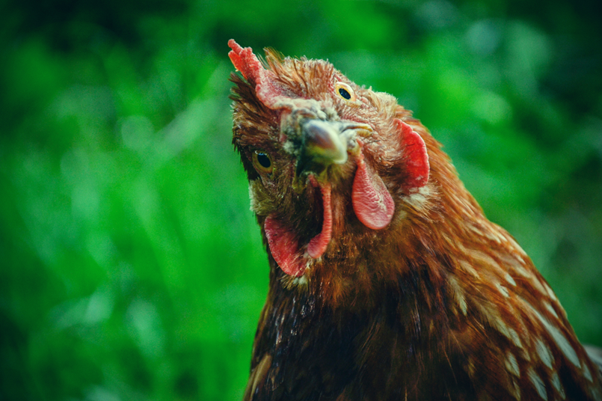
Questions?

