Slide 1
HEALTHY LOVE VS LOVE ADDICTION
Timothy R. Jennings, MD, DFAPA
Past-President, TN Psychiatric Association
Past-President, Southern Psychiatric Association
AUTHOR:
Could It Be This Simple? A Biblical Model for Healing the Mind
The God-Shaped Brain: How Changing Your View of God Transforms Your Life
The Journal of the Watcher
The Remedy New Testament Expanded Paraphrase
The God-Shaped Heart: How Correctly Understanding God’s Love Transforms Us
The Aging Brain: Proven Steps to Prevent Dementia and Sharpen Your Mind
The Remedy of the Lord in Song: The Psalms

Slide 2
WHAT IS LOVE?
A strong feeling of affection?
A strong feeling of attraction?
An overwhelming passionate desire for someone – taking your breath away?
A strong feeling of devotion?
Concern for the welfare of another?
A protocol upon which reality is constructed to operate? (which can include feelings of attraction, affection, and devotion)

Slide 3
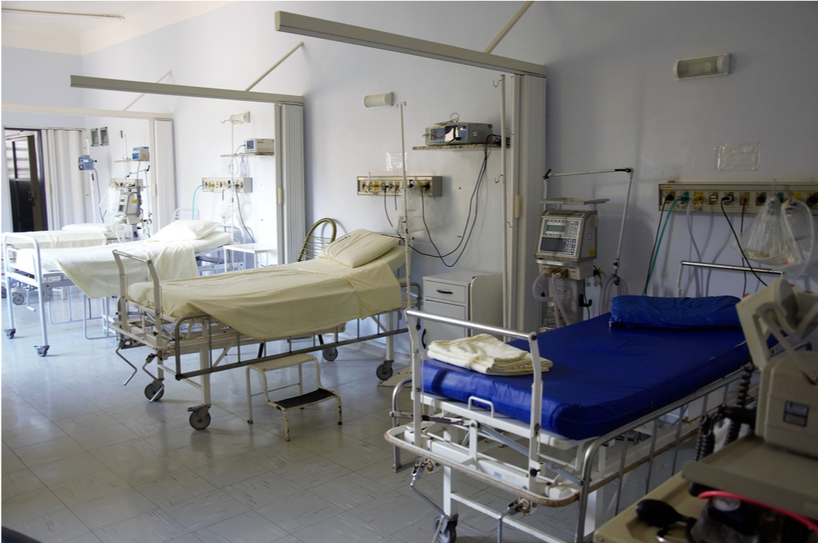
JERRY

Slide 4
DID JERRY LOVE HIS WIFE?
How do you hear the word love in the question?
Did Jerry have strong feelings for his wife?
Did Jerry have strong desire to do what is in the best interest of his wife?
Jerry definitely had strong feelings – but upon whom did his feelings focus? With whom was he primarily concerned?
Was this love?

Slide 5
LOVE VS. DEPENDENCY
Love originates in God and is giving, beneficent, other-centered, and without fear.
  A principle of doing right regardless of how one feels
Dependency originates in self and is taking, exploitive, self-centered and fear-ridden.
  A practice of gratifying self often motivated by feelings

Slide 6
LAW
When you hear the word law what comes to mind?
Rules, restrictions, regulations?
Law of Gravity or Laws of Health?

Slide 7
GOD IS DESIGNER - CREATOR
God’s Laws are the protocols upon which the fabric of the cosmos is built, the design parameters upon which reality and life actually function.
Created beings cannot create reality, so we make up rules and call them laws
States can make laws that make marijuana, tobacco, alcohol “legal”
They can NEVER pass laws to make them Healthy!

Slide 8
DO YOU WANT A HEALTHY
LOVE RELATIONSHIP?
Health – in all spheres is only possible when one lives in harmony with Design Law
Doctors cannot get patients well outside the laws of health
Why don’t you put water in the gas tank of your car?
Relationships cannot be healthy outside God’s Design parameters
Thus healthy relationships REQUIRE healthy people

Slide 9
WHAT ARE THE DESIGN LAWS FOR RELATIONSHIPS?

Slide 10
LAW OF LIBERTY
Gravity
Proposal

Slide 11
VIOLATE LIBERTY
THREE PREDICTABLE CONSEQUENCES
    Love is damaged and eventually destroyed
    A Desire to Rebel is instilled in the heart

Slide 12
LAW OF LIBERTY
Gravity
Proposal
Coke

Slide 13
VIOLATE LIBERTY
THREE PREDICTABLE CONSEQUENCES
    Love is damaged and eventually destroyed
    A Desire to Rebel is instilled in the heart
    Individuality is eroded/Shadow Person

Slide 14
LAW OF LIBERTY
Gravity
Proposal
Coke
Shirley

Slide 15
VIOLATE LIBERTY
THREE PREDICTABLE CONSEQUENCES
    Love is damaged and eventually destroyed
    A Desire to Rebel is instilled in the heart
    Individuality is eroded/Shadow Person

Slide 16
EMOTIONAL GUNS
Most people don’t use real guns…
Love can only exist in an atmosphere of Freedom
But what is love?

Slide 17
THE LAW OF LOVE
“Love is not self seeking”1 Cor 13:4,5
Love is giving
Love is the protocol upon which reality is constructed to function

Slide 18


Slide 19


Slide 20
GOD’S LAW IS DESIGN LAW
Protocols upon which reality functions
Health REQUIRES harmony with God’s design

Slide 21
IF GOD BUILT THE UNIVERSE TO OPERATE UPON THE LAW OF LOVE,
WHAT HAPPENED?

Slide 22
FALLING DOMINOES OF DESTRUCTION
Lies believed – broken love and trust
Broken love and trust – fear & selfishness (survival of the fittest)
Fear & selfishness – destructive acts (sins)
Destructive acts (sins) – damage to mind, body and relationships a terminal condition

Slide 23
FEAR DESTROYS HEALTH
Physical Growth
  Iraqi children¹
Intellectual Growth
  Test anxiety
Spiritual Growth
  Fear of God
Relational Growth
  Fear of rejection, abandonment
1. http://www.sciencedaily.com/releases/2010/03/100329082121.htm

Slide 24
DEPENDENCY IS FEAR BASED
Consider scuba diving

Slide 25
DEPENDENCY VS. LOVE
THE CONTRAST
Both can give
Dependency – gives in order to get
  Fear of loneliness, fear of not being loved leads to giving to get affirmation etc. but is irritated when recognition not received
  Consider a Cowboy and his horse
  Constantly up and down yo-yo relationship
Love – gives in order to give
  Rejoices in the doing for another and the successes of the other

Slide 26
DEPENDENCY RELATIONSHIP PHASES
Search phase
  New person, same pathology
Attraction phase
  Fantasy overshadows reality
Relief phase
  Euphoric high when relationship initiates
Anxiety phase
  Reality begins to shatter fantasy

Slide 27
DEPENDENCY RELATIONSHIP PHASES
Denial phase
  Avoidance of reality, will make excuses, distort and deny
Escalation phase
  Emotional desperation with irrational behavior, attempt to save relationship
Withdraw phase
  Disengagement, depression, and propulsion into search phase

Slide 28
LOVE VS. DEPENDENCY
Love is healing.
Love is freeing.
Love is interested in another.
Love is stable.
Love is fearless
Dependency is destructive.
Dependency is controlling.
Dependency is interested in self.
Dependency is wavering.
Dependency is fear ridden.

Slide 29
LOVE VS. DEPENDENCY
Love is orderly and reliable.
Love is based on principle.
Love is consistent.
Love is honest and truthful.
Dependency is chaotic and unreliable.
Dependency is based on feelings.
Dependency is inconsistent.
Dependency is dishonest and deceitful.

Slide 30
LOVE VS. DEPENDENCY
Love is patient.
Love is kind.
Love is forgiving.
Love protects.
Dependency is impulsive.
Dependency is cruel.
Dependence is resentful.
Dependency exploits.

Slide 31
LOVE VS. DEPENDENCY
Love sacrifices self.
Love never ends!
Love never fails!
Dependency sacrifices others.
Dependency never lasts!
Dependency never succeeds!

Slide 32
EMAIL INQUIRY
I have a friend whose husband has cheated on her for many years. He is a good father and the children love him. This woman has been an obedient child of Christ in staying with her husband.
Last year she had enough and divorced him. He came back and wanted to mend his marriage but continues to sin with other women and every week still comes home and sleeps in another room in the house. My sister in Christ would like her marriage to heal but cannot take his cheating.

Slide 33
EMAIL INQUIRY
Does God want her to stay in this marriage when her husband continues like this, role modeling evil behavior in the house?

Slide 34
WHAT IS YOUR ASSESSMENT?
Does this husband love his wife?
If the wife loves her husband what is the right action for her to take and why?

Slide 35
MY RESPONSE
Of course God does not want anyone to live in a deceitful, exploitive, selfish relationship where trust doesn't exist. Her husband doesn't love her and until she realizes it she will fail to be able to love him. The most loving action for her to take is to hold him accountable for his untrustworthy character and throw him out. She should only allow him back when he has demonstrated, reliable, documentable, credible evidence that he is trustworthy and loves her more than himself. His words are meaningless, his actions demonstrate an immature human being who is not qualified to be a husband.

Slide 36
HER RESPONSE
But Dr. Jennings ~ Can't a person still love his wife and give into the flesh? He has to love her, why would he come back to be with her & the children?
The Bible says to forgive so she has forgiven and when we marry aren't we suppose to stay married ~ God wants us to keep our families together doesn't he?!
It's confusing (when there is emotional abuse) to know what God would have us do. It must be possible to have the Holy Spirit guide us out of bad relationships and focus on God.

Slide 37
YOUR ASSESSMENT
But Dr. Jennings ~ Can't a person still love his wife and give into the flesh? He has to love her, why would he come back to be with her & the children?
What do you hear in this question?
This woman is almost certainly talking about herself, not her ‘sister in Christ.’ Note the desperate need to not admit the truth but find some pretext to hold onto the idea she is loved.
How is she loved?
Like a cowboy loves his horse…

Slide 38
YOUR ASSESSMENT
The Bible says to forgive so she has forgiven and when we marry aren't we suppose to stay married ~ God wants us to keep our families together doesn't he?!
What do you hear in this question?
Do you hear love and concern for the husband or fear for self, a desperate pleading and attempt to rationalize not divorcing?
Does forgiving someone mean you can trust them?
Does God want us to keep our families together in all circumstances, or only within His design?

Slide 39
MATTHEW 10:34,35 THE REMEDY
"Don't think I have come to make peace with a selfish world. I have not come to bring peace with selfishness, but a sword to cut selfishness out of the hearts of men. I have come to cut dysfunctional family ties and free a son from selfish loyalty to his father's ambitions and feuds, to sever a daughter from the control of an oppressive and manipulative mother, to cut through the fear and hostility a daughter-in-law has toward her mother-in-law.”

Slide 40
YOUR ASSESSMENT
It's confusing (when there is emotional abuse) to know what God would have us do. It must be possible to have the Holy Spirit guide us out of bad relationships and focus on God.
What do you hear?
She is confused. She recognizes something is wrong, but can’t figure it out. Why? What has happened in her life that has damaged her ability to figure it out?
How does the Holy Spirit work?
Spirit of Truth and Love – leaving us free to choose.

Slide 41
WHAT IS THE SOLUTION?
Truth
    Must be truthful about self and relationship
Freedom
    Must set others free to not love you
Love
    Must choose to love others, regardless of how it feels, giving to bless another rather than seeking to get for self
    Healthy Relationships REQUIRE healthy people

Slide 42
HOW?
Truth
    Meditate on God’s Word—law of worship
    Practice thinking for yourself—law of exertion
    Identify God’s design protocols and choose to apply them
Freedom
    Choose to set others free to think what they want (and you set yourself free)—law of liberty
    Form your beliefs from truth, not opinion
Love
    Meditate on God’s character of love—laws of worship and love
    Give to bless others (volunteer)—laws of love and exertion

Slide 43
Healthy Love
Comes only from God and is experienced only as we live in harmony with His Design Laws for life.

