Slide 1
THE DEVELOPING BRAIN
Timothy R. Jennings, MD, DFAPA
Past-President, TN Psychiatric Association
Past-President, Southern Psychiatric Association
AUTHOR:
Could It Be This Simple? A Biblical Model for Healing the Mind
The God-Shaped Brain: How Changing Your View of God Transforms Your Life
The Journal of the Watcher
The Remedy New Testament Expanded Paraphrase
The God-Shaped Heart: How Correctly Understanding God’s Love Transforms Us
The Aging Brain: Proven Steps to Prevent Dementia and Sharpen Your Mind
The Remedy of the Lord in Song: The Psalms

Slide 2
OVERVIEW
The Brain
Parental/Environmental Influences
Media Influences
Spiritual Influence

Slide 3
SECTION I: THE BRAIN

Slide 4
ABOUT THE BRAIN
100 billion nerve cells
Over 1 trillion supporting cells
Each brain cell with up to 10,000 connections to other cells
40,000,000,000,000,000
Forty Quadrillion
It is soft, like a banana in a hard case skull
Weighs 3 pounds, 1-2% of body weight
Uses 20% of the body’s energy

Slide 5
NORMAL BRAIN DEVELOPMENT
The human brain is so complex that over 50% of the human genome codes for the brain¹
More than twice as many neurons are produced than are eventually used¹
During fetal development 50,000 neurons are produced per second¹
1. Giedd JN, Blumenthal J, Jeffries NO, et al. Brain development during childhood and adolescence: a longitudinal MRI study. Nature Neuroscience, 1999; 2(10): 861-3.

Slide 6
NORMAL BRAIN DEVELOPMENT
From Birth to age 8 massive remodeling, with millions of neurons lost
A second wave of neurogenesis, heavily concentrated in the PFC peaks in girls at 11 and boys at 12 followed by more remodeling and neuronal loss²
White matter maturation progresses from back to front culminating around age 25²
Giedd JN, Blumenthal J, Jeffries NO, et al. Brain development during childhood and adolescence: a longitudinal MRI study. Nature Neuroscience, 1999; 2(10): 861-3.
Rapoport JL, Giedd JN, Blumenthal J, et al. Progressive cortical change during adolescence in childhood-onset schizophrenia. A longitudinal magnetic resonance imaging study. Archives of General Psychiatry, 1999; 56(7): 649-54.

Slide 7
SECTION II PARENTAL/ENVIRNOMENTAL INFLUENCES

Slide 8
HOW CLOSELY RELATED?

Slide 9
PARENTAL INFLUENCES
Hereditary
Environmental
Behavioral / Social

Slide 10
EPEGENETICS
Conrad Waddington 1957
All cells have the same DNA yet different gene products
Epi – means above
Genetics – means DNA
Epigenetics means above the DNA
Transgenerational
Gestational
Environmental

Slide 11
DNA

Slide 12
FRUIT FLIES
Geldanamycin
Outgrowths eyes
13 generations
No DNA sequence change
Gen 2-13 not exposed to drug¹
1. Wong, Cell Research (2006)16: 742-749

Slide 13
ROUND WORMS
Fed with a particular type of bacteria exhibit loss of a green fluorescent protein and a small dumpy appearance that lasts 40 generations.
No DNA sequence change
Subsequent generations were not fed the bacteria
Jablonka, E., and Raz, G. (2009). Q Rev Biol 84, 131-176.

Slide 14
TRANSGENERATIONAL EFFECTS OF FOOD SUPPLY
Grandfathers who had short food supply conferred greater mortality risks to grandsons
Grandmothers conferred greater mortality risk to granddaughters
X & Y transgenerational influences
Eur J Hum Genet. 2006 Feb;14(2):159-66.
http://www.ncbi.nlm.nih.gov/pubmed/16391557

Slide 15
TRANSGENERATIONAL EFFECTS OF SMOKING
Men who smoke before age 11
Increased obesity in sons, but not daughters
Y – Chromosome epigenetic changes
Eur J Hum Genet. 2006 Feb;14(2):159-66.
http://www.ncbi.nlm.nih.gov/pubmed/16391557

Slide 16
SMELL OF FEAR
F0 mice conditioned to fear odor (acetophenone) which activates known receptor (Olfr151)
Generations F1&F2 had hypomethylation of gene Olfr151, with increased neural pathway for this olfactory odor, and subsequent fear of this smell.
Genetic Memory?
Nature Neuroscience 17, 89–96 (2014)

Slide 17
GESTATIONAL FACTORS

Slide 18
SMOKING WHILE PREGNANT
Smaller babies¹
Increased SIDS¹
Learning and behavior problems¹
Increased psychotic disorders later in life¹
http://cerhr.niehs.nih.gov/common/smoking.html
http://bjp.rcpsych.org/cgi/content/abstract/195/4/294

Slide 19
AIR QUALITY WHILE PREGNANT
Recent Study of 40 women & Children followed for 7-9 years
Dose dependent relationship between polycyclic aromatic hydrocarbons exposure and reduced white matter in left hemisphere
Slower information processing, increased ADHD and conduct problems
:Petersen, et al., JAMA Psychiatry, March 25, 2015 online

Slide 20
ALCOHOL WHILE PREGNANT
Increased psychosis
Alcohol tastes better
Mental retardation
Multiple organ defects
Fetal alcohol syndrome
1 drink/week or less
Shorter children/Smaller heads
Behavior problems
Delinquency
Emotional problems

Slide 21
CANNABIS WHILE PREGNANT
16% use drugs #1 cannabis¹
2009-2016 rate has doubled²
70% CO dispensaries recommended cannabis for pregnancy related sickness; 36% reassuring of safety³
Crosses placental barrier altering brain development⁴
Secreted in breastmilk up to one week after use⁵
1. Azofeifa A, Mattson ME, Schauer G, et al. National Estimates of Marijuana Use and Related Indicators - National Survey on Drug Use and Health, United States, 2002-2014. MMWR Surveill Summ. 2016;65:1-28. www.cdc.gov/mmwr/volumes/65/ss/ss6511a1.htm. Accessed January 15, 2020.2. Young-Wolff KC, Tucker LY, Alexeeff S, et al. Trends in Self-reported and Biochemically Tested Marijuana Use Among Pregnant Females in California From 2009-2016. JAMA. 2017;318:2490-2491.3. Dickson B1, Mansfield C, Guiahi M, et al. Recommendations From Cannabis Dispensaries About First-Trimester Cannabis Use. Obstet Gynecol. 2018;131:1031-1038. 4. Harkany T, Guzmán M, Galve-Roperh I, et al. The emerging functions of endocannabinoid signaling during CNS development. Trends Pharmacol Sci. 2007;28:83-92. 5. Gunn JK, Rosales CB, Center KE, et al. Prenatal exposure to cannabis and maternal and child health outcomes: a systematic review and meta-analysis. BMJ Open. 2016;6:e009986.6. Huizink AC, Mulder EJ. Maternal smoking, drinking or cannabis use during pregnancy and neurobehavioral and cognitive functioning in human offspring. Neurosci Biobehav Rev. 2006;30:24-41. 7. Fine JD, Moreau AL, Karcher NR, et al. Association of Prenatal Cannabis Exposure With Psychosis Proneness Among Children in the Adolescent Brain Cognitive Development (ABCD) Study. JAMA Psychiatry. 2019;76:762-764. 8. Schneider M. Cannabis use in pregnancy and early life and its consequences: animal models. Eur Arch Psychiatry Clin Neurosci. 2009;259:383-93. 9. The Health Effects of Cannabis and Cannabinoids. Washington, DC: National Academies Press; 2017. ❒

Slide 22
CANNABIS WHILE PREGNANT
Anemia in mothers⁵
Low birth wt, increased risk preterm, stillbirth, NICU⁵
↑ rates impulsivity, delinquency, learning/mem problems, psychosis, ↓ executive function^{6,7}
↑ Autism nearly double rate⁸
Mothers: ↑ anxiety, depression, SI, (mania, psychosis genetically at risk), ↑ use of other substances like alcohol⁹
1. Azofeifa A, Mattson ME, Schauer G, et al. National Estimates of Marijuana Use and Related Indicators - National Survey on Drug Use and Health, United States, 2002-2014. MMWR Surveill Summ. 2016;65:1-28. www.cdc.gov/mmwr/volumes/65/ss/ss6511a1.htm. Accessed January 15, 2020.2. Young-Wolff KC, Tucker LY, Alexeeff S, et al. Trends in Self-reported and Biochemically Tested Marijuana Use Among Pregnant Females in California From 2009-2016. JAMA. 2017;318:2490-2491.3. Dickson B1, Mansfield C, Guiahi M, et al. Recommendations From Cannabis Dispensaries About First-Trimester Cannabis Use. Obstet Gynecol. 2018;131:1031-1038. 4. Harkany T, Guzmán M, Galve-Roperh I, et al. The emerging functions of endocannabinoid signaling during CNS development. Trends Pharmacol Sci. 2007;28:83-92. 5. Gunn JK, Rosales CB, Center KE, et al. Prenatal exposure to cannabis and maternal and child health outcomes: a systematic review and meta-analysis. BMJ Open. 2016;6:e009986.6. Huizink AC, Mulder EJ. Maternal smoking, drinking or cannabis use during pregnancy and neurobehavioral and cognitive functioning in human offspring. Neurosci Biobehav Rev. 2006;30:24-41. 7. Fine JD, Moreau AL, Karcher NR, et al. Association of Prenatal Cannabis Exposure With Psychosis Proneness Among Children in the Adolescent Brain Cognitive Development (ABCD) Study. JAMA Psychiatry. 2019;76:762-764. 8. Schneider M. Cannabis use in pregnancy and early life and its consequences: animal models. Eur Arch Psychiatry Clin Neurosci. 2009;259:383-93. 9. The Health Effects of Cannabis and Cannabinoids. Washington, DC: National Academies Press; 2017. ❒

Slide 23
MOTHER’S THINKING WHILE PREGNANT
Study of over 4000 mothers and their children
Followed for over 18 years
Mothers with negative, pessimistic, depressive thinking patterns when pregnant increased the risk of their child being depressed 18 years later.
This association remained after accounting for maternal and offspring depression.
The thought patterns of the mother accounted for 21% of the association between maternal and child depression.
(Am Journal of Psychiatry 2013; 170:434-441).

Slide 24
WHAT IF MOTHER IS STRESSED WHILE PREGNANT?
Mother’s stress hormones cross the placenta
Interferes with the stress response “braking system”
This occurs through epigenetic modification
Children are more stress prone, irritable, moody, and they pass this along to their children - unless new experience introduce new gene expression
Medina, J. Psychiatric Times, April 2010, p. 16

Slide 25
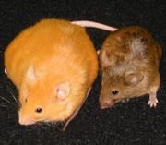
DIET OF MOTHER CHANGES CHILD
Notes:
Copyrighted

Slide 26
AGOUTI GENE EXPRESSION
What turns on the
Agouti Gene?

Slide 27
BISPHENOL A (BPA)

Slide 28
WHAT TURNS OFF THE AGOUTI GENE?
Methylation
Mother’s diet supplemented with folic acid and B12
Diet of mother during pregnancy changes the expression of genes in the child
The methyl lock down passed down 3-4 generations.
issue 2407 of New Scientist magazine, 09 August 2003, page 14

Slide 29
JACOB AND HIS SHEEP
Jacob, however, took fresh-cut branches from poplar, almond and plane trees and made white stripes on them by peeling the bark and exposing the white inner wood of the branches. Then he placed the peeled branches in all the watering troughs, so that they would be directly in front of the flocks when they came to drink. When the flocks were in heat and came to drink, they mated in front of the branches. And they bore young that were streaked or speckled or spotted. (Gen 30:37-39 NIV84)
Backon, Joshua, Jacob and the Spotted Sheep: The Role of Prenatal Nutrition on Epigenetics of Fur Color. Biology Published 2008 https://www.semanticscholar.org/paper/Jacob-and-the-Spotted-Sheep%3A-The-Role-of-Prenatal-Backon/194ef71dd0af81f87cebdeda41ac64a85bc44a74

Slide 30
GESTATIONAL EFFECTS OF FOOD SUPPLY
Netherlands WWII
Severe food shortage
Children higher rates of diabetes, obesity, metabolic problems than did their siblings of same parents
5% less methyl caps on IGF2 gene
Researchers believed this increased energy extraction from food
Proceedings of the National Academy of Sciences, DOI: 10.1073/pnas.0806560105

Slide 31
PARENTAL ENVIRNOMENTAL FACTORS

Slide 32
ANIMAL STUDIES
Pups of nurturing mothers (licking/grooming) compared to pups of mothers who didn’t nurture
Pups without attentive mothers had altered brain development such that they had over active amygdalas and social impairments
When pups of neglect mothers were reared by nurturing mothers their amygdala development was the same as the pups of the nurturing mother
http://www.ncbi.nlm.nih.gov/pubmed/15220929

Slide 33
CHILDHOOD STRESS DECREASES REWARD FIRING
Stress between K to 3rd grade was predictor of decreased reward firing from ventral tegmental area at age 26
This increases risk for mental health problems later in life, more depression, less normal reward, greater risk for substance problems.
Jamie L Hanson et al. Cumulative Stress In Childhood is Associated with Blunted Reward-Related Brain Activity In Adulthood, Social Cognitive and Affective Neuroscience (2015). DOI: 10.1093/scan/nsv124

Slide 34
GESTATIONAL EFFECTS OF FOOD SUPPLY
Enriched environment 2 weeks adolescence
Improved memory
Offspring – improved memory despite genetic defect and no enriched environment
Environment caused epigenetic changes which were passed to offspring
Junko A. Arai, Shaomin Li, Dean M. Hartley, and Larry A. Feig Transgenerational Rescue of a Genetic Defect in Long-Term Potentiation and Memory Formation by Juvenile Enrichment J. Neurosci., Feb 2009; 29: 1496 - 1502 ; doi:10.1523/JNEUROSCI.5057-08.2009

Slide 35
Mice with neuronal loss experienced improved memory after enriched environment due to epigenetic changes

Slide 36
PROTECTIVE FACTORS
Family member confidant¹
Significantly reduced the risk of overall behavioral and emotional problems by age 18.
Females at age 18 who had a family member confidant
higher self-esteem and reduced risks of major mental disorders, suicidal thoughts, depression, drug disorders, and overall behavioral problems
Males with advice-giving families
had better school performance, lower school dropout rates, less depression, behavioral or emotional problems
Family cohesion²
Males and females had higher grades, greater likelihood in receiving school and community honors, and a reduced risk of numerous problems and some mental disorders. Family cohesion appeared to be especially important for young women in reducing risk of serious mental disorders.
1. Child and Adolescent Social Work Journal Oct 2002, Vol 19, Is 5, p 393-412
2. American Journal of Orthopsychiatry, Vol 59(1), Jan 1989, 59-71

Slide 37
OTHER ENVIRONMENTAL FACTORS
Tobacco
Alcohol
Marijuana

Slide 38
TOBACCO
Nicotine binds receptors that regulate neuro development
Teens who smoke have:
Higher rates of psychosis
Higher rates of agoraphobia and panic
Higher rates of depression
Die younger from medical problems
More difficult time quitting

Slide 39
ALCOHOL & NPY EPIGENETIC CHANGES
Low Neuropeptide Y in amygdala is associated with increased alcohol preference in animal models¹
NPY receptor knockout mice show alcohol preference²
Olling et al 2009 demonstrated that ETOH causes³
Decreased histone deacetlyase (gene inhibitors)
Resulting in increased NPY in amygdala and low anxiety
Alcohol withdraw increased histone deacetylase thus suppressing NPY and increasing anxiety
Adminstration of a drug that blocked histone deacetylase blocked withdraw anxiety
1. Alcoholism: Clinical and Experimental Research Volume 23, Issue 6, pages 1023–1030, June 1999
2. The Journal of Neuroscience, 2002, 22:RC208:1-6
3. Journal of Neuroscience Research Volume 87, Issue 10, pages 2386–2397, 1 August 2009

Slide 40
MARIJUANA
Increases risk of psychotic disorder up to 40%¹
Damages white matter tracks in the brain
Impairs PFC function
Lowers IQ in those who smoke before the age of 18²
Young adults who smoke daily for several years have altered hippocampus shape and memory impairments – dose dependent³
1. Am J. Psychiatry 166:11 Nov 2009
2. Proc Natl Acad Sci. Published online August 27, 2012
3. Hippocampus. 2015 March 11. [Epub ahead of print].

Slide 41
SECTION III MEDIA INFLUENCES

Slide 42
MEDIA AND YOUR CHILD
7 studies have confirmed that children who watch TV any of any kind before the age of 2 y/o have delayed language development
There are no studies that show TV watching of educational material to under 2 y/o has any benefit

Slide 43
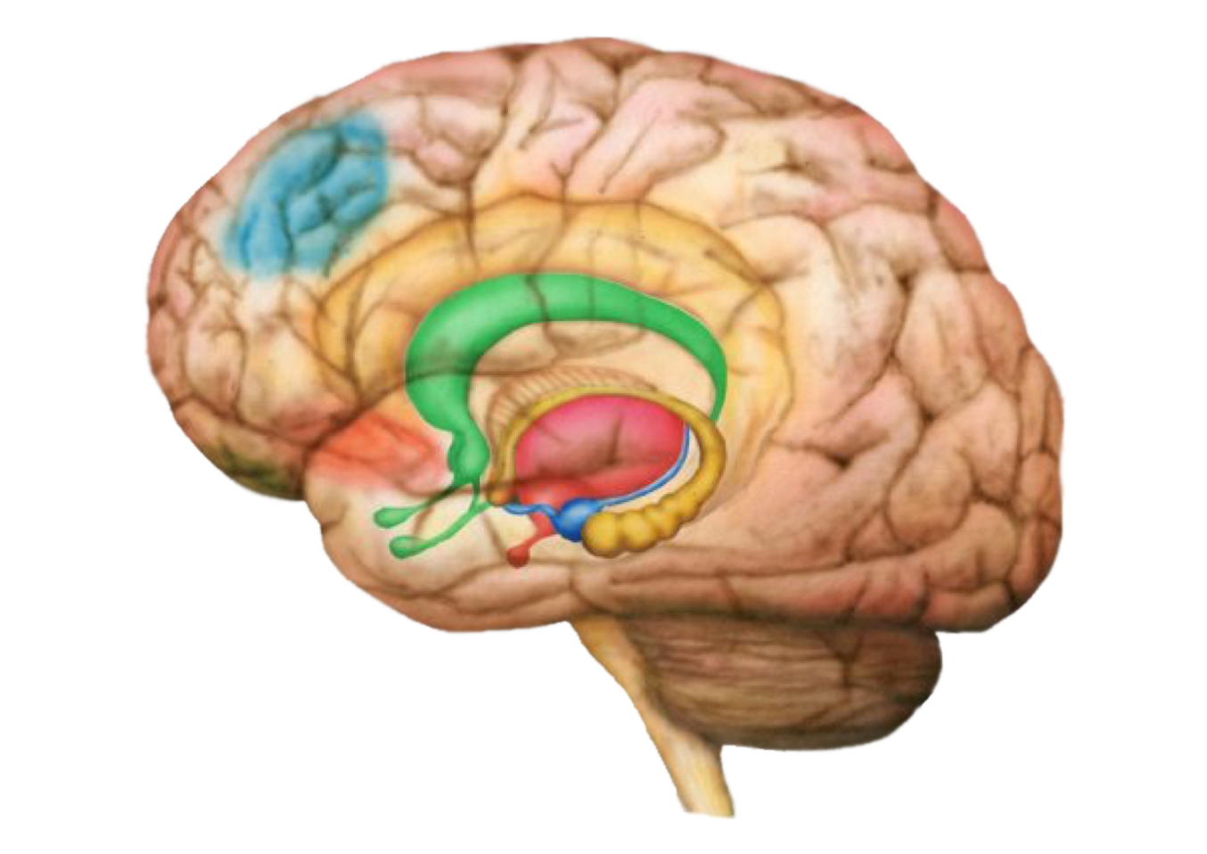
TELEVISION IMPACT ON THE BRAIN
Illustration by Simon Harrison

Slide 44
TELEVISION AND VIOLENCE
Television introduced into Canada and U.S. in 1945
Television introduced in South Africa 1974
Centerwall, B. S. “Television and Violence.” Journal of the American Medical Association 267 (1992): 3059-3063.

Slide 45
CHANGE IN MURDER RATE U.S., CANADA & SOUTH AFRICA (1945 – 1974)
140
93%
(1945-1974)
TV 1945
92%
(1945-1974)
TV 1945
120
100
Change in Murder Rate (%)
80
60
-7%
(1945-1974)
No TV
40
20
United States
Canada
South Africa
Centerwall, B.S., Journal of the American Medical Association 267 (1992): 3059-3063.

Slide 46
CHANGE IN MURDER RATE AFTER THE INTRODUCTION OF TELEVISION U.S., CANADA & SOUTH AFRICA (1945 – 1974)
130%
(1974-1987)
140
120
93%
(1945-1974)
92%
(1945-1974)
Change in Murder Rate (%)
100
80
60
40
20
United States
Canada
South Africa
Centerwall, B.S., Journal of the American Medical Association 267 (1992): 3059-3063.

Slide 47
TV AND ATTENTION
2007 Dr. Zimmerman and Christakis
Violent theatrical programming
Non-violent theatrical programming
Educational programming
Findings:
Theatrical programming, violent or non-violent caused attention problems, educational programming did not

Slide 48
MEDIA EXPOSURE AND DISASTER
Exposure to television coverage predicts fear of terrorism ¹
Social media posts focus on fear and negative sentiment (51%) and misleading information (60%) ²
Higher social media exposure associated with higher psychological distress ³
Higher television exposure in children associated with higher rates of PTSD ⁴
1.NellisAM, Savage j. (2012). Does watching the news affect fear of terrorism? The importance of media exposure on terrorism fear. Crime and Delinquency, 58. 2.Seltzer EK, et al. (2017). Public sentiment and discourse about Zikavirus on Instagram. Public Health, 150. 3.Goodwin R, et al. (2015). Association between media use, acute stress disorder, and psychological distress. Psycotherapyand Psychosomatics, 84. 4.Pfefferbaum, et al. (2008). Media coverage and children’s reactions to disaster with implications for primary care and public health. J Ok State Med Assoc, 101.

Slide 49
SECTION IV SPIRITUAL FACTORS

Slide 50
GOD CONSTRUCT CHANGES BRAIN
DLPFC
ACC
VMPFC
Orbital PFC
Pituitary
Hypothalmus
Hippocampus
Amygdala
Newberg, A. How God Changes Our Brain. Ballantine Books, New York. 2009: p.49.
Illustration by Simon Harrison

Slide 51
ALTRUISM
Youth who volunteer experienced greater
Academic achievement, civic responsibility, and life skills that include leadership and interpersonal self-confidence¹

Slide 52
HOW HEALTHY SPIRITUALITY HELPS REDUCE RISK MENTAL ILLNESS
Activates PFC and ACC, calms amygdala, lowers inflammatory response resulting in improved mental and physical health
Altruistic activities result in better mental and physical health
Reduced anxiety and worry
Healthier lifestyle so reduced oxidative stressors
Healthier relationships lower stress

Slide 53
SUMMARY
The brain is highly complex susceptible to change
Environment causes marked changes in brain development
Environment alters gene expression which is passed down through the generations

