Slide 1
Timothy R. Jennings, MD DLFAPA
Medical Director, Honey Lake Clinic
Past-President, TN & Southern Psychiatric Associations
Author:
Could It Be This Simple? A Biblical Model for Healing the Mind
The God-Shaped Brain: How Changing Your View of God Transforms Your Life
The Remedy New Testament Expanded Paraphrase
The God-Shaped Heart: How Correctly Understanding God’s Love Transforms Us
The Aging Brain: Proven Steps to Prevent Dementia and Sharpen Your Mind
The Remedy of the Lord in Song: The Psalms
May 7, 2025

Slide 2
Revelation 1:1
“The revelation of Jesus Christ, which God gave him to show his servants what must soon take place.”

Slide 3
Revelation 14:6-11
A Three Step Message
Must correctly understand the first message in order to comprehend the second
Must correctly understand the first and second messages in order to comprehend the third

Slide 4

Revelation 14:6-7
I saw another angel flying in midair, and he had the eternal gospel to proclaim to those who live on the earth—to every nation, tribe, language and people. He said in a loud voice, ‘Fear God and give him glory, because the hour of his judgment has come. Worship him who made the heavens, the earth, the sea and the springs of water.’

Slide 5
Eternal Gospel
Jesus said, “this gospel of the kingdom will be preached in the whole world as a testimony to all nations, and then the end will come” (Matthew 24:14).

Slide 6
Eternal Gospel
If the church has been sharing the gospel since Jesus’ ascension, why hasn’t the end come and why did Jesus prophesy that the final message of mercy starts with the eternal gospel?
Is it possible the gospel got lost in religion?
What is the eternal gospel?

Slide 7
The Final Message of Mercy
Starts with the Eternal Gospel
What is the Good News that has been true, eternally true; true in eternity past and future?
What is the news that the universe has doubted but is foundational to life, health, and happiness?
What is the news that dispels the lies of Satan and wins us back to trust in God?
What is the central target of Satan’s lies, upon which his rebellion has been built, and thus, the eternal good news that Satan is wrong?

Slide 8
What Is The Good News the World Needs
in Order to Win the War?
For though we live in the world, we do not wage war as the world does. The weapons we fight with are not the weapons of the world. On the contrary, they have divine power to demolish strongholds. We demolish arguments and every pretension that sets itself up against the knowledge of God, and we take captive every thought to make it obedient to Christ. 2Cor 10:3-5

Slide 9
The Eternal Good News
Is the Truth About God
“God is love” 1John 4:8
God is not the person Satan alleges
The eternal good news is what Jesus revealed ”Anyone who has seen me, has seen the Father” John 14:9
Life eternal is knowing God John 17:3
If we don’t understand the good news about God, we will misunderstand everything else!

Slide 10
And What Determines How We Understand God’s Character?
How we understand God’s law!
How do you understand God’s law?
God is Creator—He builds reality, space, time, matter, energy, life—and His laws are the laws upon which reality functions: Design Laws!
And God’s design law is an expression of His character of love!

Slide 11
The Bible Defines God’s Law As
The Law Of Love
The entire law is summed up in a single command: “Love your neighbor as yourself.” ﻿(Galatians 5:14)

Slide 12
The Bible Defines God’s Law As
The Law Of Love
The entire law is summed up in a single command: “Love your neighbor as yourself.” ﻿Galatians 5:14
Jesus replied: “‘Love the Lord your God with all your heart and with all your soul and with all your mind.’ This is the first and greatest commandment. And the second is like it: ‘Love your neighbor as yourself.’ All the Law and the Prophets hang on these two commandments.” Matthew 12:37-40

Slide 13
God Is Love & His Law Is Love
God as Designer built His universe to operate in harmony with His nature of love.

Slide 14
God Is Love & His Law Is Love
God as Designer built His universe to operate in harmony with His nature of love.
Romans 1:20 – God’s divine nature is seen in what he has made…

Slide 15
God Is Love & His Law Is Love
God as Designer built His universe to operate in harmony with His nature of love.
Romans 1:20 – God’s divine nature is seen in what he has made…
Every breath we take…

Slide 16
Something Changed In Christianity – What?

Slide 17
Something Changed In Christianity – What?
How we understand God’s law and therefore God.
Angels and humans cannot create reality.
We make up rules and call them laws, but our rules require external enforcement—Imposed Law.
Christianity exchanged the truth of God’s Design Law for Roman Imposed Law and this changed how we view God from a being of love to a cosmic enforcer.

Slide 18
EUSEBIUS
FIRST CHURCH HISTORIAN (263-339 CE)
“With the Roman Empire monarchy had come on earth as the image of the monarchy in heaven.”
S.L. Greenslade, Church and State from Constantine to Theodosius,
London: SCM Press, 1954.

Slide 19
Daniel 7:25
“He will speak against the Most High and oppress his saints and try to change the set times and the laws”

Slide 20
How Did The Idea Of God’s Law Change?
Imperialism—God’s design law was replaced with the idea that it functions no differently than human law—imposed rules.
Why doesn’t a church committee vote that on bad pollution days its members are not required to breathe?
What does it mean if a church committee votes to change God’s law?
That they no longer view it as design law!

Slide 21
An End-Time Plea
Many Reformers have embraced the 3 Angels Messages as end-time warnings for the world to get ready to meet Jesus
But they have presented the messages through the Roman Imposed Law View
We present these messages through the Creator Design Law View

Slide 22
Daniel 7:21,22
I beheld, and the same horn made war with the saints, and prevailed against them; until the Ancient of days came, and judgment was given to the saints of the most High; and the time came that the saints possessed the kingdom. KJV

Slide 23
Daniel 7:21,22
I beheld, and the same horn made war with the saints, and prevailed against them; until the Ancient of days came, and judgment was given to the saints of the most High; and the time came that the saints possessed the kingdom. KJV
What does this mean?

Slide 24
What Law Lens?

Slide 25
What Law Lens?
Imposed law—judgment means a judicial process by the ruling authority

Slide 26
What Law Lens?
Imposed law—judgment means a judicial process by the ruling authority
Design law—judgment is given, or imparted to the saints, meaning discernment, wisdom, understanding to decide

Slide 27
Revelation 14:6-7
I saw another angel flying in midair, and he had the eternal gospel to proclaim to those who live on the earth—to every nation, tribe, language and people. He said in a loud voice, ‘Fear God and give him glory, because the hour of his judgment has come. Worship him who made the heavens, the earth, the sea and the springs of water.’

Slide 28
The Four Judgments

Slide 29
First Judgment
Imagine that your spouse believes a lie that you have had an affair and has moved out. If you want him or her back, what will you have to do?
Who is on trial? Who is being judged?

Slide 30
First Judgment
“Let God be true but every man a liar. As it is written: ‘That You may be justified in Your words, And may overcome when You are judged.’” Romans 3:4 NKJV
“God must be true, even though every human being is a liar. As the scripture says, ’You must be shown to be right when you speak; you must win your case when you are being tried.’” Romans 3:4 GNB

Slide 31
First Judgment
Satan lied about God.
Adam and Eve judged wrongly and broke trust with God.
Humanity has been called to make this judgment over and over again:
  Joshua: “Choose for yourselves this day whom you will serve… as for me and my household, we will serve the LORD” Joshua 24:15
  Elijah” “If the LORD is God, follow him; but if Baal is God, follow him” 1Kings 18:21
Jesus revealed the truth about God.
We must judge: Is God like Satan says—or is God like Jesus revealed?
This judgment of ours determines whether we choose to trust God and open our hearts or not.

Slide 32
Second Judgment
“‘Then suddenly the Lord you are seeking will come to his temple; the messenger of the covenant, whom you desire, will come,’ says the Lord Almighty. But who can endure the day of his coming? Who can stand when he appears? For he will be like a refiner’s fire or a launderer’s soap. He will sit as a refiner and purifier of silver; he will purify the Levites and refine them like gold and silver. Then the Lord will have men who will bring offerings in righteousness, and the offerings of Judah and Jerusalem will be acceptable to the Lord, as in days gone by, as in former years. ‘So I will come near to you for judgment.’” Malachi 3:1–5

Slide 33
Second Judgment
This is the Judgment of the Great Physician, diagnosing what is wrong and determining the best therapeutic intervention.
  God bringing “judgments” upon rebellious people throughout history to alert, to convict, to redeem, to protect, to redirect, and to keep open the avenue for Messiah (Flood, Sodom, captivity).
Jesus’ work in the heavenly sanctuary to determine (judge):
  Who has trusted Him and given Him access to their hearts
  What residual elements of sin remain to be removed in order to perfect them for the resurrection and second coming (Cleansing His Bride—which=two become one, at-one-ment).
  But this only happens in the hearts of those who have first judged God to be trustworthy!

Slide 34
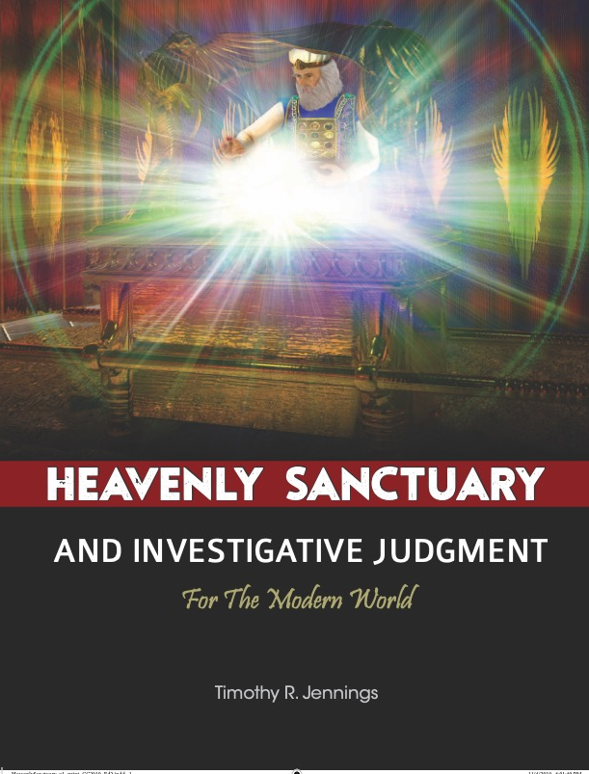
For More

Slide 35

For More

Slide 36
Third Judgment
“I saw thrones on which were seated those who had been given authority to judge. And I saw the souls of those who had been beheaded because of their testimony for Jesus and because of the word of God. They had not worshiped the beast or his image and had not received his mark on their foreheads or their hands. They came to life and reigned with Christ a thousand years.” Revelation 20:4–6
“Do you not know that we will judge angels?” 1 Corinthians 6:3
During the 1,000 years, the saints review the history of what transpired and the lives of the lost and of angels, so that no doubt is left in any mind as to why the unrepentant are not in heaven.

Slide 37
Fourth Judgment
“I saw a great white throne and him who was seated on it. … And I saw the dead, great and small, standing before the throne, and books were opened. Another book was opened, which is the book of life. The dead were judged according to what they had done as recorded in the books.” Revelation 20:11, 12
And what is recorded in the books of heaven?
The “names” of people and in Scripture what do names represent?
Character!

Slide 38
Fourth Judgment
“Make a tree good and its fruit will be good, or make a tree bad and its fruit will be bad, for a tree is recognized by its fruit. You brood of vipers, how can you who are evil say anything good? For out of the overflow of the heart the mouth speaks. The good man brings good things out of the good stored up in him, and the evil man brings evil things out of the evil stored up in him. But I tell you that men will have to give account on the day of judgment for every careless word they have spoken. For by your words you will be acquitted, and by your words you will be condemned.” Matthew 12:33–37 NIV84
What is being described?
  Character—the actual condition of each heart, a diagnosis of what actually is.

Slide 39
Fourth Judgment
The end of the 1,000 years, when:
    New Jerusalem gates are open and no one comes in.
    The wicked acknowledge they were wrong and God was right—but they attack the city anyway.
    They then experience the fire of unveiled truth, cry for the mountains to fall upon them, reaping what they have sown: eternal non-existence.
    And all the saved judge that God could have done nothing more to save them.
    There is no human law court determining guilt or innocence and imposing punishments—that is Satan’s lie.

Slide 40
Judgment
Imposed law: Be afraid and obey the right rules because God is holding his tribunal to determine guilt and punishment

Slide 41
Judgment
Imposed law: Be afraid and obey the right rules because God is holding his tribunal to determine guilt and punishment
Design law: Be in awe of God and trust Him to heal you for you are dying of a terminal condition, then be His witness, reveal the glory of His character and methods of love to others for the time in human history has come for people to make a right judgment about God and worship the Creator, Him who made…

Slide 42
Revelation 14:6-7
I saw another angel flying in midair, and he had the eternal gospel to proclaim to those who live on the earth—to every nation, tribe, language and people. He said in a loud voice, ‘Fear God and give him glory, because the hour of his judgment has come. Worship him who made the heavens, the earth, the sea and the springs of water.’

Slide 43
The War
Satan is the father of lies

Slide 44
The War
Satan is the father of lies
He has lied about God by misrepresenting God’s law to be like human law—imposed rules

Slide 45
The War
Satan is the father of lies
He has lied about God by misrepresenting God’s law to be like human law—imposed rules
Christianity accepted the lie and many now worship a god who functions like a sinful dictator—the source of inflicted punishment

Slide 46
The War
Satan is the father of lies
He has lied about God by misrepresenting God’s law to be like human law—imposed rules
Christianity accepted the lie and many now worship a god who functions like a sinful dictator—the source of inflicted punishment
Thus Jesus has sent the 3 Angels’ Messages to present the truth about Him and call them out of the false system that intoxicates the world

Slide 47

Revelation 14:8
A second angel followed and said, ‘Fallen! Fallen is Babylon the Great, which made all the nations drink the maddening wine of her adulteries.’

Slide 48
Beastly Intoxication
The “maddening wine” is the lies about God that the entire world accepts —especially that God’s laws are imposed and God functions as enforcer and source of inflicted pain, suffering, and death.

Slide 49
Come Out of Babylon
Of all the nations in the Bible story arc that warred against Israel—
Babylon is the first to create a legal code—the Code of Hammurabi
We are called to leave the imposed law systems of this world and return to worship Him who made the heavens….

Slide 50
Revelation 14:9
Once we understand the Eternal Gospel and Worship God as Creator and Understand His law as Design Law
Once we have left the Imposed Law system of Babylon
Then we are ready

Slide 51

Revelation 14:9
A third angel followed them and said in a loud voice: “If anyone worships the beast and his image and receives his mark on the forehead or on the hand…

Slide 52
Revelation 14:10
he, too, will drink of the wine of God’s fury, which has been poured full strength into the cup of his wrath. He will be tormented with burning sulfur in the presence of the holy angels and of the Lamb…

Slide 53
Revelation 14:11
And the smoke of their torment rises for ever and ever. There is no rest day or night for those who worship the beast and his image, or for anyone who receives the mark of his name.”

Slide 54
What Did You Hear?
Good News?
Righteousness by faith?
A God of love?
What law lens are you reading it through?
Do you see God’s design law at work?
Do you see God describing reality, His character and methods of truth, love, and liberty?

Slide 55
Revelation 14:9
A third angel followed them and said in a loud voice: “If anyone worships the beast and his image and receives his mark on the forehead or on the hand…

Slide 56
Law of Worship
By beholding we are changed. 2Corinthians 3:18
They followed worthless idols and became worthless themselves. Jeremiah 2:5
Romans 1:18-32 rejecting the truth about God darkens minds
“Let us fix our eyes on Jesus, the author and perfecter of our faith.” Hebrews 12:2
“We know that when he appears, we shall be like him, for we shall see him as he is.” 1John 3:2
Which requires we reject the imperial view of God with the human law construct and worship the Creator.

Slide 57
Law of Worship
If you worship the dictator you mark yourself in character (forehead) or behavior (hand) to be beastly

Slide 58
Revelation 14:10
he, too, will drink of the wine of God’s fury, which has been poured full strength into the cup of his wrath.
What does this mean?
What is God’s wrath?

Slide 59
Romans 1:18, 24, 26, 28
For the wrath of God is revealed from heaven against all ungodliness and unrighteousness of men, who by their unrighteousness suppress the truth (v. 18 ESV).
“God gave them up…” (vs. 24,26,28).

Slide 60
Law of Liberty
If you choose Satan’s version of an imperial god who uses beastly methods of coercion and mark yourself in character and deed to be beastly then God leaves you free. He stops interceding to protect you from your choice and this is know as God’s wrath.

Slide 61
From the Bible Commentary:
Hard Sayings of the Bible
“The human condition, which Paul describes in Romans 1:18-32, is not something caused by God. The phrase “revealed from heaven” (where “heaven” is a typical Jewish substitute word for “God”) does not depict some kind of divine intervention, but rather the inevitability of human debasement which results when God’s will, built into the created order, is violated….

Slide 62
Hard Sayings of the Bible
Since the created order has its origin in God, Paul can say that the wrath of God is now (constantly) being revealed “from heaven.” It is revealed in the fact that the rejection of God’s truth (Rom 1:18-20), that is, the truth about God’s nature and will, leads to futile thinking (Rom 1:21-22), idolatry (Rom 1:23), perversion of God-intended sexuality (Rom 1:24-27) and relational-moral brokenness (Rom 1:28-32)…

Slide 63
Hard Sayings of the Bible
The expression “God gave them over” (or “handed them over”), which appears three times in this passage (Rom 1:24,26,28), supports the idea that the sinful perversion of human existence, though resulting from human decisions, is to be understood ultimately as God’s punishment which we, in freedom, bring upon ourselves…

Slide 64
Hard Sayings of the Bible
In light of these reflections, the common notion that God punishes or blesses in direct proportion to our sinful or good deeds cannot be maintained… God loves us with an everlasting love. But the rejection of that love separates us from its life-giving power. The result is disintegration and death.” p. 543

Slide 65
Revelation 14:9
A third angel followed them and said in a loud voice: “If anyone worships the beast and his image and receives his mark on the forehead or on the hand…
The Law of Worship

Slide 66
Revelation 14:10
he, too, will drink of the wine of God’s fury, which has been poured full strength into the cup of his wrath.
The Law of Liberty

Slide 67
Revelation 14:10
He will be tormented with burning sulfur in the presence of the holy angels and of the Lamb…
What Law?

Slide 68
What is the Truth about the Consuming Fire?
  That Is Consistent With Scripture,
  And
  Harmonizes With The Laws Of Love And Liberty?
  “The sinners in Zion are terrified; trembling grips the godless: ‘Who of us can dwell with the consuming fire? Who of us can dwell with the everlasting burning?’” Isaiah 33:14

Slide 69
Who Dwells in the Consuming Fire?
He who walks righteously and speaks what is right, who rejects gain from extortion and keeps his hand from accepting bribes, who stops his ears against plots of murder and shuts his eyes against contemplating evil Isaiah 33:15

Slide 70
Evidence From Scripture
  Moses and the bush Exodus 3:2
  Sinai Exodus 24:17
  Solomon’s Temple Dedication 2Chronicles 7:2
  Lucifer amongst fiery stones Ezekiel 28:14,16
  Ancient of days & rivers of fire Daniel 7:9,10
  Our God is a consuming fire Hebrews 12:29
  New Jerusalem Revelation 22:5

Slide 71
The Lie of Satan?
The place you don’t want to go is the place of eternal burning and consuming fire but that place is GOD’S VERY PRESENCE!
The righteous are transformed – like Moses’ face after 40 days radiated God’s glory Exodus 34:29-35
But the people shrank back – why?
The wicked are destroyed by the brightness of Christ’s coming 2 Thessalonians 2:8

Slide 72
A Fire That Destroys the Wicked, but Heals the Righteous?
It is a fire that consumes sin.
And what is sin made out of?
Lies and selfishness
What consumes a lie?
TRUTH!
What consumes selfishness?
LOVE!

Slide 73
The Holy Spirit is the Spirit of:
Truth & Love John 16:13, 1John 4:8, Galatians 5:22

Slide 74
The Holy Spirit is the Spirit of:
Truth & Love John 16:13, 1John 4:8, Galatians 5:22
At Pentecost the Spirit fell and they saw – two streams of fire – the fire of truth and love – but no one got burned, the building didn’t catch on fire. Acts 2:3

Slide 75
Further Evidence
Aaron’s sons Nadab and Abihu… offered unauthorized fire before the Lord... So fire came out from the presence of the Lord and consumed them, and they died before the Lord…Moses summoned [their cousins], and said to them, “Come here; carry your cousins outside the camp…” So they came and carried them, still in their tunics, outside the camp, as Moses ordered. Leviticus 10:1-5

Slide 76
What Happens to Those Solidified In Lies and Selfishness When they Come Into Unveiled Love and Truth?

Slide 77
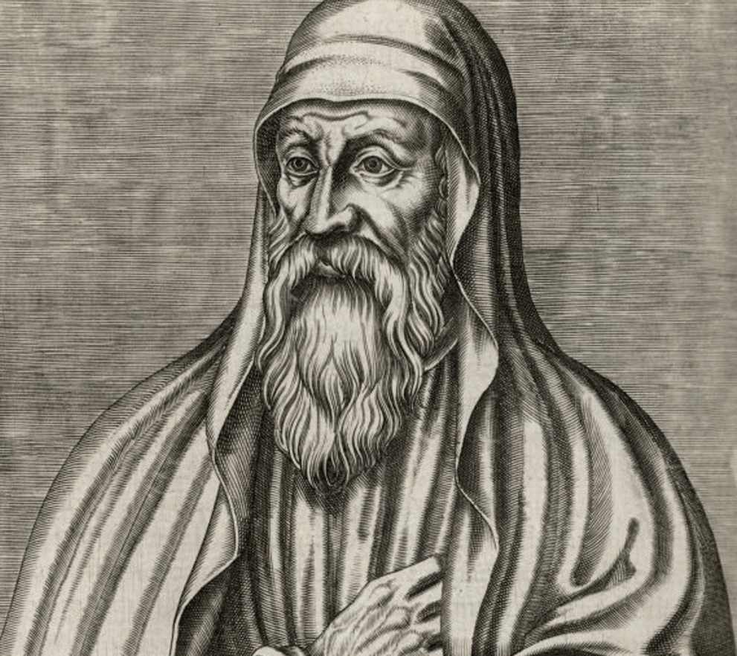
Origen of Alexandria
“Scripture indicates that every sinner kindles for himself the flame of his own fire, and is not plunged into a fire which has been previously kindled by someone else or which existed before him.”
Origen on First Principles, translated by Butterworth, p. 141

Slide 78
Lucifer’s End
By your many sins and dishonest trade you have desecrated your sanctuaries. So I made a fire come out from you, and it consumed you… Ezekiel 28:18

Slide 79
Revelation 14:10
He will be tormented with burning sulfur in the presence of the holy angels and of the Lamb…

Slide 80
What About Revelation 14?
The word translated brimstone or sulfurous fire is the Greek word “thion” which is a form of the word thios which means divine, Godhead, divinity.
Therefore, the word translated brimstone should more accurately be translated “divine incense” or “holy fire” because it is the fire of God’s presence!

Slide 81
Revelation 14:10
He will be tormented with burning sulfur [thion– truth and love] in the presence of the holy angels and of the Lamb…

Slide 82
Revelation 14:11
And the smoke of their torment rises for ever and ever. There is no rest day or night for those who worship the beast and his image, or for anyone who receives the mark of his name.”

Slide 83
What About the Smoke?
Smoke is what remains after something is burned, thus it is symbolic of the memory of what happened to them, how unremedied sin caused such suffering and torment and ultimate destruction. This will never be forgotten.

Slide 84
The Design Laws of God
The law of worship: worship the beast and become beastly
The law of liberty: God sets you free (wrath) to reap what you have chosen
The laws of truth and love: are the unveiled life-giving glory of God’s truth and love when it burns free over the planet again

Slide 85
Where Do We Find Ourselves Now?

Slide 86
Where Do We Find Ourselves Now?
In a war between two versions of God and His law:

Slide 87
Where Do We Find Ourselves Now?
In a war between two versions of God and His law:
A god who is like Satan alleges – arbitrary, imposes rules, requires legal payments and is the source of inflicted punishment and death

Slide 88
Where Do We Find Ourselves Now?
In a war between two versions of God and His law:
A god who is like Satan alleges – arbitrary, imposes rules, requires legal payments and is the source of inflicted punishment and death
The God Jesus revealed, who is Love, and who created reality to operate only in harmony with Himself. The God who gave His life to heal!

Slide 89
Where Do We Find Ourselves Now?
People are settling into one of the two views

Slide 90
Where Do We Find Ourselves Now?
People are settling into one of the two views
Those who love God and others more than self – such that they would give their lives for others

Slide 91
Where Do We Find Ourselves Now?
People are settling into one of the two views
Those who love God and others more than self – such that they would give their lives for others
  These are they who do not love their lives so much as to shrink from death. Revelation 12:11

Slide 92
Where Do We Find Ourselves Now?
People are settling into one of the two views
Those who love God and others more than self – such that they would give their lives for others
  These are they who do not love their lives so much as to shrink from death. Revelation 12:11
  The Sealed of God

Slide 93
Where Do We Find Ourselves Now?
Or those who solidify in selfishness:
  either believing in the beastly methods of coercion – thus marked in their foreheads, or

Slide 94
Where Do We Find Ourselves Now?
Or those who solidify in selfishness:
  either believing in the beastly methods of coercion – thus marked in their foreheads, or
  practicing the beastly methods of coercion – thus marked in their hands.

Slide 95
God Is Waiting For A People To Be Settled Into The Truth About Him
Rev 7:1-3

Slide 96
The Final Message
Is the truth about God as Creator whose character is love and whose laws are design laws. (First Angel)
Is the message of freedom, calling people from the enslavement of the beastly imperial view of God (Second Angel)
Is the message of reality and warning for those who insist on rejecting the first two messages: the laws of worship, liberty, love and truth and the ultimate destruction that unremedied sin brings. (Third Angel)

Slide 97
You Must Judge
Is God the kind of being Jesus revealed—our Designer who seeks to heal and save us from our terminal sin condition?
OR
Is God the kind of being Satan alleges—imposer of law who will inflict pain and suffering on all those who don’t propitiate him with the blood of a human sacrifice?

Slide 98
Whom You Will Serve?

Slide 99
Whom You Will Serve?
The Choice Is Yours!

Slide 100
Questions

