Slide 2
The Old Testament Sanctuary: Decoding the Secret Meaning
Timothy R. Jennings, MD, DFAPA
Past-President, TN Psychiatric Association
Past-President, Southern Psychiatric Association
Author: Could It Be This Simple? A Biblical Model for Healing the Mind
The God-Shaped Brain: How Changing Your View of God Transforms Your Life
The Journal of the Watcher
The Remedy New Testament Expanded Paraphrase
The God-Shaped Heart: How Correctly Understanding God’s Love Transforms Us
The Aging Brain: Proven Steps to Prevent Dementia and Sharpen Your Mind
May 13, 2018

Slide 3
All Bible Metaphor Point to One Reality
Parables
Illustrations
Metaphors
Object Lessons
Rituals
Similes
God’s character and methods of Love and His plan to heal and restore His universe.
➔

Slide 4
If there is no Reality to which a metaphor points,
Then it is no longer metaphor.
It is Fantasy!

Slide 5
There is not one element in the Old Testament sanctuary which is to be taken literally.

Slide 6
There is not one element in the Old Testament sanctuary which is to be taken literally.
It is all symbolic, pointing to a larger reality!

Slide 7
There is not one element in the Old Testament sanctuary which is to be taken literally.
It is all symbolic, pointing to a larger reality!
In order to understand it, we must decode it.

Slide 8
E = mc ²
?

Slide 9
E = mc ²
?
Eternal life = taking Mass at Church 2 times/week?

Slide 10
E = mc ²
?
Energy = Mass times the Speed of Light squared

Slide 11
E = mc ²
?
If you don’t understand the symbols,
then the equation is meaningless!

Slide 12
E = mc ²
?
What’s worse than not understanding the symbols?

Slide 13
E = mc ²
Attributing a false meaning to them!
Notes:
Eternal Life is when you take mass at church twice

Slide 14
E = mc ²
?
Attributing a false meaning to them,
because then we still don’t know the truth, but we think we do, so we no longer search for the truth!

Slide 15
The Sanctuary Has Been Terribly Misunderstood

Slide 16
The Sanctuary Has Been Terribly Misunderstood
Contributing to gross distortions about God, His character and methods and the plan of salvation, which has…

Slide 17
The Sanctuary Has Been Terribly Misunderstood
Contributing to gross distortions about God, His character and methods and the plan of salvation, which has…kept millions trapped in a distorted belief system, with no power to heal and transform.

Slide 18
Christian Radio Easter 2016: What is the Meaning of the OT Sacrifices?

Slide 19
Christian Radio Easter 2016: What is the Meaning of the OT Sacrifices?
Blood represents life and there has to be the punishment of death for sin, so therefore an animal had to take the punishment and give its life — its blood — so that the offeror could live. That was the substitution. What my former professor… used to call, the exchange of life… The animal dies, the person lives. And so that’s the reason for the Old Testament sacrifice for atonement. First Theologian
Chris Fabry Live Radio Show March 23, 2016, Moody Broadcasting
The second hour beginning at minute 12:25, guests quoted Michael Vanlaningham and Michael Rydelink.

Slide 20
Christian Radio Easter 2016: What is the Meaning of the OT Sacrifices?
In the Old Testament, the death of an animal was required to take care of the human sin problem and now we have not the death of an animal, but of the very Son of God, who dies for us. And so His loss of blood is the thing whereby He succumbed on our behalf. Second Theologian
Chris Fabry Live Radio Show March 23, 2016, Moody Broadcasting
The second hour beginning at minute 12:25, guests quoted Michael Vanlaningham and Michael Rydelink.

Slide 21
Their Answers are Predicated on the False Law Construct: The Lie that God’s Law Functions Like Human Laws

Slide 22
Their Answers are Predicated on the False Law Construct: The Lie that God’s Law Functions Like Human Laws
The gifts and sacrifices being offered were not able to clear the conscience of the worshiper. They are only a matter of food and drink and various ceremonial washings—external regulations applying until the time of the new order… But those sacrifices are an annual reminder of sins, because it is impossible for the blood of bulls and goats to take away sins.
Heb 9:9.10, 10:3,4

Slide 23
Animal Sacrifices Were NEVER Able to Take Away Sin—God Told Them This!

Slide 24
Animal Sacrifices Were NEVER Able to Take Away Sin—God Told Them This!
“The multitude of your sacrifices— what are they to me?” says the Lord. “I have more than enough of burnt offerings, of rams and the fat of fattened animals; I have no pleasure in the blood of bulls and lambs and goats… wash and make yourselves clean. Take your evil deeds out of my sight! Stop doing wrong, learn to do right! Seek justice, encourage the oppressed. Defend the cause of the fatherless, plead the case of the widow.”
Isa 1:11,16,17

Slide 25
Animal Sacrifices Were NEVER Able to Take Away Sin—God Told Them This!
“I want your constant love, not your animal sacrifices. I would rather have my people know me than burn offerings to me.”
Hos 6:6 GNT

Slide 26
If Animal Sacrifices Could Not Cleanse From Sin, Then What Was The Purpose?

Slide 27
If Animal Sacrifices Could Not Cleanse From Sin, Then What Was The Purpose?
Theater—drama—to engage the sinner in activities designed to teach and transform.

Slide 28
If Animal Sacrifices Could Not Cleanse From Sin, Then What Was The Purpose?
Theater—drama—to engage the sinner in activities designed to teach and transform.
Consider what it would have been like for you to, after you have sinned, confess that sin on the head of your pet and kill your pet?

Slide 29
The Great Stage Play

Slide 30
The Great Stage Play
The entire Levitical system was a drama, a play, an acted out production—a little theater.

Slide 31
The Great Stage Play
The entire Levitical system was a drama, a play, an acted out production—a little theater.
The system was given to a group of uneducated former slaves.

Slide 32
The Great Stage Play
The entire Levitical system was a drama, a play, an acted out production—a little theater.
The system was given to a group of uneducated former slaves
So, on a grand scale, God directed them through Moses, to build a very impressive stage (sanctuary/temple), intricate costumes, expensive props, and provided them with a very detailed script.

Slide 33
The Great Stage Play
The children of Israel were the cast—the acting troupe, to act out in recurring yearly cycles God’s plan to heal and save humanity, God’s plan to recreate human beings back to his original ideal.

Slide 34
The Great Stage Play
The children of Israel were the cast—the acting troupe, to act out in recurring yearly cycles God’s plan to heal and save humanity, God’s plan to recreate human beings back to his original ideal.
“It seems to me that God has put us who bear his Message on stage in a theater in which no one wants to buy a ticket.” 1Cor 4:9, The Message

Slide 35
Salvation Was NOT Dependent on Acting in the Play

Slide 36
Salvation Was NOT Dependent on Acting in the Play
Did not have to be a member of the acting troupe (Israel) to be saved.

Slide 37
Salvation Was NOT Dependent on Acting in the Play
Did not have to be a member of the acting troupe (Israel) to be saved.
To be saved one only had to experience the reality to which the enactment was pointing.

Slide 38
Salvation Was NOT Dependent on Acting in the Play
Did not have to be a member of the acting troupe (Israel) to be saved.
To be saved one only had to experience the reality to which the enactment was pointing.
Naaman, Melchezidek, Jethro, the widow who sheltered Elijah—all saved, yet none participated in the Levitical system.

Slide 39
Salvation Was NOT Dependent on Acting in the Play
A person could join the troupe and become part of the cast if they desired—Ruth & Rahab.

Slide 40
Salvation Was NOT Dependent on Acting in the Play
A person could join the troupe and become part of the cast if they desired—Ruth & Rahab.
But once a member of the cast (part of Israel), they were expected to follow the script.

Slide 41
Salvation Was NOT Dependent on Acting in the Play
A person could join the troupe and become part of the cast if they desired—Ruth & Rahab.
But once a member of the cast (part of Israel), they were expected to follow the script.
If a cast member refused to follow the script, or should we say the Script-ure, they were removed from stage.

Slide 42
Salvation Was NOT Dependent on Acting in the Play
What does a director on Broadway do if an actor refuses to stay on script?

Slide 43
Salvation Was NOT Dependent on Acting in the Play
What does a director on Broadway do if an actor refuses to stay on script?
This is what God did to many in the OT, but this doesn’t mean a person was eternally lost—consider Hagar, Ishmael, Esau

Slide 44
Salvation Was NOT Dependent on Acting in the Play
What does a director on Broadway do if an actor refuses to stay on script?
This is what God did to many in the OT, but this doesn’t mean a person was eternally lost—consider Hagar, Ishmael, Esau
The actors (Israelites) got so far off script at one point that God shut the entire play down (70 year captivity)—yet people were still being saved without acting in the play (Daniel)

Slide 45
Salvation Was NOT Dependent on Acting in the Play
Eventually they rebuilt their stage and began reenacting the play (end of 70 year captivity).

Slide 46
Salvation Was NOT Dependent on Acting in the Play
Eventually they rebuilt their stage and began reenacting the play (end of 70 year captivity).
But some didn’t return home and participate in the play (Mordecai/Esther), yet God didn’t abandon them. Why?

Slide 47
Salvation Was NOT Dependent on Acting in the Play
Eventually they rebuilt their stage and began reenacting the play (end of 70 year captivity).
But some didn’t return home and participate in the play (Mordecai/Esther), yet God didn’t abandon them. Why?
Because God is not concerned with theater, symbols, and metaphor. God is concerned with the reality to which it all points!

Slide 48
Salvation Was NOT Dependent on Acting in the Play
They became so consumed with following the letter of the Script that they failed to comprehend reality, and when Jesus (reality) came, they rejected and killed Him.

Slide 49
Salvation Was NOT Dependent on Acting in the Play
They became so consumed with following the letter of the Script that they failed to comprehend reality, and when Jesus (reality) came, they rejected and killed Him.
So God had the stage torn down again and began directing new helpers to take the reality, which Christ achieved, to the world.

Slide 50
Consider the Black Death (1346-1353)

Slide 51
Consider the Black Death (1346-1353)
They think it is punishment from God.

Slide 52
Consider the Black Death (1346-1353)
They think it is punishment from God.
It is a bacterial infection carried by fleas.

Slide 53
Consider the Black Death (1346-1353)
They think it is punishment from God.
It is a bacterial infection carried by fleas.
If you had an antibiotic that could cure, how could you educate the people to watch for symptoms and take the medicine when needed?

Slide 54
Consider the Black Death (1346-1353)
They think it is punishment from God.
It is a bacterial infection carried by fleas.
If you had an antibiotic that could, cure how could you educate the people to watch for symptoms and take the medicine when needed?
Would flyers, pamphlets, and posters work?

Slide 55
Consider the Black Death (1346-1353)
They think it is punishment from God.
It is a bacterial infection carried by fleas,
If you had an antibiotic that could, cure how could you educate the people to watch for symptoms and take the medicine when needed?
Would flyers, pamphlets, and posters work?
What about a little play?

Slide 56
Theme
Humanity is separated from God by sin and God is working through Christ to bring humanity back into unity with himself, by restoring in our hearts his character of love.

Slide 57
The Camp

Slide 58
The Camp
God at Center

Slide 59
The Camp
God at Center
People separated from God

Slide 60
The Camp
God at Center
People separated from God
Levites in between

Slide 61
The Camp
God at Center
People separated from God
Levites in between
Sinners from the 4 corners of the earth are called back to God by the priesthood of believers

Slide 62
Moses

Slide 63
Moses
Represents Christ in Pre-incarnate form

Slide 64
Moses
Represents Christ in Pre-incarnate form
Spoke to God then confronted the ruler holding the people in slavery, set them free and built the sanctuary

Slide 65
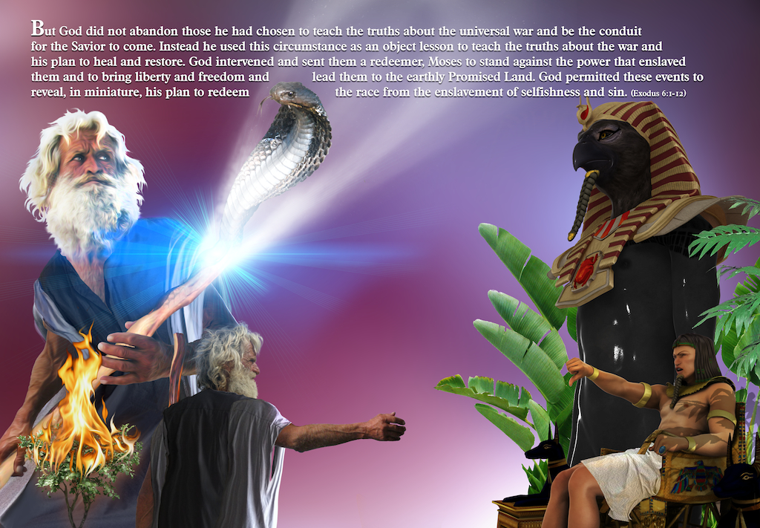
Moses
Jesus spoke with God, left to confront the ruler who held humanity captive, set us free and built the true sanctuary

Slide 66
Zechariah 6:12-13
Tell him this is what the Lord Almighty says: ‘Here is the man whose name is the Branch, and he will branch out from his place and build the temple of the Lord. It is he who will build the temple of the Lord, and he will be clothed with majesty and will sit and rule on his throne. And he will be a priest on his throne. And there will be harmony between the two.’

Slide 67
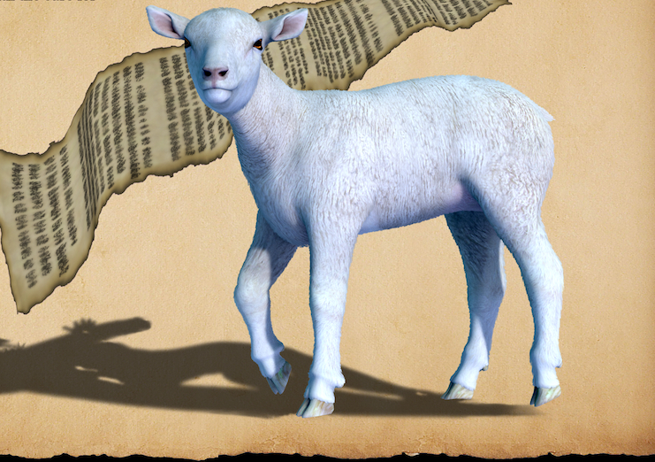
The Lamb

Slide 68
The Lamb
Jesus as human on earth

Slide 69
The Lamb
Jesus as human on earth
“The lamb of God who takes away the sin of the world.” Jn 1:29

Slide 70
High Priest

Slide 71
High Priest
Jesus after His victory on Earth and ascension to heaven

Slide 72
High Priest
Jesus after His victory on Earth and ascension to heaven
“Therefore, since we have a great high priest who has gone through the heavens, Jesus the Son of God…” Heb 4:14

Slide 73
The Court

Slide 74
The Court
What is the lesson being taught?

Slide 75
The Court
What is the lesson being taught?
What law lens do you use?

Slide 76
The Court
What is the lesson being taught?
What law lens do you use?
What is the problem sin caused that the plan of salvation is designed to fix?

Slide 77
The Court
When man sinned, did God get changed?

Slide 78
The Court
When man sinned, did God get changed?
Did God’s law get changed?

Slide 79
The Court
When man sinned, did God get changed?
Did God’s law get changed?
Did humankind get changed?

Slide 80
The Court
When man sinned, did God get changed?
Did God’s law get changed?
Did humankind get changed?
Do we interpret the symbols to fix man or to do something to God or God’s law?

Slide 81
The Bronze Altar
Notes:
Additionally the inner fat of the sacrificial animal, the fat hidden within the animal around the organs, was removed and burned on the brazen altar. This represents the work of Christ in taking our sinful condition upon Himself and destroying the infection of fear and selfishness at the Cross. He did this when he was tempted to save self, but didn’t give in to those temptations. Christ was tempted in every way just as we are, yet without sin. (Heb 4:15). And we are tempted by our own evil desires (James 1:14). In other words, we have temptations that come from within. And Jesus was tempted like us. In Gethsemane he experienced powerful human emotions to act to save self—but Jesus instead of giving in to such selfish temptation, instead gave self in love. “No one takes my life away from me. I give it up of my own free will.” (Jn 10:18 GNT) By this choice to love, with his human brain, despite the temptation to act in self-interest, Jesus destroyed the infection of fear and selfishness and restored God’s law of love into humanity. This is symbolized by the cutting away and burning the fat of the inner organs.
Throughout Scripture the burning of the fat is described as a “pleasing aroma” to the Lord. (Lev 4:31, 17:6, Num 18:17) Now we can understand why. It is symbolic of the burning away of the carnal nature, the selfish desires, the infection of sin within God’s children. If your child was dying of leukemia and was given chemotherapy and the chemo burned away the cancer cells saving your child, would you be pleased? God is immensely pleased when sinfulness is burned out of the hearts, minds and characters of his earthly children!
The horns of the brazen altar represent the power of sin in our lives, the defects of character that are in need of removal and transformation by the work of God through Christ in our lives—represented by the application of the blood to the horns. “To the arrogant I say, `Boast no more,' and to the wicked, `Do not lift up your horns. Do not lift your horns against heaven; do not speak with outstretched neck.' " (Ps 75:4,5)
The fire in the altar represents God the Holy Spirit. Before the blood was applied to the altar the fire represented the working of Holy Spirit to bring conviction and draw sinners to conversion. And after the blood was applied, the fire represented the Holy Spirit working in the new convert to bring transformation, consume the desires and motives of carnal nature and regenerate to a Christlike heart.
As God said immediately after Adam and Eve sinned, “And I will put enmity between you and the woman, and between your offspring and hers.” (Gen 3:15) The Holy Spirit began working in the hearts and minds of sinners to convict of sin and draw us back to himself. And when the truth is presented the Holy Spirit is there to enlighten and sink it home in the heart: "Were not our hearts burning within us while he talked with us on the road and opened the Scriptures to us?" (Luke 24:32) And when we respond to the truth and open the heart in truth, the Holy Spirit is there to burn out defects of character and create God-shaped hearts of love: “They saw what seemed to be tongues of fire that separated and came to rest on each of them. All of them were filled with the Holy Spirit and began to speak in other tongues as the Spirit enabled them.” (Acts 2:3,4)

Slide 82
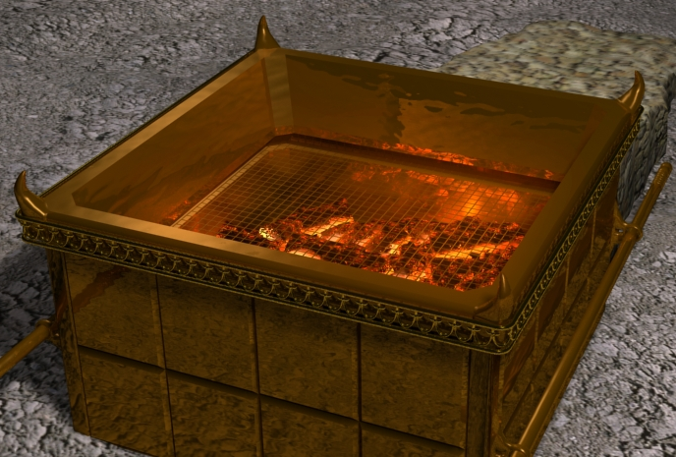
The Bronze Altar
Shittam (Acacia tree) wood covered in bronze, an impure metal (an impure heart—terminal)
Notes:
Additionally the inner fat of the sacrificial animal, the fat hidden within the animal around the organs, was removed and burned on the brazen altar. This represents the work of Christ in taking our sinful condition upon Himself and destroying the infection of fear and selfishness at the Cross. He did this when he was tempted to save self, but didn’t give in to those temptations. Christ was tempted in every way just as we are, yet without sin. (Heb 4:15). And we are tempted by our own evil desires (James 1:14). In other words, we have temptations that come from within. And Jesus was tempted like us. In Gethsemane he experienced powerful human emotions to act to save self—but Jesus instead of giving in to such selfish temptation, instead gave self in love. “No one takes my life away from me. I give it up of my own free will.” (Jn 10:18 GNT) By this choice to love, with his human brain, despite the temptation to act in self-interest, Jesus destroyed the infection of fear and selfishness and restored God’s law of love into humanity. This is symbolized by the cutting away and burning the fat of the inner organs.
Throughout Scripture the burning of the fat is described as a “pleasing aroma” to the Lord. (Lev 4:31, 17:6, Num 18:17) Now we can understand why. It is symbolic of the burning away of the carnal nature, the selfish desires, the infection of sin within God’s children. If your child was dying of leukemia and was given chemotherapy and the chemo burned away the cancer cells saving your child, would you be pleased? God is immensely pleased when sinfulness is burned out of the hearts, minds and characters of his earthly children!
The horns of the brazen altar represent the power of sin in our lives, the defects of character that are in need of removal and transformation by the work of God through Christ in our lives—represented by the application of the blood to the horns. “To the arrogant I say, `Boast no more,' and to the wicked, `Do not lift up your horns. Do not lift your horns against heaven; do not speak with outstretched neck.' " (Ps 75:4,5)
The fire in the altar represents God the Holy Spirit. Before the blood was applied to the altar the fire represented the working of Holy Spirit to bring conviction and draw sinners to conversion. And after the blood was applied, the fire represented the Holy Spirit working in the new convert to bring transformation, consume the desires and motives of carnal nature and regenerate to a Christlike heart.
As God said immediately after Adam and Eve sinned, “And I will put enmity between you and the woman, and between your offspring and hers.” (Gen 3:15) The Holy Spirit began working in the hearts and minds of sinners to convict of sin and draw us back to himself. And when the truth is presented the Holy Spirit is there to enlighten and sink it home in the heart: "Were not our hearts burning within us while he talked with us on the road and opened the Scriptures to us?" (Luke 24:32) And when we respond to the truth and open the heart in truth, the Holy Spirit is there to burn out defects of character and create God-shaped hearts of love: “They saw what seemed to be tongues of fire that separated and came to rest on each of them. All of them were filled with the Holy Spirit and began to speak in other tongues as the Spirit enabled them.” (Acts 2:3,4)

Slide 83
The Bronze Altar
Shittam (Acacia tree) wood covered in bronze, an impure metal (an impure heart)
Starting point in salvation
Notes:
Additionally the inner fat of the sacrificial animal, the fat hidden within the animal around the organs, was removed and burned on the brazen altar. This represents the work of Christ in taking our sinful condition upon Himself and destroying the infection of fear and selfishness at the Cross. He did this when he was tempted to save self, but didn’t give in to those temptations. Christ was tempted in every way just as we are, yet without sin. (Heb 4:15). And we are tempted by our own evil desires (James 1:14). In other words, we have temptations that come from within. And Jesus was tempted like us. In Gethsemane he experienced powerful human emotions to act to save self—but Jesus instead of giving in to such selfish temptation, instead gave self in love. “No one takes my life away from me. I give it up of my own free will.” (Jn 10:18 GNT) By this choice to love, with his human brain, despite the temptation to act in self-interest, Jesus destroyed the infection of fear and selfishness and restored God’s law of love into humanity. This is symbolized by the cutting away and burning the fat of the inner organs.
Throughout Scripture the burning of the fat is described as a “pleasing aroma” to the Lord. (Lev 4:31, 17:6, Num 18:17) Now we can understand why. It is symbolic of the burning away of the carnal nature, the selfish desires, the infection of sin within God’s children. If your child was dying of leukemia and was given chemotherapy and the chemo burned away the cancer cells saving your child, would you be pleased? God is immensely pleased when sinfulness is burned out of the hearts, minds and characters of his earthly children!
The horns of the brazen altar represent the power of sin in our lives, the defects of character that are in need of removal and transformation by the work of God through Christ in our lives—represented by the application of the blood to the horns. “To the arrogant I say, `Boast no more,' and to the wicked, `Do not lift up your horns. Do not lift your horns against heaven; do not speak with outstretched neck.' " (Ps 75:4,5)
The fire in the altar represents God the Holy Spirit. Before the blood was applied to the altar the fire represented the working of Holy Spirit to bring conviction and draw sinners to conversion. And after the blood was applied, the fire represented the Holy Spirit working in the new convert to bring transformation, consume the desires and motives of carnal nature and regenerate to a Christlike heart.
As God said immediately after Adam and Eve sinned, “And I will put enmity between you and the woman, and between your offspring and hers.” (Gen 3:15) The Holy Spirit began working in the hearts and minds of sinners to convict of sin and draw us back to himself. And when the truth is presented the Holy Spirit is there to enlighten and sink it home in the heart: "Were not our hearts burning within us while he talked with us on the road and opened the Scriptures to us?" (Luke 24:32) And when we respond to the truth and open the heart in truth, the Holy Spirit is there to burn out defects of character and create God-shaped hearts of love: “They saw what seemed to be tongues of fire that separated and came to rest on each of them. All of them were filled with the Holy Spirit and began to speak in other tongues as the Spirit enabled them.” (Acts 2:3,4)

Slide 84
The Bronze Altar
Shittam (Acacia tree) wood covered in bronze, an impure metal (an impure heart)
Starting point in salvation
Blood at base then horns
Notes:
Additionally the inner fat of the sacrificial animal, the fat hidden within the animal around the organs, was removed and burned on the brazen altar. This represents the work of Christ in taking our sinful condition upon Himself and destroying the infection of fear and selfishness at the Cross. He did this when he was tempted to save self, but didn’t give in to those temptations. Christ was tempted in every way just as we are, yet without sin. (Heb 4:15). And we are tempted by our own evil desires (James 1:14). In other words, we have temptations that come from within. And Jesus was tempted like us. In Gethsemane he experienced powerful human emotions to act to save self—but Jesus instead of giving in to such selfish temptation, instead gave self in love. “No one takes my life away from me. I give it up of my own free will.” (Jn 10:18 GNT) By this choice to love, with his human brain, despite the temptation to act in self-interest, Jesus destroyed the infection of fear and selfishness and restored God’s law of love into humanity. This is symbolized by the cutting away and burning the fat of the inner organs.
Throughout Scripture the burning of the fat is described as a “pleasing aroma” to the Lord. (Lev 4:31, 17:6, Num 18:17) Now we can understand why. It is symbolic of the burning away of the carnal nature, the selfish desires, the infection of sin within God’s children. If your child was dying of leukemia and was given chemotherapy and the chemo burned away the cancer cells saving your child, would you be pleased? God is immensely pleased when sinfulness is burned out of the hearts, minds and characters of his earthly children!
The horns of the brazen altar represent the power of sin in our lives, the defects of character that are in need of removal and transformation by the work of God through Christ in our lives—represented by the application of the blood to the horns. “To the arrogant I say, `Boast no more,' and to the wicked, `Do not lift up your horns. Do not lift your horns against heaven; do not speak with outstretched neck.' " (Ps 75:4,5)
The fire in the altar represents God the Holy Spirit. Before the blood was applied to the altar the fire represented the working of Holy Spirit to bring conviction and draw sinners to conversion. And after the blood was applied, the fire represented the Holy Spirit working in the new convert to bring transformation, consume the desires and motives of carnal nature and regenerate to a Christlike heart.
As God said immediately after Adam and Eve sinned, “And I will put enmity between you and the woman, and between your offspring and hers.” (Gen 3:15) The Holy Spirit began working in the hearts and minds of sinners to convict of sin and draw us back to himself. And when the truth is presented the Holy Spirit is there to enlighten and sink it home in the heart: "Were not our hearts burning within us while he talked with us on the road and opened the Scriptures to us?" (Luke 24:32) And when we respond to the truth and open the heart in truth, the Holy Spirit is there to burn out defects of character and create God-shaped hearts of love: “They saw what seemed to be tongues of fire that separated and came to rest on each of them. All of them were filled with the Holy Spirit and began to speak in other tongues as the Spirit enabled them.” (Acts 2:3,4)

Slide 85
The Bronze Altar
Shittam (Acacia tree) wood covered in bronze, an impure metal (an impure heart)
Starting point in salvation
Blood at base then horns
Horns defects of character
Notes:
Additionally the inner fat of the sacrificial animal, the fat hidden within the animal around the organs, was removed and burned on the brazen altar. This represents the work of Christ in taking our sinful condition upon Himself and destroying the infection of fear and selfishness at the Cross. He did this when he was tempted to save self, but didn’t give in to those temptations. Christ was tempted in every way just as we are, yet without sin. (Heb 4:15). And we are tempted by our own evil desires (James 1:14). In other words, we have temptations that come from within. And Jesus was tempted like us. In Gethsemane he experienced powerful human emotions to act to save self—but Jesus instead of giving in to such selfish temptation, instead gave self in love. “No one takes my life away from me. I give it up of my own free will.” (Jn 10:18 GNT) By this choice to love, with his human brain, despite the temptation to act in self-interest, Jesus destroyed the infection of fear and selfishness and restored God’s law of love into humanity. This is symbolized by the cutting away and burning the fat of the inner organs.
Throughout Scripture the burning of the fat is described as a “pleasing aroma” to the Lord. (Lev 4:31, 17:6, Num 18:17) Now we can understand why. It is symbolic of the burning away of the carnal nature, the selfish desires, the infection of sin within God’s children. If your child was dying of leukemia and was given chemotherapy and the chemo burned away the cancer cells saving your child, would you be pleased? God is immensely pleased when sinfulness is burned out of the hearts, minds and characters of his earthly children!
The horns of the brazen altar represent the power of sin in our lives, the defects of character that are in need of removal and transformation by the work of God through Christ in our lives—represented by the application of the blood to the horns. “To the arrogant I say, `Boast no more,' and to the wicked, `Do not lift up your horns. Do not lift your horns against heaven; do not speak with outstretched neck.' " (Ps 75:4,5)
The fire in the altar represents God the Holy Spirit. Before the blood was applied to the altar the fire represented the working of Holy Spirit to bring conviction and draw sinners to conversion. And after the blood was applied, the fire represented the Holy Spirit working in the new convert to bring transformation, consume the desires and motives of carnal nature and regenerate to a Christlike heart.
As God said immediately after Adam and Eve sinned, “And I will put enmity between you and the woman, and between your offspring and hers.” (Gen 3:15) The Holy Spirit began working in the hearts and minds of sinners to convict of sin and draw us back to himself. And when the truth is presented the Holy Spirit is there to enlighten and sink it home in the heart: "Were not our hearts burning within us while he talked with us on the road and opened the Scriptures to us?" (Luke 24:32) And when we respond to the truth and open the heart in truth, the Holy Spirit is there to burn out defects of character and create God-shaped hearts of love: “They saw what seemed to be tongues of fire that separated and came to rest on each of them. All of them were filled with the Holy Spirit and began to speak in other tongues as the Spirit enabled them.” (Acts 2:3,4)

Slide 86
The Bronze Altar
“The sin of Judah is written with a pen of iron, and with the point of a diamond: it is graven upon the table of their heart, and upon the horns of your altars.” Jer 17:1
Notes:
Additionally the inner fat of the sacrificial animal, the fat hidden within the animal around the organs, was removed and burned on the brazen altar. This represents the work of Christ in taking our sinful condition upon Himself and destroying the infection of fear and selfishness at the Cross. He did this when he was tempted to save self, but didn’t give in to those temptations. Christ was tempted in every way just as we are, yet without sin. (Heb 4:15). And we are tempted by our own evil desires (James 1:14). In other words, we have temptations that come from within. And Jesus was tempted like us. In Gethsemane he experienced powerful human emotions to act to save self—but Jesus instead of giving in to such selfish temptation, instead gave self in love. “No one takes my life away from me. I give it up of my own free will.” (Jn 10:18 GNT) By this choice to love, with his human brain, despite the temptation to act in self-interest, Jesus destroyed the infection of fear and selfishness and restored God’s law of love into humanity. This is symbolized by the cutting away and burning the fat of the inner organs.
Throughout Scripture the burning of the fat is described as a “pleasing aroma” to the Lord. (Lev 4:31, 17:6, Num 18:17) Now we can understand why. It is symbolic of the burning away of the carnal nature, the selfish desires, the infection of sin within God’s children. If your child was dying of leukemia and was given chemotherapy and the chemo burned away the cancer cells saving your child, would you be pleased? God is immensely pleased when sinfulness is burned out of the hearts, minds and characters of his earthly children!
The horns of the brazen altar represent the power of sin in our lives, the defects of character that are in need of removal and transformation by the work of God through Christ in our lives—represented by the application of the blood to the horns. “To the arrogant I say, `Boast no more,' and to the wicked, `Do not lift up your horns. Do not lift your horns against heaven; do not speak with outstretched neck.' " (Ps 75:4,5)
The fire in the altar represents God the Holy Spirit. Before the blood was applied to the altar the fire represented the working of Holy Spirit to bring conviction and draw sinners to conversion. And after the blood was applied, the fire represented the Holy Spirit working in the new convert to bring transformation, consume the desires and motives of carnal nature and regenerate to a Christlike heart.
As God said immediately after Adam and Eve sinned, “And I will put enmity between you and the woman, and between your offspring and hers.” (Gen 3:15) The Holy Spirit began working in the hearts and minds of sinners to convict of sin and draw us back to himself. And when the truth is presented the Holy Spirit is there to enlighten and sink it home in the heart: "Were not our hearts burning within us while he talked with us on the road and opened the Scriptures to us?" (Luke 24:32) And when we respond to the truth and open the heart in truth, the Holy Spirit is there to burn out defects of character and create God-shaped hearts of love: “They saw what seemed to be tongues of fire that separated and came to rest on each of them. All of them were filled with the Holy Spirit and began to speak in other tongues as the Spirit enabled them.” (Acts 2:3,4)

Slide 87
The Bronze Altar
Inner fat removed and burned (Christ’s victory in destroying the infection of fear and selfishness—Gethsemane/Cross)
Notes:
Additionally the inner fat of the sacrificial animal, the fat hidden within the animal around the organs, was removed and burned on the brazen altar. This represents the work of Christ in taking our sinful condition upon Himself and destroying the infection of fear and selfishness at the Cross. He did this when he was tempted to save self, but didn’t give in to those temptations. Christ was tempted in every way just as we are, yet without sin. (Heb 4:15). And we are tempted by our own evil desires (James 1:14). In other words, we have temptations that come from within. And Jesus was tempted like us. In Gethsemane he experienced powerful human emotions to act to save self—but Jesus instead of giving in to such selfish temptation, instead gave self in love. “No one takes my life away from me. I give it up of my own free will.” (Jn 10:18 GNT) By this choice to love, with his human brain, despite the temptation to act in self-interest, Jesus destroyed the infection of fear and selfishness and restored God’s law of love into humanity. This is symbolized by the cutting away and burning the fat of the inner organs.
Throughout Scripture the burning of the fat is described as a “pleasing aroma” to the Lord. (Lev 4:31, 17:6, Num 18:17) Now we can understand why. It is symbolic of the burning away of the carnal nature, the selfish desires, the infection of sin within God’s children. If your child was dying of leukemia and was given chemotherapy and the chemo burned away the cancer cells saving your child, would you be pleased? God is immensely pleased when sinfulness is burned out of the hearts, minds and characters of his earthly children!
The horns of the brazen altar represent the power of sin in our lives, the defects of character that are in need of removal and transformation by the work of God through Christ in our lives—represented by the application of the blood to the horns. “To the arrogant I say, `Boast no more,' and to the wicked, `Do not lift up your horns. Do not lift your horns against heaven; do not speak with outstretched neck.' " (Ps 75:4,5)
The fire in the altar represents God the Holy Spirit. Before the blood was applied to the altar the fire represented the working of Holy Spirit to bring conviction and draw sinners to conversion. And after the blood was applied, the fire represented the Holy Spirit working in the new convert to bring transformation, consume the desires and motives of carnal nature and regenerate to a Christlike heart.
As God said immediately after Adam and Eve sinned, “And I will put enmity between you and the woman, and between your offspring and hers.” (Gen 3:15) The Holy Spirit began working in the hearts and minds of sinners to convict of sin and draw us back to himself. And when the truth is presented the Holy Spirit is there to enlighten and sink it home in the heart: "Were not our hearts burning within us while he talked with us on the road and opened the Scriptures to us?" (Luke 24:32) And when we respond to the truth and open the heart in truth, the Holy Spirit is there to burn out defects of character and create God-shaped hearts of love: “They saw what seemed to be tongues of fire that separated and came to rest on each of them. All of them were filled with the Holy Spirit and began to speak in other tongues as the Spirit enabled them.” (Acts 2:3,4)

Slide 88
The Bronze Altar
Inner fat removed and burned (Christ’s victory in destroying the infection of fear and selfishness—Gethsemane/Cross)
Pleasing aroma—the destruction of sin is pleasing to God
Notes:
Additionally the inner fat of the sacrificial animal, the fat hidden within the animal around the organs, was removed and burned on the brazen altar. This represents the work of Christ in taking our sinful condition upon Himself and destroying the infection of fear and selfishness at the Cross. He did this when he was tempted to save self, but didn’t give in to those temptations. Christ was tempted in every way just as we are, yet without sin. (Heb 4:15). And we are tempted by our own evil desires (James 1:14). In other words, we have temptations that come from within. And Jesus was tempted like us. In Gethsemane he experienced powerful human emotions to act to save self—but Jesus instead of giving in to such selfish temptation, instead gave self in love. “No one takes my life away from me. I give it up of my own free will.” (Jn 10:18 GNT) By this choice to love, with his human brain, despite the temptation to act in self-interest, Jesus destroyed the infection of fear and selfishness and restored God’s law of love into humanity. This is symbolized by the cutting away and burning the fat of the inner organs.
Throughout Scripture the burning of the fat is described as a “pleasing aroma” to the Lord. (Lev 4:31, 17:6, Num 18:17) Now we can understand why. It is symbolic of the burning away of the carnal nature, the selfish desires, the infection of sin within God’s children. If your child was dying of leukemia and was given chemotherapy and the chemo burned away the cancer cells saving your child, would you be pleased? God is immensely pleased when sinfulness is burned out of the hearts, minds and characters of his earthly children!
The horns of the brazen altar represent the power of sin in our lives, the defects of character that are in need of removal and transformation by the work of God through Christ in our lives—represented by the application of the blood to the horns. “To the arrogant I say, `Boast no more,' and to the wicked, `Do not lift up your horns. Do not lift your horns against heaven; do not speak with outstretched neck.' " (Ps 75:4,5)
The fire in the altar represents God the Holy Spirit. Before the blood was applied to the altar the fire represented the working of Holy Spirit to bring conviction and draw sinners to conversion. And after the blood was applied, the fire represented the Holy Spirit working in the new convert to bring transformation, consume the desires and motives of carnal nature and regenerate to a Christlike heart.
As God said immediately after Adam and Eve sinned, “And I will put enmity between you and the woman, and between your offspring and hers.” (Gen 3:15) The Holy Spirit began working in the hearts and minds of sinners to convict of sin and draw us back to himself. And when the truth is presented the Holy Spirit is there to enlighten and sink it home in the heart: "Were not our hearts burning within us while he talked with us on the road and opened the Scriptures to us?" (Luke 24:32) And when we respond to the truth and open the heart in truth, the Holy Spirit is there to burn out defects of character and create God-shaped hearts of love: “They saw what seemed to be tongues of fire that separated and came to rest on each of them. All of them were filled with the Holy Spirit and began to speak in other tongues as the Spirit enabled them.” (Acts 2:3,4)

Slide 89
The Bronze Altar
Fire—Holy Spirit—before and after blood applied
Notes:
Additionally the inner fat of the sacrificial animal, the fat hidden within the animal around the organs, was removed and burned on the brazen altar. This represents the work of Christ in taking our sinful condition upon Himself and destroying the infection of fear and selfishness at the Cross. He did this when he was tempted to save self, but didn’t give in to those temptations. Christ was tempted in every way just as we are, yet without sin. (Heb 4:15). And we are tempted by our own evil desires (James 1:14). In other words, we have temptations that come from within. And Jesus was tempted like us. In Gethsemane he experienced powerful human emotions to act to save self—but Jesus instead of giving in to such selfish temptation, instead gave self in love. “No one takes my life away from me. I give it up of my own free will.” (Jn 10:18 GNT) By this choice to love, with his human brain, despite the temptation to act in self-interest, Jesus destroyed the infection of fear and selfishness and restored God’s law of love into humanity. This is symbolized by the cutting away and burning the fat of the inner organs.
Throughout Scripture the burning of the fat is described as a “pleasing aroma” to the Lord. (Lev 4:31, 17:6, Num 18:17) Now we can understand why. It is symbolic of the burning away of the carnal nature, the selfish desires, the infection of sin within God’s children. If your child was dying of leukemia and was given chemotherapy and the chemo burned away the cancer cells saving your child, would you be pleased? God is immensely pleased when sinfulness is burned out of the hearts, minds and characters of his earthly children!
The horns of the brazen altar represent the power of sin in our lives, the defects of character that are in need of removal and transformation by the work of God through Christ in our lives—represented by the application of the blood to the horns. “To the arrogant I say, `Boast no more,' and to the wicked, `Do not lift up your horns. Do not lift your horns against heaven; do not speak with outstretched neck.' " (Ps 75:4,5)
The fire in the altar represents God the Holy Spirit. Before the blood was applied to the altar the fire represented the working of Holy Spirit to bring conviction and draw sinners to conversion. And after the blood was applied, the fire represented the Holy Spirit working in the new convert to bring transformation, consume the desires and motives of carnal nature and regenerate to a Christlike heart.
As God said immediately after Adam and Eve sinned, “And I will put enmity between you and the woman, and between your offspring and hers.” (Gen 3:15) The Holy Spirit began working in the hearts and minds of sinners to convict of sin and draw us back to himself. And when the truth is presented the Holy Spirit is there to enlighten and sink it home in the heart: "Were not our hearts burning within us while he talked with us on the road and opened the Scriptures to us?" (Luke 24:32) And when we respond to the truth and open the heart in truth, the Holy Spirit is there to burn out defects of character and create God-shaped hearts of love: “They saw what seemed to be tongues of fire that separated and came to rest on each of them. All of them were filled with the Holy Spirit and began to speak in other tongues as the Spirit enabled them.” (Acts 2:3,4)

Slide 90
Laver

Slide 91
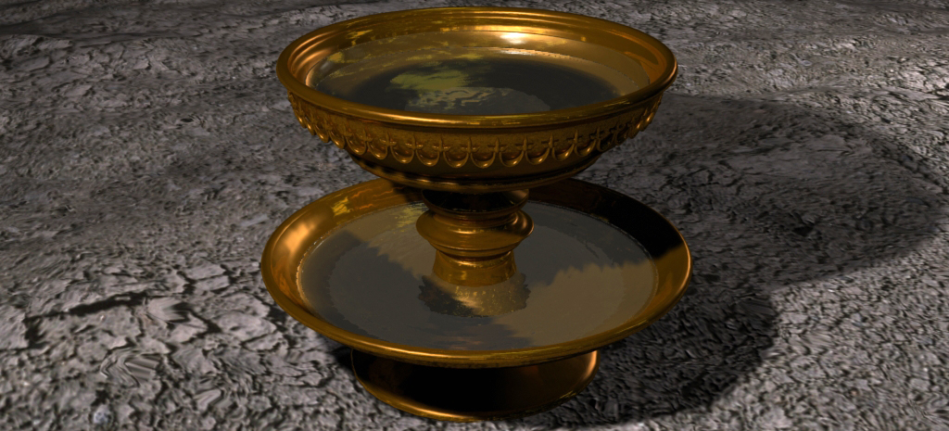
Laver
Washing of the HS

Slide 92
Laver
Washing of the HS
Built from mirrors, which represents the Word of God

Slide 93
Laver
Washing of the HS
Built from mirrors, which represents the Word of God
Only High Priest and daily priests washed in Laver and always before ministering in the sanctuary

Slide 94
Vessels Used to Carry the Blood

Slide 95
Vessels Used to Carry the Blood
Symbolic of God’s people on earth who carry the truth and love of Jesus to others.

Slide 96
Vessels Used to Carry the Blood
Symbolic of God’s people on earth who carry the truth and love of Jesus to others
The blood is life—the life of Christ and life is only carried in living beings!

Slide 97
Vessels Used to Carry the Blood
Symbolic of God’s people on earth who carry the truth and love of Jesus to others.
The blood is life—the life of Christ and life is only carried in living beings!
“But the Lord said unto him, Go thy way: for he [Paul] is a chosen vessel unto me, to bear my name before the Gentiles, and kings, and the children of Israel…” Acts 9:15

Slide 98
Daily Priests

Slide 99
Daily Priests
In white robes

Slide 100
Daily Priests
In white robes
Priesthood of believers with characters like Jesus

Slide 101
The Holy Place

Slide 102
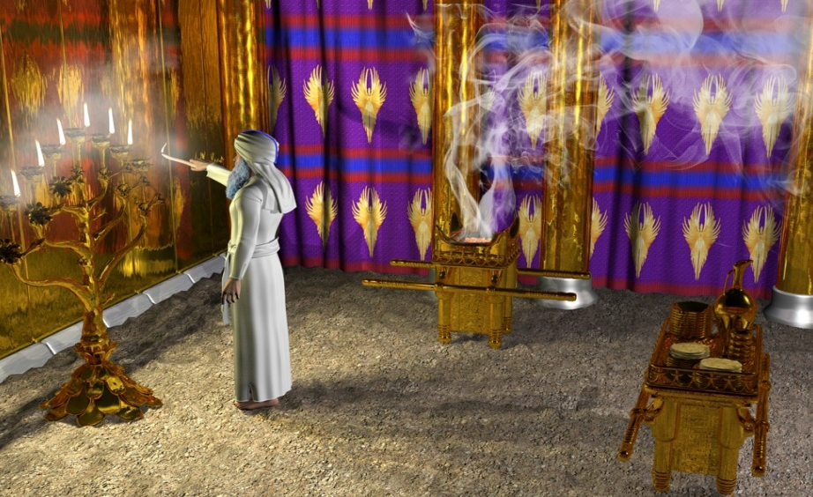
The Holy Place
Church golden in the love of Christ

Slide 103
The Holy Place
Church golden in the love of Christ
Door—Christ our way to the Father

Slide 104
The Holy Place
Church golden in the love of Christ
Door—Christ our way to the Father
Through door light of the lamp shone into the courtyard—through Christ the light of God shines into the world

Slide 105
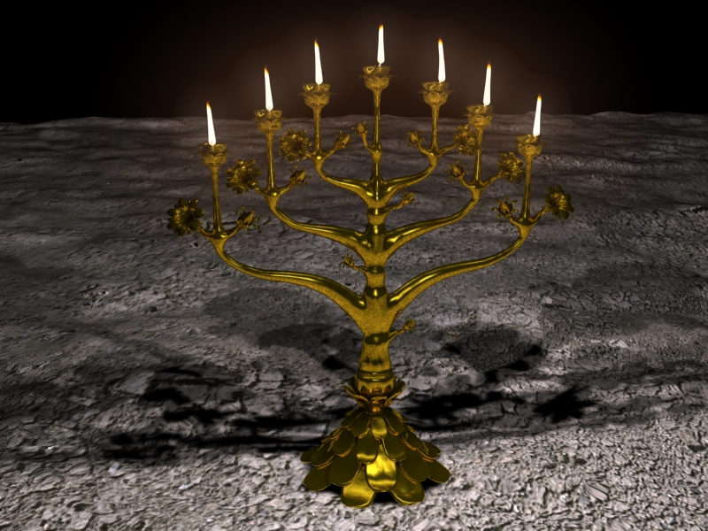
The Lampstand

Slide 106
The Lampstand
Word of God—living and written

Slide 107
The Lampstand
Word of God—living and written
Central stand—Christ

Slide 108
The Lampstand
Word of God—living and written
Central stand—Christ
Six branches mankind

Slide 109
The Lampstand
Word of God—living and written
Central stand—Christ
Six branches mankind
Connected with Christ=7 perfection

Slide 110
The Lampstand
Word of God—living and written
Central stand—Christ
Six branches mankind
Connected with Christ=7 perfection
We are healed and able to shine light only as we are connected with Christ

Slide 111
The Lampstand
Oil represents the HS

Slide 112
The Lampstand
Oil represents the HS
The bowls represent our hearts, where the word, enlightened by the Spirit, burns within

Slide 113
The Lampstand
Oil represents the HS
The bowls represent our hearts, where the word, enlightened by the Spirit, burns within
Only High Priest trimmed the wicks, evening and morning—Christ working in us to perfect us to shine more brightly

Slide 114
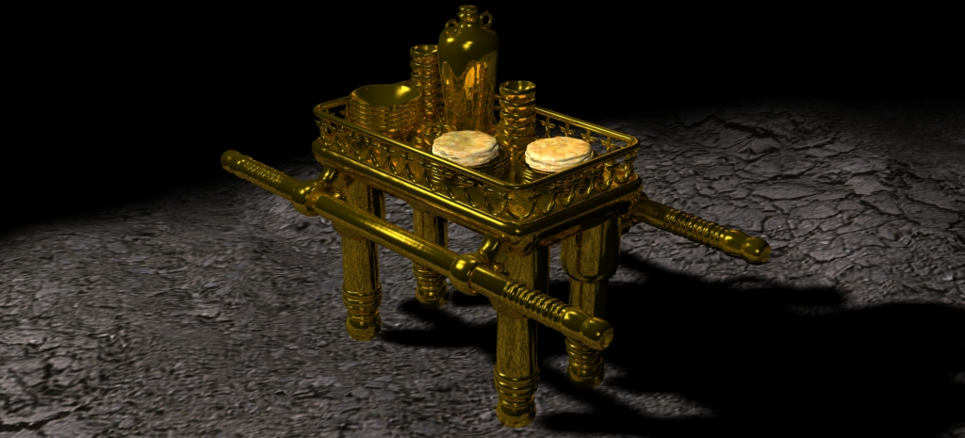
The Table

Slide 115
The Table
Wood covered in gold—Jesus our incarnate sinless God

Slide 116
The Table
Wood covered in gold—Jesus our incarnate sinless God
Border handbreadth high, only measure not in cubits

Slide 117
The Table
Wood covered in gold—Jesus our incarnate sinless God
Border handbreadth high, only measure not in cubits
12 loaves unleavened bread—Christ bread of life

Slide 118
The Table
Incense on top—sweetness of Christ

Slide 119
The Table
Incense on top—sweetness of Christ
Wine perfect character/ sinless life of Jesus

Slide 120
The Table
Incense on top—sweetness of Christ
Wine perfect character/ sinless life of Jesus
Every Sabbath daily priests and High Priest met in HP, burn incense and eat bread

Slide 121
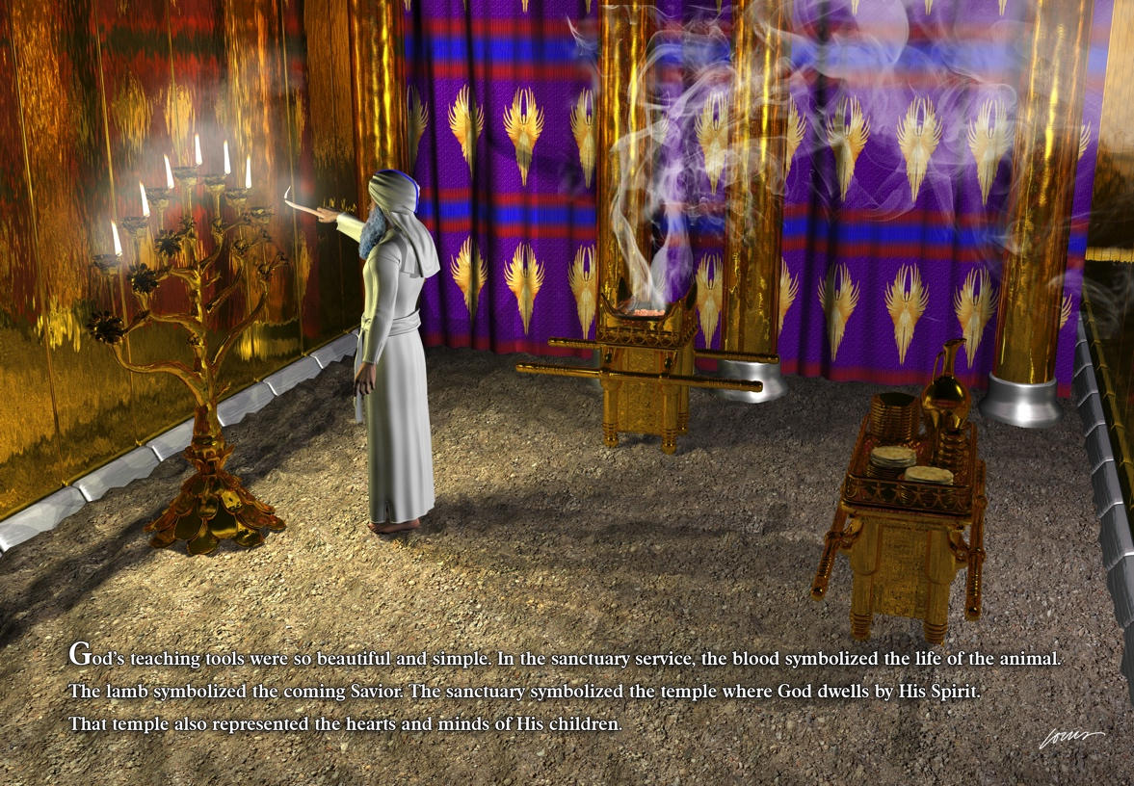
Golden Altar

Slide 122
Golden Altar
Hearts of the saved

Slide 123
Golden Altar
Hearts of the saved
Prayers offered from converted—incense burned

Slide 124
Golden Altar
Hearts of the saved
Prayers offered from converted—incense burned
Incense—Christ’s character lived out and wafted over camp drawing the unsaved

Slide 125
Golden Altar
“But thanks be to God, who always leads us in triumphal procession in Christ and through us spreads everywhere the fragrance of the knowledge of him. For we are to God the aroma of Christ among those who are being saved and those who are perishing.” 2Cor 2:14,15

Slide 126
Golden Altar
Fire the work of the HS in the heart

Slide 127
Golden Altar
Fire the work of the HS in the heart
Horns—smaller than on brazen altar, represent the vestigial defects of character being removed by the work of Christ

Slide 128
Golden Altar
Fire the work of the HS in the heart
Horns—smaller than on brazen altar, represent the vestigial defects of character being removed by the work of Christ
Golden crown represents the crown of victory (no crown on brazen altar, because the unconverted are not victorious)

Slide 129
The Curtain

Slide 130
The Curtain
If you were a priest worshipping in the temple and longed to see God more fully and looked toward the Most Holy Place, what would you see?

Slide 131
The Curtain
If you were a priest worshipping in the temple and longed to see God more fully and looked toward the Most Holy Place, what would you see?
Your approach to and view of God is obstructed by a veil

Slide 132
The Curtain
What happened to this veil?

Slide 133
The Curtain
What happened to this veil?
What does it represent?

Slide 134
The Curtain
What happened to this veil?
What does it represent?
Satan’s lies and our carnal nature

Slide 135
The Curtain
What happened to this veil?
What does it represent?
Satan’s lies and our carnal nature
Angels God’s agencies sent to help us battle with these two forces, but no angel could break the barrier and open the way

Slide 136
The Curtain
Jesus destroyed both the lies of Satan and our carnal nature and opened a new and living way back into God’s presence

Slide 137
The Curtain
“By his death he destroyed him who holds the power of death that is the devil.” Heb 2:14

Slide 138
The Curtain
“By his death he destroyed him who holds the power of death that is the devil.” Heb 2:14
By his death “he destroyed death and brought life and immortality to light…” 2Tim 1:10

Slide 139
The Curtain
“By his death he destroyed him who holds the power of death that is the devil.” Heb 2:14
By his death “he destroyed death and brought life and immortality to light…” 2Tim 1:10
“And so, dear brothers and sisters, we can boldly enter heaven’s Most Holy Place because of the blood of Jesus. By his death, Jesus opened a new and life-giving way through the curtain into the Most Holy Place.” Heb 10,19,20 NLT

Slide 140
The Curtain
“And even if our gospel is veiled, it is veiled to those who are perishing. The god of this age has blinded the minds of unbelievers, so that they cannot see the light of the gospel of the glory of Christ, who is the image of God.” 2 Cor 2:3,4

Slide 141
The Curtain
“And even if our gospel is veiled, it is veiled to those who are perishing. The god of this age has blinded the minds of unbelievers, so that they cannot see the light of the gospel of the glory of Christ, who is the image of God.” 2 Cor 2:3,4
If we make the veil Jesus body, rather than the assumed fallen nature and lies of Satan, then we have God killing Jesus at the Cross.

Slide 142
The Curtain
When we recognize the reality of what God was accomplishing through Jesus, and what obstructs us from God, then we realize God, through Jesus, destroyed death, Satan’s power, and Satan’s work.

Slide 143
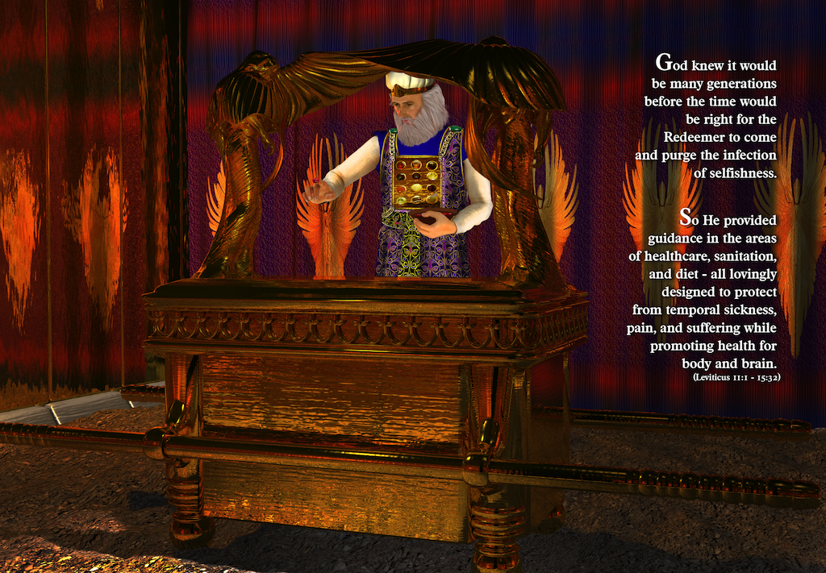
Most Holy Place

Slide 144
Most Holy Place
Universe cleansed of sin and reconciled back to oneness with God

Slide 145
Most Holy Place
Universe cleansed of sin and reconciled back to oneness with God
Shekinah—God

Slide 146
Most Holy Place
Universe cleansed of sin and reconciled back to oneness with God
Shekinah—God
Angels—unfallen beings

Slide 147
Most Holy Place
Universe cleansed of sin and reconciled back to oneness with God
Shekinah—God
Angels—unfallen beings
Lid—solid gold, Jesus, Paul uses the term to refer to Jesus in Romans 3

Slide 148
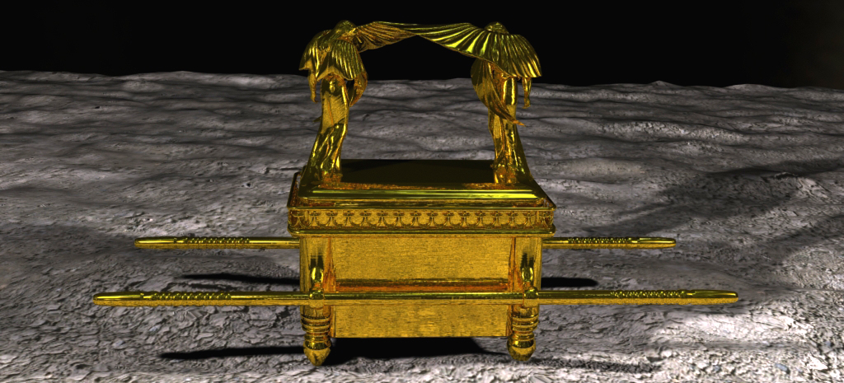
Box Beneath The Lid

Slide 149
Box Beneath The Lid
Porous wood covered in gold—sinful humans restored to unity with God

Slide 150
Box Beneath The Lid
Porous wood covered in gold—sinful humans restored to unity with God
It contained?

Slide 151
Box Beneath The Lid
Porous wood covered in gold—sinful humans restored to unity with God
It contained?
Manna—Jesus

Slide 152
Box Beneath The Lid
Porous wood covered in gold—sinful humans restored to unity with God
It contained?
Manna—Jesus
10 Commandments—God’s operating system

Slide 153
Box Beneath The Lid
Porous wood covered in gold—sinful humans restored to unity with God
It contained?
Manna—Jesus
10 Commandments—God’s operating system
Aaron’s rod—dead in sin brought to life fruits of righteousness

Slide 154
Box Beneath The Lid
Those in penal view claim the lid covers the broken law, but what law was kept in the ark? The one Moses broke or the unbroken one?

Slide 155
Box Beneath The Lid
Those in penal view claim the lid covers the broken law, but what law was kept in the ark? The one Moses broke or the unbroken one?
Jesus is the lid of solid gold—the connecting link unifying the universe

Slide 156
Box Beneath The Lid
“And he made known to us the mystery of his will according to his good pleasure, which he purposed in Christ, to be put into effect when the times will have reached their fulfillment--to bring all things in heaven and on earth together under one head, even Christ.” Eph 1:9,10

Slide 157
Decode the Meaning Sin Offering Non-Priest Jew

Slide 158
Decode the Meaning Sin Offering Non-Priest Jew
Sinner confess sin on head—sin happens in mind.

Slide 159
Decode the Meaning Sin Offering Non-Priest Jew
Sinner confess sin on head—sin happens in mind.
Sinner kills the animal—sin severs God’s design/law of love.

Slide 160
Decode the Meaning Sin Offering Non-Priest Jew
Sinner confess sin on head—sin happens in mind.
Sinner kills the animal—sin severs God’s design/law of love.
Animal represents sinless Jesus, who took our terminal condition upon Himself, in order to fix humanity and become our remedy.

Slide 161
Decode the Meaning Sin Offering Non-Priest Jew
Sinner confess sin on head—sin happens in mind.
Sinner kills the animal—sin severs God’s design/law of love.
Animal represents sinless Jesus, who took our terminal condition upon Himself, in order to fix humanity and become our remedy.
Blood represents the sinless perfect character of Jesus.

Slide 162
Decode the Meaning Sin Offering Non-Priest Jew
Sinner confess sin on head—sin happens in mind.
Sinner kills the animal—sin severs God’s design/law of love.
Animal represents sinless Jesus, who took our terminal condition upon Himself, in order to fix humanity and become our remedy.
Blood represents the sinless perfect character of Jesus.
Blood carried by ministering priest in vessels: both priest and vessels represent believers carrying the gospel message.

Slide 163
Decode the Meaning Sin Offering Non-Priest Jew
Blood first poured out at base of brazen altar represents a foundational change in heart of the sinner, the conversion from distrust and selfishness to love and trust.

Slide 164
Decode the Meaning Sin Offering Non-Priest Jew
Blood first poured out at base of brazen altar represents a foundational change in heart of the sinner, the conversion from distrust and selfishness to love and trust.
Blood then applied to the horns on the brazen altar represents the work of Christ in our hearts, removing defects of character.

Slide 165
Decode the Meaning Sin Offering Non-Priest Jew
Washing of the organs represents the cleansing of the inner man, removing guilt, shame, and selfishness.

Slide 166
Decode the Meaning Sin Offering Non-Priest Jew
Washing of the organs represents the cleansing of the inner man, removing guilt, shame, and selfishness.
Separating fat from organs and burning it represents Christ’s work of destroying the carnal nature and its desires circumcision of the heart.

Slide 167
Decode the Meaning Sin Offering Non-Priest Jew
Burning of the organs represents the work of the Holy Spirit within to burn out the old desires and recreate new motives within.

Slide 168
Decode the Meaning Sin Offering Non-Priest Jew
Burning of the organs represents the work of the Holy Spirit within to burn out the old desires and recreate new motives within.
Priests eating the meat of the sacrificed lamb represents the growth in spiritual strength as we partake of Christ in ministry to others.

Slide 169
Decode the Meaning Sin Offering for a Priest

Slide 170
Decode the Meaning Sin Offering for a Priest
Sinner confess sin on head—sin happens in mind.

Slide 171
Decode the Meaning Sin Offering for a Priest
Sinner confess sin on head—sin happens in mind.
Sinner kills the animal—sin severs God’s design/law of love.

Slide 172
Decode the Meaning Sin Offering for a Priest
Sinner confess sin on head—sin happens in mind.
Sinner kills the animal—sin severs God’s design/law of love.
Animal represents sinless Jesus, who took our terminal condition upon Himself, in order to fix humanity and become our remedy.

Slide 173
Decode the Meaning Sin Offering for a Priest
Sinner confess sin on head—sin happens in mind.
Sinner kills the animal—sin severs God’s design/law of love.
Animal represents sinless Jesus, who took our terminal condition upon Himself, in order to fix humanity and become our remedy.
Blood represents the sinless perfect character of Jesus.

Slide 174
Decode the Meaning Sin Offering for a Priest
Blood carried by ministering priest in vessels: both priest and vessels represent believers carrying the gospel message.

Slide 175
Decode the Meaning Sin Offering for a Priest
Blood carried by ministering priest in vessels: both priest and vessels represent believers carrying the gospel message.
Blood sprinkled before the veil represents the application of truth and Christlike love to remove any lies, correct any misrepresentation, and heal any wounds that obstructs our union with God when believers in Christ sin, thus healing the church.

Slide 176
Decode the Meaning Sin Offering for a Priest
Blood placed on the horns of the golden altar represents the removal of residual defects of character from the heart of the repentant believer.

Slide 177
Decode the Meaning Sin Offering for a Priest
Blood placed on horns of golden altar represents the removal of residual defects of character from the heart of the repentant believer.
Remaining blood poured out at base of brazen altar represents the power of God to reach unbelievers when Christians are gracious to each other and practice God’s methods.

Slide 178
Decode the Meaning Sin Offering for a Priest
Washing of the organs represents the cleansing of the inner man, removing guilt, shame, and selfishness.

Slide 179
Decode the Meaning Sin Offering for a Priest
Washing of the organs represents the cleansing of the inner man, removing guilt, shame, and selfishness.
Separating fat from organs and burning it represents Christ’s work of destroying the carnal nature and its desires, circumcision of the heart.

Slide 180
Decode the Meaning Sin Offering for a Priest
Washing of the organs represents the cleansing of the inner man, removing guilt, shame, and selfishness.
Separating fat from organs and burning it represents Christ’s work of destroying the carnal nature and its desires, circumcision of the heart.
Burning of the organs represents the work of the Holy Spirit within to burn out the old desires and recreate new motives within.

Slide 181
Unity Is the Goal

Slide 182
Unity Is the Goal
The entire drama is to teach God’s plan to eliminate sin and restore the universe to one-ness (at-one-ment) with Him again.

Slide 183
Unity Is the Goal
The entire drama is to teach God’s plan to eliminate sin and restore the universe to one-ness (at-one-ment) with Him again.
The sin offerings represent, in symbol, the plan to heal and restore individuals.

Slide 184
Unity Is the Goal
The entire drama is to teach God’s plan to eliminate sin and restore the universe to one-ness (at-one-ment) with Him again
The sin offerings represent, in symbol, the plan to heal and restore individuals.
The feast days represent the grand plan from Adam’s sin to a universe cleansed.

Slide 185
Summary
OT Sanctuary was theater.

Slide 186
Summary
OT Sanctuary was theater.
To reveal God’s plan to heal and restore.

Slide 187
Summary
OT Sanctuary was theater.
To reveal God’s plan to heal and restore.
Salvation is found in the reality—not the symbols—and that reality is Jesus!

Slide 188
Summary
OT Sanctuary was theater.
To reveal God’s plan to heal and restore.
Salvation is found in the reality—not the symbols—and that reality is Jesus!
Today, we are in the next to the final act of the play, the time when God is preparing a people to meet Him face to face!

Slide 189
Summary
OT Sanctuary was theater.
To reveal God’s plan to heal and restore.
Salvation is found in the reality—not the symbols—and that reality is Jesus!
Today, we are in the next to the final act of the play, the time when God is preparing a people to meet Him face to face!
The next act in the play—Jesus comes again!

Slide 191
Special Thanks to: Louis Johnson for all the illustrations and Dean Scott for the 3D animation of the 2nd coming, tabernacle 3D cutaway illustration, and presentation graphic design

