Slide 1
GOD AND YOUR BRAIN
SEMINAR
How Love overcomes fear and heals the brain
Answers to many of life’s questions
How lies damage the brain
How different views of God affect the brain

Slide 2
THE GOD-SHAPED BRAIN
How Changing Your View of God Transforms Your Life
Timothy R. Jennings, M.D. FAPA
President-Elect, Tennessee Psychiatric Association
Vice President, Southern Psychiatric Association
Author of:
Could It Be This Simple? A Biblical Model for Healing the Mind – 2007
The God Shaped Brain: How Changing Your View of God Transforms Your Life - 2013
comeandreason.com

Slide 3
GOD AND YOUR BRAIN
SEMINAR
How Love overcomes fear and heals the brain
Answers to many of life’s questions
How lies damage the brain
How different views of God affect the brain

Slide 4
SESSION 1
THE GOD-SHAPED BRAIN
How Changing Your View of God
Transforms Your Life

Slide 5
OBJECTIVES
Identify the relationship between belief and physical and mental health.

Slide 6
OBJECTIVES
Identify the relationship between belief and physical and mental health.
Examine the scientific evidence documenting how a change in belief can alter brain function resulting in a change in health.

Slide 7
OBJECTIVES
Identify the relationship between belief and physical and mental health.
Examine the scientific evidence documenting how a change in belief can alter brain function resulting in a change in health.
Formulate a methodology for separating healthy from unhealthy beliefs.

Slide 8
We Have Power Over
What We Believe BUT What We Believe Has
Power Over Us!

Slide 9
WHAT WE BELIEVE HAS POWER OVER US POWER TO HEAL AND POWER TO DESTROY

Slide 10
WHAT WE BELIEVE HAS POWER OVER US POWER TO HEAL AND POWER TO DESTROY
Vance Vanders

Slide 11
WHAT WE BELIEVE HAS POWER OVER US POWER TO HEAL AND POWER TO DESTROY
Vance Vanders
Sam Shoeman

Slide 12
WHAT WE BELIEVE HAS POWER OVER US POWER TO HEAL AND POWER TO DESTROY
Vance Vanders
Sam Shoeman
Derek Adams

Slide 13
WHAT WE BELIEVE HAS POWER OVER US POWER TO HEAL AND POWER TO DESTROY
Vance Vanders
Sam Shoeman
Derek Adams
Placebo / Nocebo

Slide 14
We Have Power Over
What We Believe BUT What We Believe Has
Power Over Us!

Slide 15
WHAT DO YOU BELIEVE?

Slide 16
WHAT DO YOU BELIEVE?
God is love?

Slide 17
WHAT DO YOU BELIEVE?
God is love?
God is loving, but he is also just?

Slide 18
WHAT DO YOU BELIEVE?
God is love?
God is loving, but he is also just?
God is punishing and severe?

Slide 19
WHAT DO YOU BELIEVE?
God is love?
God is loving, but he is also just?
God is punishing and severe?
God is distant and uninvolved?

Slide 20
WHAT DO YOU BELIEVE?
God is love?
God is loving, but he is also just?
God is punishing and severe?
God is distant and uninvolved?
What we believe has power over us!

Slide 21
WHAT DO YOU BELIEVE?
God is love?
God is loving, but he is also just?
God is punishing and severe?
God is distant and uninvolved?
What we believe has power over us!
What view of God do you hold AND

Slide 22
WHAT DO YOU BELIEVE?
God is love?
God is loving, but he is also just?
God is punishing and severe?
God is distant and uninvolved?
What we believe has power over us!
What view of God do you hold AND
Upon what do you base your beliefs?

Slide 23
WORLD CHRISTIAN ENCYCLOPEDIA OF 2001
19 major world religions.

Slide 24
WORLD CHRISTIAN ENCYCLOPEDIA OF 2001
19 major world religions.
Divided into 270 large religious groups.

Slide 25
WORLD CHRISTIAN ENCYCLOPEDIA OF 2001
19 major world religions.
Divided into 270 large religious groups.
Subdivided further into tens of thousands of smaller sects.

Slide 26
WORLD CHRISTIAN ENCYCLOPEDIA OF 2001
19 major world religions.
Divided into 270 large religious groups.
Subdivided further into tens of thousands of smaller sects.
And within Christianity?

Slide 27
WORLD CHRISTIAN ENCYCLOPEDIA OF 2001
19 major world religions.
Divided into 270 large religious groups.
Subdivided further into tens of thousands of smaller sects.
And within Christianity?
34,000 separate groups all claiming the Bible as their basis of faith.

Slide 28
2006 BAYLOR UNIVERSITY SURVEY
ON VIEWS OF GOD

Slide 29
2006 BAYLOR UNIVERSITY SURVEY
ON VIEWS OF GOD
32% of people in the U.S. Viewed God as authoritarian.

Slide 30
2006 BAYLOR UNIVERSITY SURVEY
ON VIEWS OF GOD
32% of people in the U.S. Viewed God as authoritarian.
24% as distant.

Slide 31
2006 BAYLOR UNIVERSITY SURVEY
ON VIEWS OF GOD
32% of people in the U.S. Viewed God as authoritarian.
24% as distant.
23% as benevolent or loving.

Slide 32
2006 BAYLOR UNIVERSITY SURVEY
ON VIEWS OF GOD
32% of people in the U.S. Viewed God as authoritarian.
24% as distant.
23% as benevolent or loving.
16% as critical.

Slide 33
2006 BAYLOR UNIVERSITY SURVEY
ON VIEWS OF GOD
32% of people in the U.S. Viewed God as authoritarian.
24% as distant.
23% as benevolent or loving.
16% as critical.
5% atheist.

Slide 34
2006 BAYLOR UNIVERSITY SURVEY
ON VIEWS OF GOD
32% of people in the U.S. Viewed God as authoritarian.
24% as distant.
23% as benevolent or loving.
16% as critical.
5% atheist.
But 75% of Americans are Christian.

Slide 35
With so many different views of God being taught, questions arise...
Does our understanding of God make a difference?

Slide 36
With so many different views of God being taught, questions arise...
Does our understanding of God make a difference?
Or is it enough to simply believe in God?

Slide 37
SPIRITUALITY IN MEDICINE CONFERENCE
Speakers: Jewish Rabbi, Catholic Priest, Protestant Pastor, Islamic Cleric, Christian Science Leader.
Advocating for inclusion of spirituality in medical treatment.
A woman came to the mic…

Slide 38
DO OUR BELIEFS MATTER?
Is it enough to merely believe, or…

Slide 39
DO OUR BELIEFS MATTER?
Is it enough to merely believe, or…
Could our beliefs in God, if those beliefs are distorted in some way, actually cause injury, pain and suffering?

Slide 40
WHAT DO YOU BELIEVE?
Laura
image courtesy of shutterstock.com

Slide 41
2 CORINTHIANS 10:3-5
For though we live in the world, we do not wage war as the world does. The weapons we fight with are not the weapons of the world. On the contrary, they have divine power to demolish strongholds. We demolish arguments and every pretension that sets itself up against the knowledge of God, and we take captive every thought to make it obedient to Christ.

Slide 42
ROMANS 1:18-31
Exchanged the truth of God for a lie.

Slide 43
ROMANS 1:18-31
Exchanged the truth of God for a lie.
Didn’t think it worthwhile to retain a knowledge of God.

Slide 44
ROMANS 1:18-31
Exchanged the truth of God for a lie.
Didn’t think it worthwhile to retain a knowledge of God.
Preferred images made with their own hands to the knowledge of God.

Slide 45
ROMANS 1:18-31
Exchanged the truth of God for a lie.
Didn’t think it worthwhile to retain a knowledge of God.
Preferred images made with their own hands to the knowledge of God.
Their minds became darkened, futile and depraved.

Slide 46
ROMANS 1:18-31
Exchanged the truth of God for a lie.
Didn’t think it worthwhile to retain a knowledge of God.
Preferred images made with their own hands to the knowledge of God.
Their minds became darkened, futile and depraved.
The Bible is taking the position that our view of God is critical to our mental health.

Slide 47
UPON WHAT DO WE BASE OUR BELIEFS ABOUT GOD?

Slide 48
UPON WHAT DO WE BASE OUR BELIEFS ABOUT GOD?
Ideas formed in childhood

Slide 49
UPON WHAT DO WE BASE OUR BELIEFS ABOUT GOD?
Ideas formed in childhood
Opinions
Parental, political, scholastic, church

Slide 50
UPON WHAT DO WE BASE OUR BELIEFS ABOUT GOD?
Ideas formed in childhood
Opinions
Parental, political, scholastic, church
Feelings

Slide 51
UPON WHAT DO WE BASE OUR BELIEFS ABOUT GOD?
Ideas formed in childhood
Opinions
Parental, political, scholastic, church
Feelings
Traditions
What about in medicine?

Slide 52
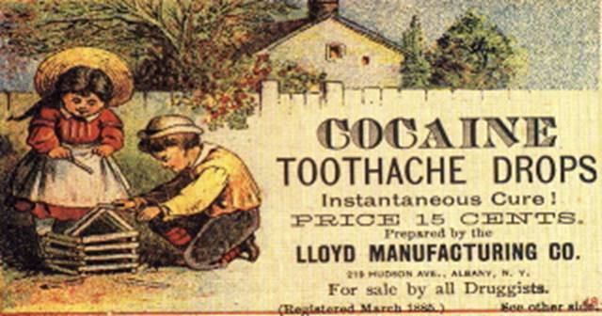
TRADITIONAL MEDICINE

Slide 53
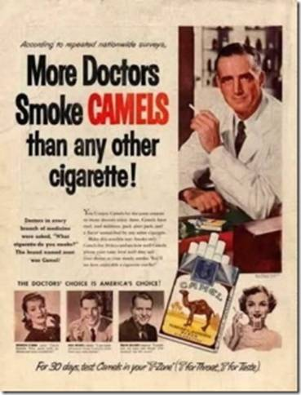
TRADITIONAL MEDICINE

Slide 54
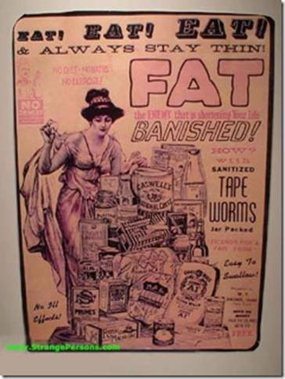
TRADITIONAL MEDICINE

Slide 55
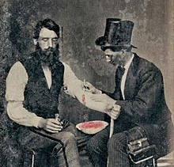
TRADITIONAL MEDICINE

Slide 56
UPON WHAT DO WE BASE OUR BELIEFS ABOUT GOD?
Ideas formed in childhood
Opinions
Parental, political, scholastic, church
Feelings
Traditions
What about in medicine?
Evidence

Slide 57
UPON WHAT DO WE BASE OUR BELIEFS ABOUT GOD?
Ideas formed in childhood
Opinions
Parental, political, scholastic, church
Feelings
Traditions
What about in medicine?
Evidence
Sound scientific beliefs are based upon evidence.

Slide 58
UPON WHAT DO WE BASE OUR BELIEFS ABOUT GOD?
Ideas formed in childhood
Opinions
Parental, political, scholastic, church
Feelings
Traditions
What about in medicine?
Evidence
Sound scientific beliefs are based upon evidence.
What about our beliefs about/in God – should they be based on evidence?

Slide 59
TWO THEORIES FOR CHRISTIAN BELIEF
We have “faith;” we don’t need evidence.

Slide 60
TWO THEORIES FOR CHRISTIAN BELIEF
We have “faith;” we don’t need evidence.
Our faith is based upon the evidence.

Slide 61
INTEGRATIVE EVIDENCE-BASED APPROACH
Scripture: All Scripture is God-breathed and is useful for teaching, rebuking, correcting and training in righteousness. (2 Timothy 3:16)

Slide 62
INTEGRATIVE EVIDENCE-BASED APPROACH
Scripture: All Scripture is God-breathed and is useful for teaching, rebuking, correcting and training in righteousness. (2 Timothy 3:16)
Science: For since the creation of the world God’s invisible qualities—his eternal power and divine nature—have been clearly seen, being understood from what has been made, so that men are without excuse. (Romans 1:20 - emphasis mine)

Slide 63
INTEGRATIVE EVIDENCE-BASED APPROACH
Scripture: All Scripture is God-breathed and is useful for teaching, rebuking, correcting and training in righteousness. (2 Timothy 3:16)
Science: For since the creation of the world God’s invisible qualities—his eternal power and divine nature—have been clearly seen, being understood from what has been made, so that men are without excuse. (Romans 1:20 - emphasis mine)
Experience: Taste and see that the Lord is good. (Ps 34:8); Then he said to Thomas, ‘Put your finger here; see my hands. Reach out your hand and put it into my side. Stop doubting and believe.’ (John 20:27)

Slide 64
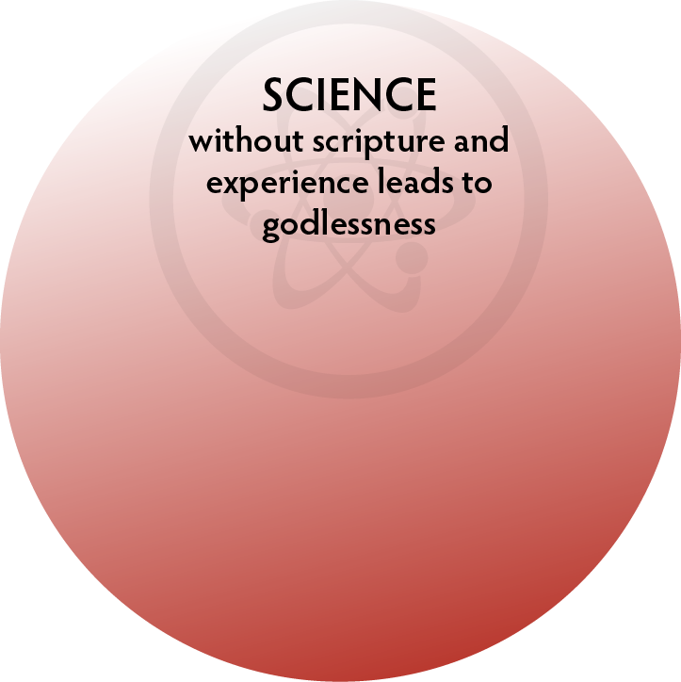
THE PROBLEM IF WE SEPARATE THE 3 THREADS

Slide 65
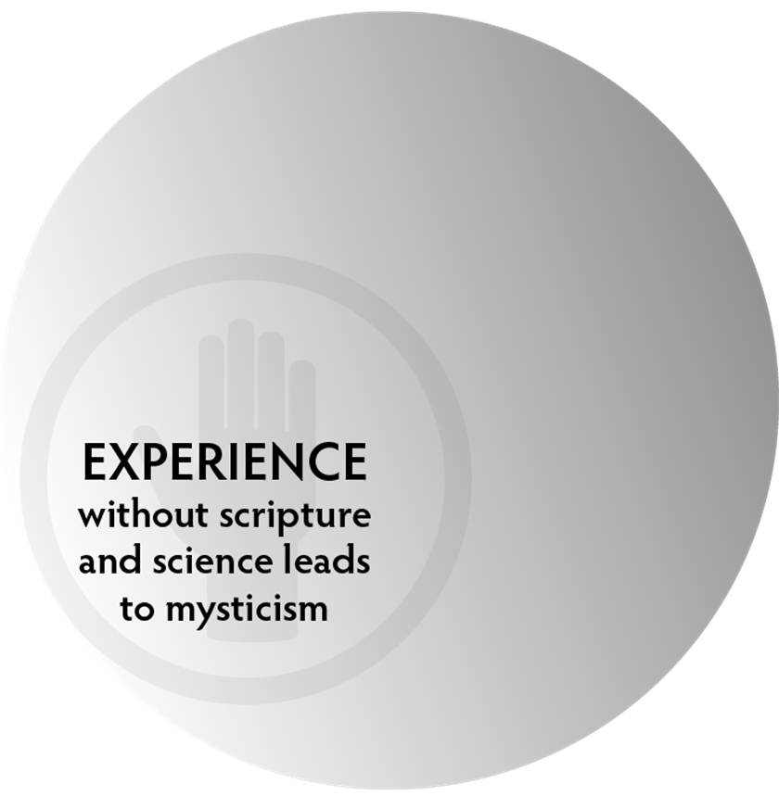
THE PROBLEM IF WE SEPARATE THE 3 THREADS

Slide 66
THE PROBLEM IF WE SEPARATE THE 3 THREADS

Slide 67
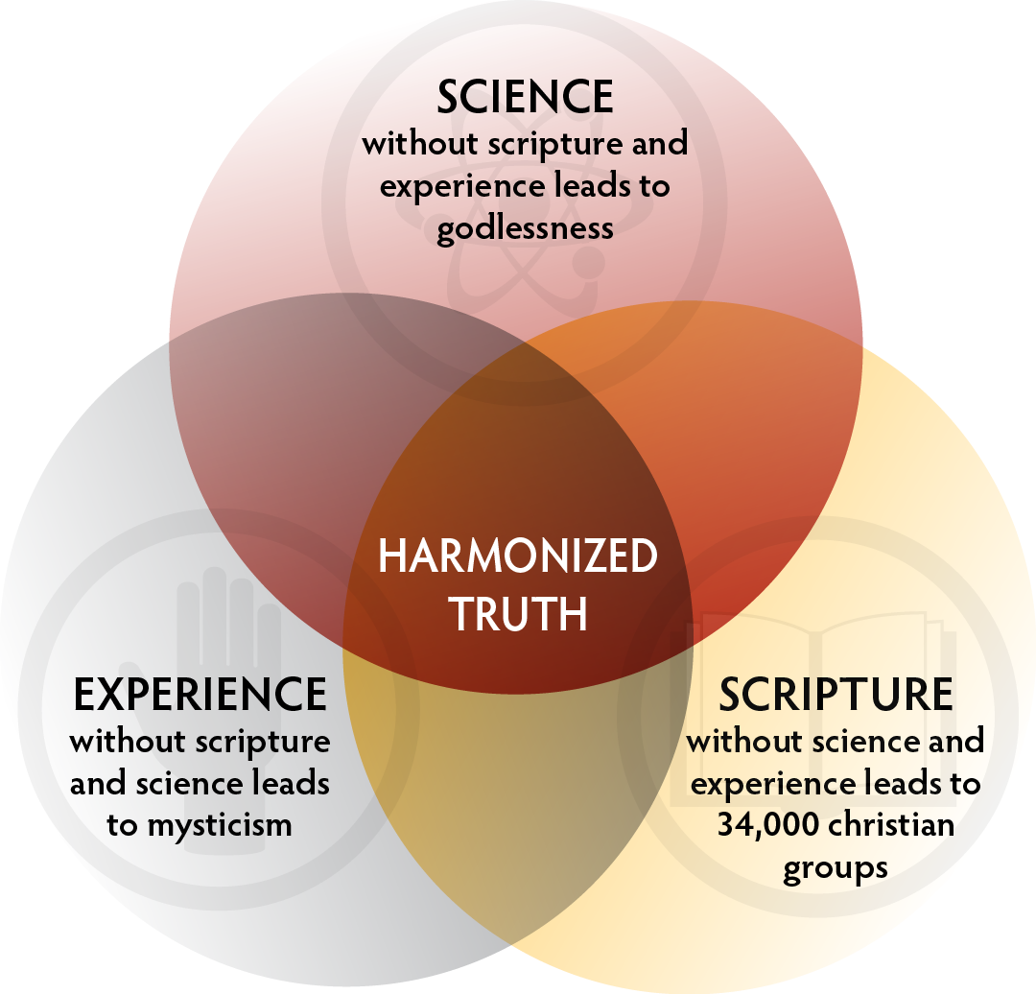
INTEGRATIVE EVIDENCE-BASED APPROACH

Slide 68
WHAT EVIDENCE HAS GOD GIVEN?

Slide 69
WHAT EVIDENCE HAS GOD GIVEN?
The history of His actions recorded in Scripture.

Slide 70
WHAT EVIDENCE HAS GOD GIVEN?
The history of His actions recorded in Scripture.
The evidence of His character as revealed in Christ.

Slide 71
WHAT EVIDENCE HAS GOD GIVEN?
The history of His actions recorded in Scripture.
The evidence of His character as revealed in Christ.
His testable laws (science and nature).

Slide 72
WHAT EVIDENCE HAS GOD GIVEN?
The history of His actions recorded in Scripture.
The evidence of His character as revealed in Christ.
His testable laws (science and nature).
The evidence in our lives of answered prayer, transformation of character and our experience with Him.

Slide 73
“The law of the Lord is perfect, reviving the soul.”
Psalms 19:7 ESV

Slide 74
WHAT IS THE LAW OF THE LORD?

Slide 75
WHAT IS THE LAW OF THE LORD?
Does it exist?

Slide 76
WHAT IS THE LAW OF THE LORD?
Does it exist?
Is it definable?

Slide 77
WHAT IS THE LAW OF THE LORD?
Does it exist?
Is it definable?
Is it imposed or natural?

Slide 78
WHAT IS THE LAW OF THE LORD?
Does it exist?
Is it definable?
Is it imposed or natural?
Is it testable?

Slide 79
WHAT IS THE LAW OF THE LORD?
Does it exist?
Is it definable?
Is it imposed or natural?
Is it testable?
Is it a “rule” enacted or a principle upon which life is built?

Slide 80
INTEGRATIVE EVIDENCE-BASED APPROACH
God’s Law
demonstrated in
Scripture

Slide 81
THE BIBLE DEFINES GOD’S LAW AS THE LAW OF LOVE
“So if you faithfully obey the commands I am giving you today — to love the Lord your God and to serve him with all your heart and with all your soul...” Deuteronomy 11:13

Slide 82
THE BIBLE DEFINES GOD’S LAW AS THE LAW OF LOVE
“So if you faithfully obey the commands I am giving you today — to love the Lord your God and to serve him with all your heart and with all your soul...” Deuteronomy 11:13
“Love does no harm to its neighbor. Therefore love is the fulfillment of the law.” Romans 13:10

Slide 83
THE BIBLE DEFINES GOD’S LAW AS THE LAW OF LOVE
“The entire law is summed up in a single command: ‘Love your neighbor as yourself.’” ﻿Galatians 5:14

Slide 84
THE BIBLE DEFINES GOD’S LAW AS THE LAW OF LOVE
“The entire law is summed up in a single command: ‘Love your neighbor as yourself.’” ﻿Galatians 5:14
“If you really keep the royal law found in Scripture, ‘Love your neighbor as yourself,’﻿﻿ you are doing right.” James 2:8

Slide 85
THE BIBLE DEFINES GOD’S LAW AS THE LAW OF LOVE
“Jesus replied: ‘Love the Lord your God with all your heart and with all your soul and with all your mind.’ This is the first and greatest commandment. And the second is like it: ‘Love your neighbor as yourself.’ All the Law and the Prophets hang on these two commandments.” Matthew 12:37-40

Slide 86
THE LAW OF LOVE

Slide 87
THE LAW OF LOVE
“Love is not self seeking” 1 Cor 13:4, 5

Slide 88
THE LAW OF LOVE
“Love is not self seeking” 1 Cor 13:4, 5
“God is love.” 1 John 4:8

Slide 89
THE LAW OF LOVE
“Love is not self seeking” 1 Cor 13:4, 5
“God is love.” 1 John 4:8
Eternal power and Divine Nature Romans 1:20

Slide 90
THE LAW OF LOVE
“Love is not self seeking” 1 Cor 13:4, 5
“God is love.” 1 John 4:8
Eternal power and Divine Nature Romans 1:20
“He who pursues righteousness and love finds life, prosperity and honor.” Proverbs 21:21

Slide 91
THE LAW OF LOVE
The Scripture is suggesting that God constructed nature to operate upon the law of giving, beneficence, and love
Let’s test it!

Slide 92
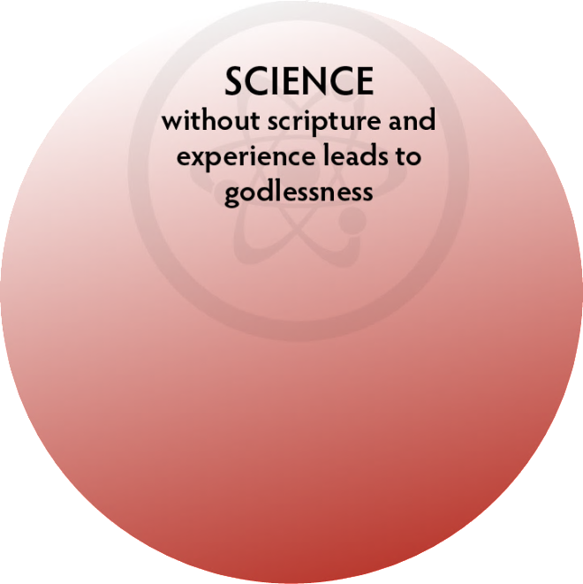
INTEGRATIVE EVIDENCE-BASED APPROACH
Law of love
demonstrated in
Nature

Slide 93
WATER
image courtesy of chrusion | FX

Slide 94
image courtesy of Dr. Tim Jennings

Slide 95
YAHOO NEWS SEPTEMBER 20, 2013
Over the past seven years, a stunning one-third of the U.S. honeybee population has disappeared without a trace…raising concerns about the impact on the American food supply.
U.S. Department of Agriculture bee researcher Jeff Pettis, who is leading the government’s search for answers, said...

Slide 96
YAHOO NEWS SEPTEMBER 20, 2013
“If you walk into your grocery store, you might see about only one-third of the produce left in the produce aisle,” Pettis said, explaining what a world without bees would look like. “Apples and nuts and many of the fruits and vegetables would simply not be available if we didn't have bees or something to pollinate.”

Slide 97
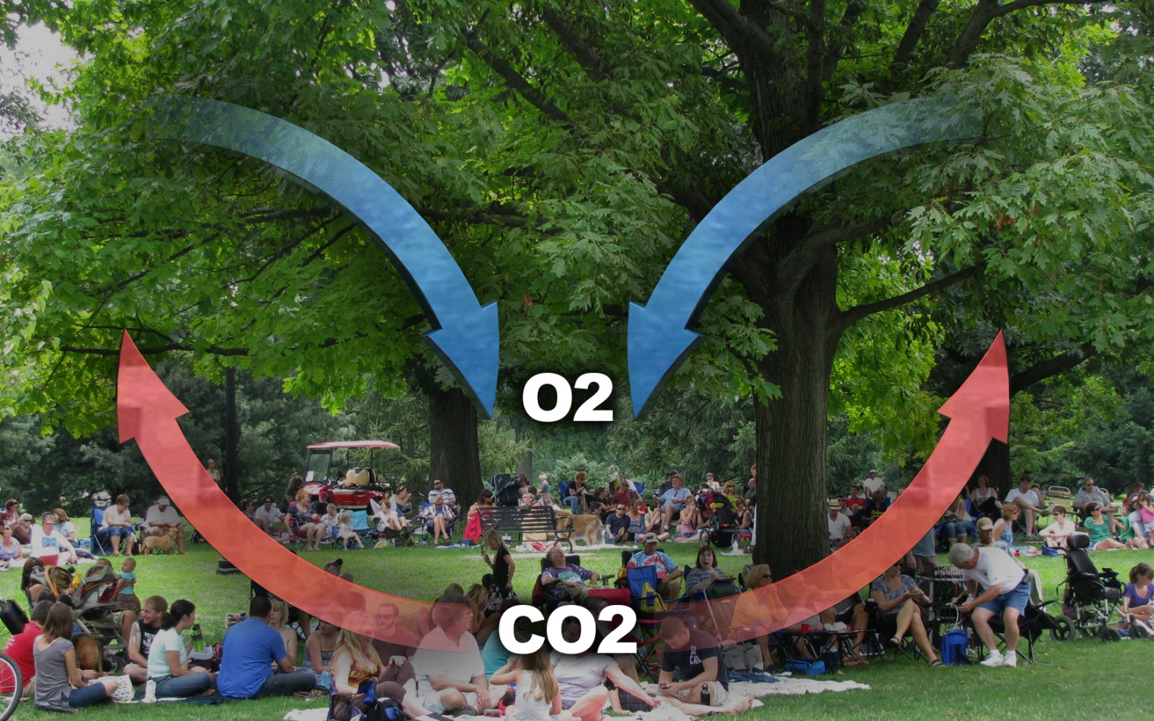
OXYGEN-CO2
image courtesy of chrusion | FX

Slide 98
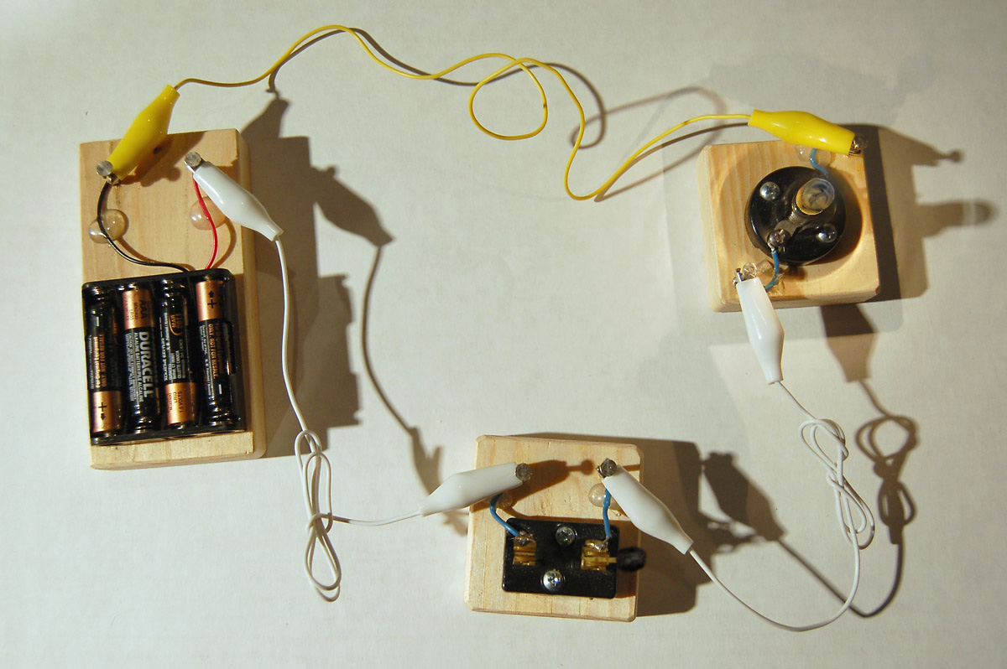
ELECTRICITY
image courtesy of exploratorium.edu

Slide 99
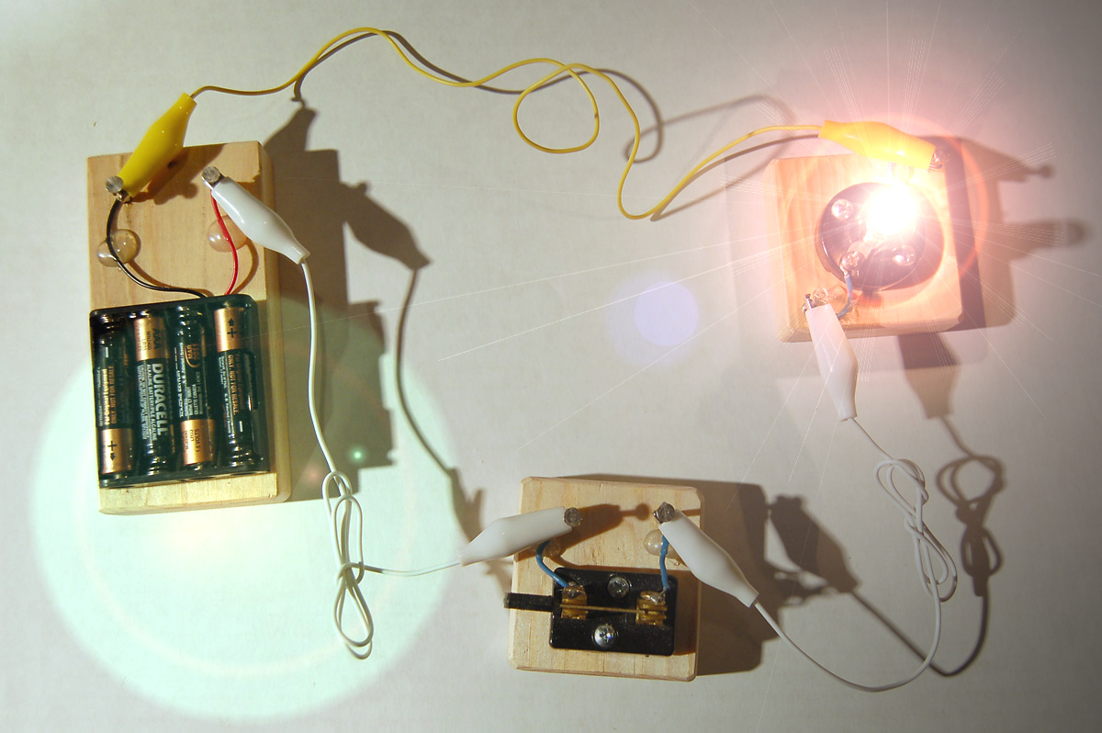
ELECTRICITY
image courtesy of exploratorium.edu

Slide 100
ECONOMY
image courtesy of shutterstock.com

Slide 101
LAW OF LOVE GOD’S DESIGN FOR LIFE
Electrons
Planets
Solar system
Galaxies
Ezekiel Chapter 10
Everything that lives - GIVES

Slide 102
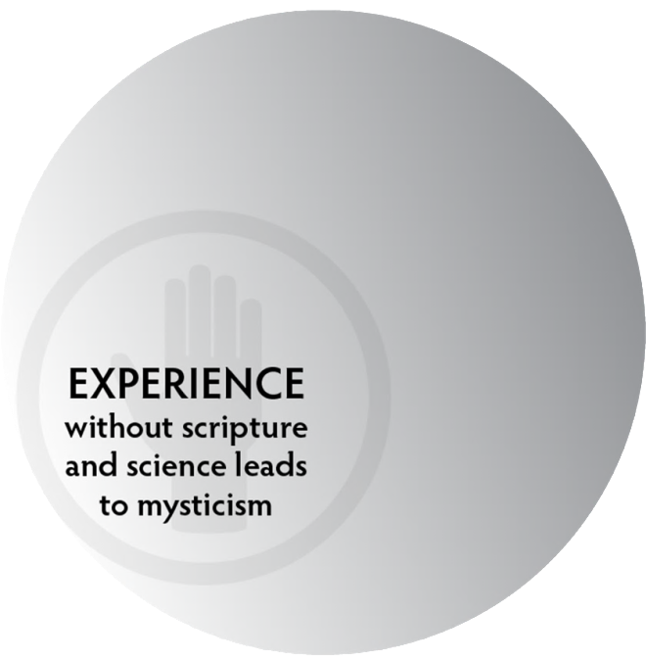
INTEGRATIVE EVIDENCE-BASED APPROACH
Law of love demonstrated in
Experience

Slide 103
LAW OF LOVE DEMONSTRATED IN EXPERIENCE

Slide 104
LAW OF LOVE DEMONSTRATED IN EXPERIENCE
Youth who volunteer experienced:
greater academic achievement, civic responsibility, and life skills that include leadership and interpersonal self-confidence. Post, S. Altruism and Health Perspectives from Empirical Research, Oxford University Press, New York, 2007: p. 20, 21).

Slide 105
LAW OF LOVE DEMONSTRATED IN EXPERIENCE
Youth who volunteer experienced:
greater academic achievement, civic responsibility, and life skills that include leadership and interpersonal self-confidence. Post, S. Altruism and Health Perspectives from Empirical Research, Oxford University Press, New York, 2007: p. 20, 21).
Adults who volunteer (after accounting for variables such as education, baseline health, smoking, etc.)
live longer, have less illness, less disability, less depression, less dementia and live independently longer than those who did not. Ibid. p. 22, 26

Slide 106
LAW OF LOVE DEMONSTRATED IN EXPERIENCE
Youth who volunteer experienced:
greater academic achievement, civic responsibility, and life skills that include leadership and interpersonal self-confidence. Post, S. Altruism and Health Perspectives from Empirical Research, Oxford University Press, New York, 2007: p. 20, 21).
Adults who volunteer (after accounting for variables such as education, baseline health, smoking, etc.)
live longer, have less illness, less disability, less depression, less dementia and live independently longer than those who did not. Ibid. p. 22, 26
The law of the Lord is perfect… Psalms 19:7

Slide 107
If God Built the Universe
to Operate upon the
Law of Love,
What Happened?

Slide 108
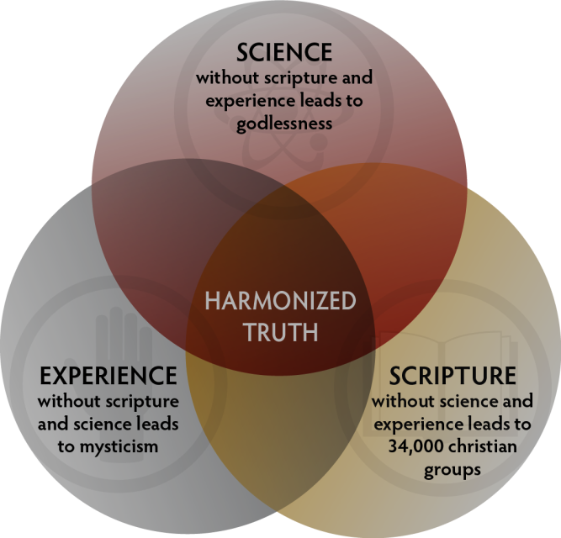
INTEGRATIVE EVIDENCE-BASED APPROACH
Scripture:
When he [satan] lies, he speaks his native language, for he is a liar and the father of lies. John 8:44

Slide 109
FALLING DOMINOES OF DESTRUCTION

Slide 110
FALLING DOMINOES OF DESTRUCTION
Lies believed = broken love and trust.

Slide 111
FALLING DOMINOES OF DESTRUCTION
Lies believed = broken love and trust.
Broken love and trust = fear & selfishness.
(survival of the fittest) .

Slide 112
FALLING DOMINOES OF DESTRUCTION
Lies believed = broken love and trust.
Broken love and trust = fear & selfishness.
(survival of the fittest) .
Fear & selfishness = destructive acts (sins).

Slide 113
FALLING DOMINOES OF DESTRUCTION
Lies believed = broken love and trust.
Broken love and trust = fear & selfishness.
(survival of the fittest) .
Fear & selfishness = destructive acts (sins).
Destructive acts (sins) damage the mind, character, and body = a terminal condition.

Slide 114
TWO ANTAGONISTIC PRINCIPLES
Altruistic Love
vs.
Survival-of-the-fittest

Slide 115
INTEGRATIVE EVIDENCE-BASED APPROACH
Scripture:
When he [satan] lies, he speaks his native language, for he is a liar and the father of lies. John 8:44
Science:
If God Built the Universe to Operate upon the Law of Love, What Happened in Nature and Science?

Slide 116
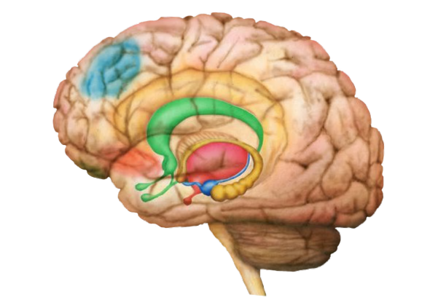
BRAIN CIRCUITS
Illustration by:
Simon Harrison

Slide 117
BRAIN CIRCUITS
Amygdala (alarm)
Illustration by:
Simon Harrison

Slide 118
BRAIN CIRCUITS
Hypothalmus
(911 Operator)
Amygdala (alarm)
Pituitary
Illustration by:
Simon Harrison

Slide 119
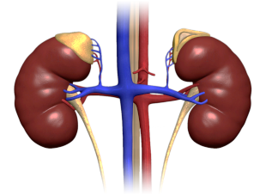
BRAIN CIRCUITS
Adrenal Glands
(first responders)
Hypothalmus
(911 Operator)
Amygdala (alarm)
Pituitary
Illustration by:
Simon Harrison

Slide 120
BRAIN CIRCUITS
Adrenal Glands
(first responders)
Hypothalmus
(911 Operator)
Amygdala (alarm)
Hippocampus
(fire chief)
Pituitary
Illustration by:
Simon Harrison

Slide 121
BRAIN CIRCUITS
Dorsal Lateral Pre-Frontal
Cortex
(administrator)
Adrenal Glands
(first responders)
Hypothalmus
(911 Operator)
Amygdala (alarm)
Hippocampus
(fire chief)
Pituitary
Illustration by:
Simon Harrison

Slide 122
SALIENCE NETWORK
Temporal-
pariatal
Junction
Dorsal Lateral Pre-Frontal
Cortex (PFC)
Anterior Cingulate Cortex
Thalamus
Orbital PFC
Ventral
Median PFC
Amygdala
Illustration by:
Simon Harrison
Nucleus Accumbens

Slide 123
WHAT DISRUPTS SALIENCE NETWORK?

Slide 124
WHAT DISRUPTS SALIENCE NETWORK?
Denial, refusing truth, lies believed.

Slide 125
WHAT DISRUPTS SALIENCE NETWORK?
Denial, refusing truth, lies believed.
Violating God’s law of love – guilt and refusing to repent.

Slide 126
WHAT DISRUPTS SALIENCE NETWORK?
Denial, refusing truth, lies believed.
Violating God’s law of love – guilt and refusing to repent.
Grudge holding and resentment.

Slide 127
WHAT IF ALARM DOESN’T STOP?
Dorsal Lateral Pre-Frontal
Cortex
(administrator)
Adrenal Glands
(first responders)
Hypothalmus
(911 Operator)
Amygdala (alarm)
Hippocampus
(fire chief)
Pituitary
Illustration by:
Simon Harrison

Slide 128
OVER ACTIVE AMYGDALA
Activates sympathetic nervous system

Slide 129
OVER ACTIVE AMYGDALA
Activates sympathetic nervous system
Which activates macrophages –
Why?

Slide 130
OVER ACTIVE AMYGDALA
Activates sympathetic nervous system
Which activates macrophages –
Why?
Which release cytokines – IL1, IL6, TNF

Slide 131
OVER ACTIVE AMYGDALA
Activates sympathetic nervous system
Which activates macrophages –
Why?
Which release cytokines – IL1, IL6, TNF
Which damage:
Insulin receptors, glucocorticoid receptors, interfere with NE, 5HT, DA signaling.

Slide 132
OVER ACTIVE AMYGDALA
Activates sympathetic nervous system
Which activates macrophages –
Why?
Which release cytokines – IL1, IL6, TNF
Which damage:
Insulin receptors, glucocorticoid receptors, interfere with NE, 5HT, DA signaling.
Resulting in:
Increased DM, obesity, high cholesterol, MI, Stroke, autoimmune problems and bone density loss.

Slide 133
INTEGRATIVE EVIDENCE-BASED APPROACH
Scripture:
When he [satan] lies, he speaks his native language, for he is a liar and the father of lies. John 8:44
Science:
Love circuits calm fear circuits, and lies disrupt this circuitry increasing fear, increased inflammation…

Slide 134
INTEGRATIVE EVIDENCE-BASED APPROACH
Scripture:
When he [satan] lies, he speaks his native language, for he is a liar and the father of lies. John 8:44
Science:
Love circuits calm fear circuits, and lies disrupt this circuitry increasing fear, increased inflammation…
Experience:
If God Built the Universe to Operate upon the Law of Love, What Happened to our Experience?

Slide 135
EXPERIENCE CONFIRMS THAT
FEAR IS THE BASIS OF DEATH

Slide 136
EXPERIENCE CONFIRMS THAT
FEAR IS THE BASIS OF DEATH
Physical Growth
Iraqi children ¹
1. http://www.sciencedaily.com/releases/2010/03/100329082121.htm

Slide 137
EXPERIENCE CONFIRMS THAT
FEAR IS THE BASIS OF DEATH
Physical Growth
Iraqi children ¹
Intellectual Growth
Test anxiety
1. http://www.sciencedaily.com/releases/2010/03/100329082121.htm

Slide 138
EXPERIENCE CONFIRMS THAT
FEAR IS THE BASIS OF DEATH
Physical Growth
Iraqi children ¹
Intellectual Growth
Test anxiety
Relational Growth
Fear of rejection, abandonment
1. http://www.sciencedaily.com/releases/2010/03/100329082121.htm

Slide 139
EXPERIENCE CONFIRMS THAT
FEAR IS THE BASIS OF DEATH
Physical Growth
Iraqi children ¹
Intellectual Growth
Test anxiety
Relational Growth
Fear of rejection, abandonment
Spiritual Growth
Fear of God
1. http://www.sciencedaily.com/releases/2010/03/100329082121.htm

Slide 140
What is the Solution?

Slide 141
INTEGRATIVE EVIDENCE-BASED APPROACH
Scripture:
“Perfect Love Casts Out All Fear” 1 John 4:18
“The Law of the Lord is perfect reviving the soul” Psalms 19:7
“The Truth will set you free.” John 8:32

Slide 142
INTEGRATIVE EVIDENCE-BASED APPROACH
Scripture:
“Perfect Love Casts Out All Fear” 1 John 4:18
“The Law of the Lord is perfect reviving the soul” Psalms 19:7
“The Truth will set you free.” John 8:32
Science:

Slide 143
GOD CONSTRUCT CHANGES BRAIN
Dorsal Lateral Pre-Frontal
Cortex (PFC)
Anterior Cingulate Cortex
Orbital PFC
Ventral
Median PFC
Amygdala
Illustration by:
Simon Harrison
Newberg, A., How God Changes Your Brain, Random House, 2009 p. 34.

Slide 144
INTEGRATIVE EVIDENCE-BASED APPROACH
Scripture:
“Perfect Love Casts Out All Fear” 1 John 4:18
“The Law of the Lord is perfect reviving the soul” Psalms 19:7
“The Truth will set you free.” John 8:32
Science:
Meditating on a God of love calms the fear circuits of the brain and grows the love circuits

Slide 145
IMPACT OF COGNITIVE THERAPY ON AMYGDALA AND PREFRONTAL (DORSOLATERAL PFC) ACTIVITY IN MDD
Emotional
Is it you? UGLY
b. Cognitive
Put the digits in numerical order
7 4 3 1 5
0.15
Patients with depression (n=9)
Controls (n=24)
0.30
Pre
0.25
Post
0.10
0.20
Control
BOLD Signal (% Change)
0.15
0.05
BOLD Signal (% Change)
0.10
0.00
0.05
-0.05
0.00
2
4
6
8
10
12
2
4
6
8
10
12
14
16
18
Time (Seconds)
Time (Seconds)
12 Weeks of Cognitive Therapy
Adapted from DeRubeis RJ, et al. Nat Rev Neurosci. 2008;9(10):788-796.

Slide 146
INTEGRATIVE EVIDENCE-BASED APPROACH
Scripture:
“Perfect Love Casts Out All Fear” 1 John 4:18
“The Law of the Lord is perfect reviving the soul” Psalms 19:7
“The Truth will set you free.” John 8:32
Science:
Meditating on a God of love calms the fear circuits of the brain and grows the love circuits
Truth reconnects salience network and calms fear circuits

Slide 147
INTEGRATIVE EVIDENCE-BASED APPROACH
Scripture:
“Perfect Love Casts Out All Fear” 1 John 4:18
“The Law of the Lord is perfect reviving the soul” Psalms 19:7
“The Truth will set you free.” John 8:32
Science:
Meditating on a God of love calms the fear circuits of the brain and grows the love circuits
Truth reconnects salience network and calms fear circuits
Experience:

Slide 148
PERFECT LOVE CASTS OUT ALL FEAR
(1 JOHN 4:18)

Slide 149
PERFECT LOVE CASTS OUT ALL FEAR
(1 JOHN 4:18)
Imagine crossing the street

Slide 150
PERFECT LOVE CASTS OUT ALL FEAR
(1 JOHN 4:18)
Imagine crossing the street
Lady with panic

Slide 151
TRUTH SETS FREE
(John 8:32)

Slide 152
TRUTH SETS FREE
(John 8:32)
If You believe the lie your spouse is having an affair what happens when you discover the truth?

Slide 153
INTEGRATIVE EVIDENCE-BASED APPROACH
Scripture:
“Perfect Love Casts Out All Fear” 1 John 4:18
“The Law of the Lord is perfect reviving the soul” Psalms 19:7
“The Truth will set you free.” John 8:32
Science:
Meditating on a God of love calms the fear circuits of the brain and grows the love circuits
Truth reconnects salience network and calms fear circuits
Experience:
Truth Heals

Slide 154
INTEGRATIVE EVIDENCE-BASED APPROACH
Scripture:
“Perfect Love Casts Out All Fear” 1 John 4:18
“The Law of the Lord is perfect reviving the soul” Psalms 19:7
“The Truth will set you free.” John 8:32
Science:
Meditating on a God of love calms the fear circuits of the brain and grows the love circuits
Truth reconnects salience network and calms fear circuits
Experience:
Truth Heals
Truth & Love for others overcomes fear

Slide 155
IF THE SOLUTION IS PERFECT LOVE & TRUTH – WHERE DO WE FIND IT?

Slide 156
IF THE SOLUTION IS PERFECT LOVE & TRUTH – WHERE DO WE FIND IT?
“God is love.” (1 John 4:8)

Slide 157
IF THE SOLUTION IS PERFECT LOVE & TRUTH – WHERE DO WE FIND IT?
“God is love.” (1 John 4:8)
“This is eternal life: that they may know you, the only true God, and Jesus Christ, whom you have sent.” (John 17:3)

Slide 158
IF THE SOLUTION IS PERFECT LOVE & TRUTH – WHERE DO WE FIND IT?
“God is love.” (1 John 4:8)
“This is eternal life: that they may know you, the only true God, and Jesus Christ, whom you have sent.” (John 17:3)
Then why do so many people not find love?

Slide 159
LIES BELIEVED
BREAK THE CIRCLE OF LOVE AND TRUST
“For though we live in the world, we do not wage war as the world does. The weapons we fight with are not the weapons of the world. On the contrary, they have divine power to demolish strongholds. We demolish arguments and every pretension that sets itself up against the knowledge of God, and we take captive every thought to make it obedient to Christ.” 2 Corinthians 10:3-5
What is needed to restore love?

Slide 160
YOU WILL KNOW THE TRUTH
AND THE TRUTH WILL SET YOU FREE
(John 8:32)

Slide 161
YOU WILL KNOW THE TRUTH
AND THE TRUTH WILL SET YOU FREE
(John 8:32)
Truth about what?

Slide 162
YOU WILL KNOW THE TRUTH
AND THE TRUTH WILL SET YOU FREE
(John 8:32)
Truth about what?
God!

Slide 163
YOU WILL KNOW THE TRUTH
AND THE TRUTH WILL SET YOU FREE
(John 8:32)
Truth about what?
God!
Where do we find the clearest truth about God?

Slide 164
INTEGRATIVE EVIDENCE-BASED APPROACH
Scripture
Jesus answered, “I am the way and the truth and the life. No one comes to the Father except through me.” (John 14:6)
“Anyone who has seen me has seen the Father.” (John 14:9)
What did Jesus spend His time doing?

Slide 165
INTEGRATIVE EVIDENCE-BASED APPROACH
Scripture
Jesus answered, “I am the way and the truth and the life. No one comes to the Father except through me.” (John 14:6)
“Anyone who has seen me has seen the Father.” (John 14:9)
What did Jesus spend His time doing?
Science/Nature
Circle of giving revealed in nature.

Slide 166
INTEGRATIVE EVIDENCE-BASED APPROACH
Scripture
Jesus answered, “I am the way and the truth and the life. No one comes to the Father except through me.” (John 14:6)
“Anyone who has seen me has seen the Father.” (John 14:9)
What did Jesus spend His time doing?
Science/Nature
Circle of giving revealed in nature.
Experience
What happens in you when you love? What happens in you when you are loved? What happens when you are coerced or threatened?

Slide 167
HEALING PROGRESSION

Slide 168
HEALING PROGRESSION
Truth believed destroys lies and restores to trust.

Slide 169
HEALING PROGRESSION
Truth believed destroys lies and restores to trust.
Restored trust results in open heart and experience God’s love poured in and fear cast out.

Slide 170
HEALING PROGRESSION
Truth believed destroys lies and restores to trust.
Restored trust results in open heart and experience God’s love poured in and fear cast out.
Trust and love result in acts of righteousness, acts of service, selflessness, giving.

Slide 171
HEALING PROGRESSION
Truth believed destroys lies and restores to trust.
Restored trust results in open heart and experience God’s love poured in and fear cast out.
Trust and love result in acts of righteousness, acts of service, selflessness, giving.
Acts of righteousness result in growing in godliness and witnessing God’s kingdom of love.

Slide 172
WHEN WE ACCEPT THE TRUTH ABOUT GOD

Slide 173
WHEN WE ACCEPT THE TRUTH ABOUT GOD
Trust is restored and God pours His love into our hearts. (Romans 5:5)

Slide 174
WHEN WE ACCEPT THE TRUTH ABOUT GOD
Trust is restored and God pours His love into our hearts. (Romans 5:5)
Fear and selfishness are replaced with God’s law of love.

Slide 175
WHEN WE ACCEPT THE TRUTH ABOUT GOD
Trust is restored and God pours His love into our hearts. (Romans 5:5)
Fear and selfishness are replaced with God’s law of love.
He writes his law upon our hearts. (Hebrews 8:10)

Slide 176
WHEN WE ACCEPT THE TRUTH ABOUT GOD
Trust is restored and God pours His love into our hearts. (Romans 5:5)
Fear and selfishness are replaced with God’s law of love.
He writes his law upon our hearts. (Hebrews 8:10)
We no longer live for self, but live to love God and others.

Slide 177
WHEN WE ACCEPT THE TRUTH ABOUT GOD
Trust is restored and God pours His love into our hearts. (Romans 5:5)
Fear and selfishness are replaced with God’s law of love.
He writes his law upon our hearts. (Hebrews 8:10)
We no longer live for self, but live to love God and others.
Those ready for translation. (Revelations 12:11)
they did not love their lives so much as to shrink from death.

Slide 178
FORMING HEALTHY BELIEFS

Slide 179
FORMING HEALTHY BELIEFS
Think for yourself (don’t follow the crowd).

Slide 180
FORMING HEALTHY BELIEFS
Think for yourself (don’t follow the crowd).
Use the Integrative Evidence-Based method.

Slide 181
FORMING HEALTHY BELIEFS
Think for yourself (don’t follow the crowd).
Use the Integrative Evidence-Based method.
Be reasonable.

Slide 182
FORMING HEALTHY BELIEFS
Think for yourself (don’t follow the crowd).
Use the Integrative Evidence-Based method.
Be reasonable.
Identify testable laws.

Slide 183
FORMING HEALTHY BELIEFS
Think for yourself (don’t follow the crowd).
Use the Integrative Evidence-Based method.
Be reasonable.
Identify testable laws.
Believe, trust, or have faith when evidence supports it is reasonable.

Slide 184
FORMING HEALTHY BELIEFS
Think for yourself (don’t follow the crowd).
Use the Integrative Evidence-Based method.
Be reasonable.
Identify testable laws.
Believe, trust, or have faith when evidence supports it is reasonable.
Don’t allow feelings to form beliefs.

Slide 185
FORMING HEALTHY BELIEFS
Think for yourself (don’t follow the crowd).
Use the Integrative Evidence-Based method.
Be reasonable.
Identify testable laws.
Believe, trust, or have faith when evidence supports it is reasonable.
Don’t allow feelings to form beliefs.
Require all God concepts to harmonize with the life of Jesus and God’s law of love.

Slide 186
We Have Power Over
What We Believe BUT What We Believe Has
Power Over Us!

Slide 187
What Do You Believe?

